Slide 1
On the Journey: Assessing, Training, and Promoting Diversity in DPL’s Collections
Becker Parkhurst-Strout and Erin Sladen Denver Public Library

Slide 2
Becker:
Library Journal: Diversity and Cultural Competency training
Extensive reading
Presenting these topics (for staff, DU MLS classes) makes me learn more
Erin:
Library Journal: Evaluating, Auditing, and Diversifying Your Collection
Core Collection
DPL classes:
Diversity and Inclusion in DPL Collections
Cultural Connections: Working with Diverse Customers
From A to T: Welcoming Transgender Customers
Communicating Across Cultures: Speaking and Listening Across Borders
Learn, Evaluate, Train, Learn Some More
Notes:
both

Slide 3
Adult Fiction Diversity Audit - In Progress!
Goal: To assess the diversity of our circulating adult fiction collection.
Sample: A combination of randomly selected titles and regularly promoted titles. We aimed for 10% of our 42,000+ title collection.
Notes:
Becker Sample taken from: Core Collection, booklists, staff picks, power zone display picks, book club picks, Featured Titles, top circulating, approximately ⅓ randomly selected books

Slide 4
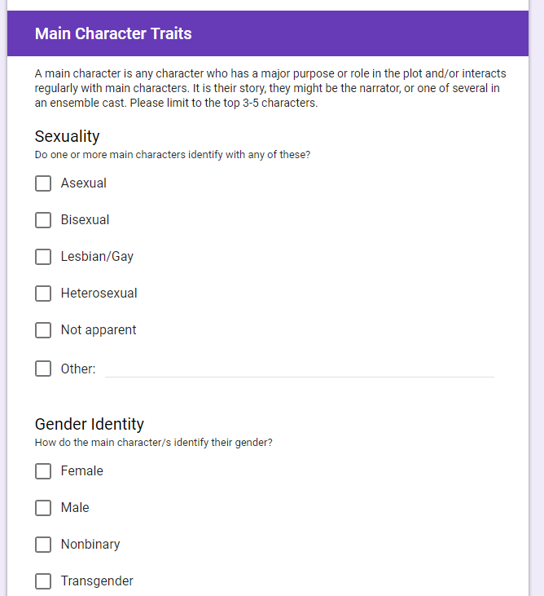
Adult Fiction Diversity Audit - Method
List: Compile all the books to be audited.
Form: Create a Google Form to be filled out for each book.
Recruit: Get help! Ask coworkers to help you audit the books.
Process: Get to work!
Notes:
Erin 1. List includes the following for each book: bib record number, call number, author, and title
2. For each book, the form asks about: own voices, main character traits (sexuality, gender identity, disabilities, mental health, neurodiversity, and ethnicity), and if the book was translated.
3. We opened the auditing up to all of our staff! Anyone interested is welcome to begin auditing.
4. Get to work! We are hoping to have all the books audited by the end of 2019.

Slide 5
Adult Fiction Diversity Audit - Next Steps
5. What to do with all the data?
Establish a clear picture of what diversity looks like within our collection--share it.
Pinpoint any gaps in our collection.
Buy smarter in the future--and advocate for more diversity within publishing!
Redo project in future (5-10 years) to see how we’re doing
Notes:
Becker

Slide 6
Core Collections
Notes:
Both?

Slide 7
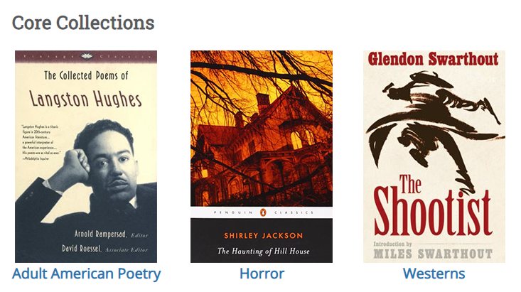
Core Collections: The Collections So Far
Adult Lists:
Horror
Westerns
American Poetry
Short Stories
True Crime
Alternate Classics
Standalone Mysteries
Children Lists:
Beginning Readers
World Poetry
Juvenile Fiction
Notes:
Becker

Slide 8
Diversity in Core Collections
Diversity within a collection is assessed in multiple ways when creating lists:
Being conscious of including diverse voices
Performing small scale diversity audits
Expanding the idea of a genre (ie, Westerns)
Including works that have been overlooked
Notes:
Erin

Slide 9
Developing a Diversity Training for Staff: “Diversity & Inclusion in DPL Collections”
Wanted a DPL specific D & I in collections class
Used LJ class info and supplemented with:
Diversity audit done on Beginning Readers Collection
Denver specific demographics
Very focused on collection & advisory work, since DPL has EDI committee working on staff and customer interactions
Notes:
Becker: Talk about process/steps
Erin: What did gained from taking class?

Slide 10
Emphasis includes:
Statistics on diversity in children’s book publishing
Difference between buying for children vs adults
Tips on finding diverse titles for advisory interactions & including them in all work
Notes:
Becker: Talk about process/steps
Erin: What did gained from taking class?

Slide 11
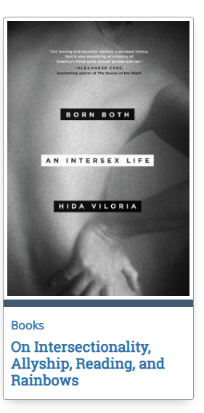
Promoting Diversity
Staff Reading Challenges: Read the World, #OwnVoices
Being mindful of diversity in purchasing decisions, including OwnVoices, Featured titles
Encouraging staff to incorporate diverse titles in staff picks, personalized reading lists, bookmarks, public blog posts, etc--not just for “cultural month”
Expectation of incorporating diversity into all collection work
Notes:
Both

Slide 12
Thank you.
bstrout@denverlibrary.org
esladen@denverlibrary.org

