Slide 1
Presented by Philip Gaddis ILL & Acquisitions Manager, Auraria Library

Slide 2
What is SILLVR? Streaming Interlibrary Loan Video Resources
SILLVR allows discovery and sharing of streaming video resources among libraries
Built upon partnerships with Colorado Alliance/Prospector, libraries, and vendors.
Two key ideas behind SILLVR
Change in formats, from DVD to Streaming, should not mean loss of library services such as ILL
Libraries make use of ILL data to inform their purchasing decisions – ILL can lead to increased sales for vendors!

Slide 4
Year 2 SILLVR Partnerships
Prospector - Union Catalog with member libraries throughout Colorado and the University of Wyoming
Allows discovery & requesting of SILLVR-eligible videos
Popular feature films ~ 1,000 titles
Lending restricted to Academic Libraries
Approximately 5,000 educational videos
Lending allowed to all Prospector libraries

Slide 5
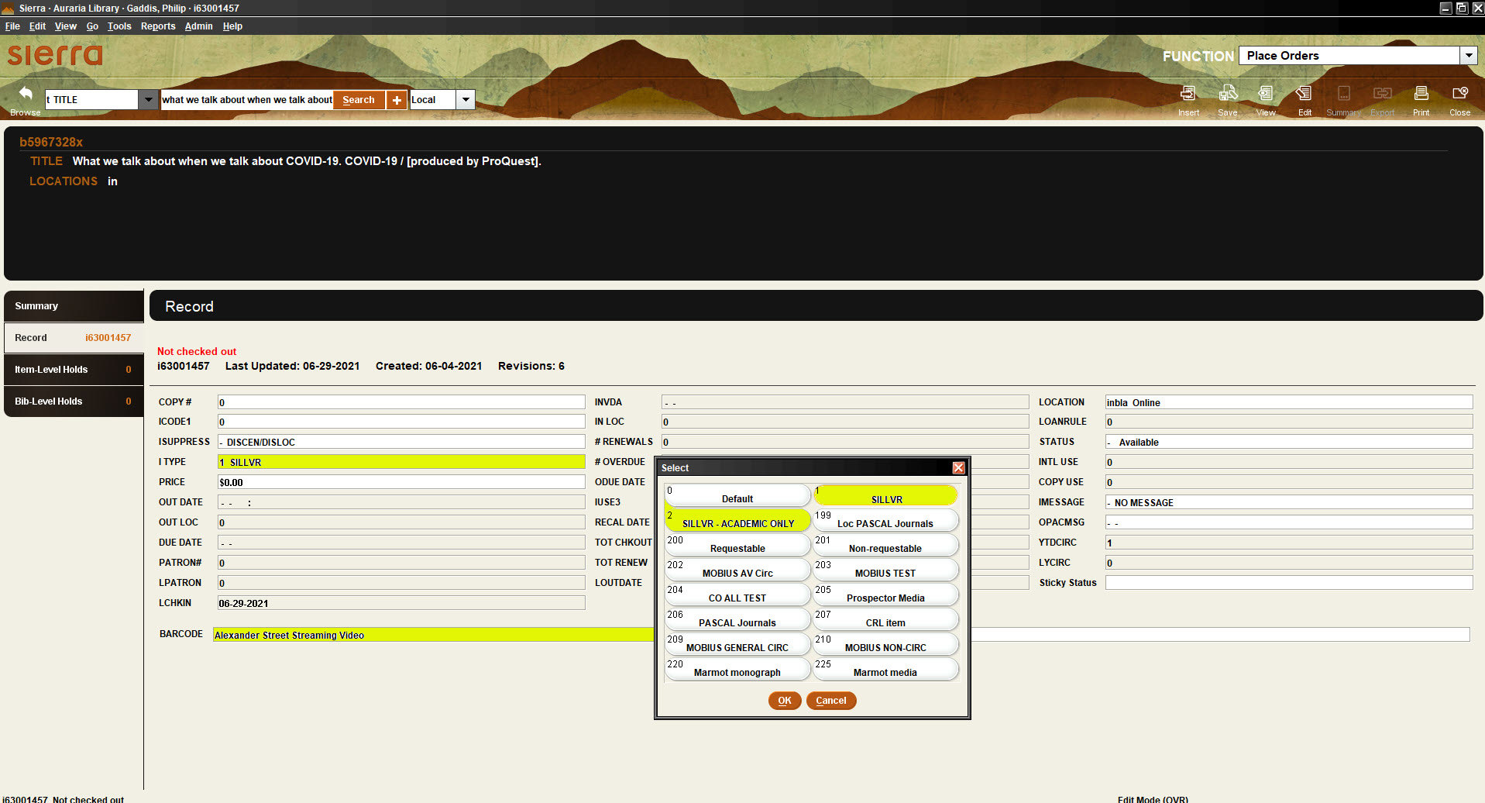
Preparing for SILLVR
Lending libraries upload their holdings to Prospector
SILLVR required some changes to libraries’ streaming video records to make them eligible for requesting

Slide 6
Changes to MARC record
For Swank titles, add line to 856 field:

Slide 7
SILLVR Workflow
Patron locates video in Prospector
Places a request on the item
Lending library receives request via Prospector paging slip
Borrowing library sends to patron an email with embedded link to video
Patron has 21 days to review video. After 21 days it automatically expires.
Lending library generates URL request, emails URL to borrowing library

Slide 8
Demonstration
Searching Prospector
Requesting a video
Email to vendor (lending library)
Email from vendor to lending library (with URL)
Email to borrowing library system (lending library)
Email to Patron (borrowing library)
Accessing the borrowed video

Slide 9
Conclusion
Many thanks to our fantastic partners Swank Motion Pictures and Alexander Street for making the SILLVR pilot year 2 possible!
Please check out our SILLVR article in Collaborative Librarianship! https://digitalcommons.du.edu/collaborativelibrarianship/vol11/iss4/8/
Email us: ProjectSILLVR@gmail.com
Philip.Gaddis@ucdenver.edu
Questions?

