Slide 1
SILLVR: Streaming Interlibrary Loan Video Resources
Alliance Cat-Ref Meeting / November 6, 2019
KATY DIVITTORIO | COLLECTIONS STRATEGIES, DEPARTMENT HEAD| KATY.DIVITTORIO@UCDENVER.EDU
PHILIP GADDIS | INTERLIBRARY LOAN & ACQUISITIONS MANAGER | PHILIP.GADDIS@UCDENVER.EDU

Slide 2
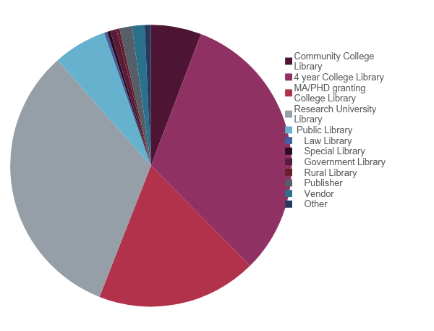
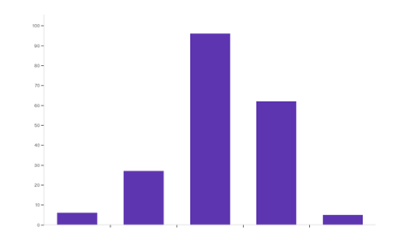
Which category best describes your institution? (check all that apply)
If your users could borrow streaming videos from other libraries via ILL how often do you think they would use this service?
4 year college library
32%
Research university library
33%
MA/PhD granting college library
18%
Never Rarely Occasionally Very frequently Always

Slide 3
WHY DOES ILL FOR STREAMING VIDEO MATTER?
New collection types should not mean loss of services
DVDs/VHS may become obsolete
28% of faculty are assigning videos for coursework
92% of students are using streaming video for classes
Aligns with national and professional goals of providing access and digital inclusion
WHY DOES ILL FOR STREAMING VIDEO MATTER?
Notes:
Beyond the survey we saw other reasons why this is important. 2017 ACRL stat show over 65 million streaming video in academic libraries. By 2020, it is estimated that streaming video viewing in libraries will be the equivalent of 7.2 billion DVDs per month (Against the Grain, June 2018, p. 72)
The next most common faculty requirement is access to an online homework system (37%), followed by video and film (28%). Most course material requirements remained relatively stable in 2017-18, as compared to 2016-17. Changes are present in the requirements for “articles and case studies” (down from 53% to 47%), and in “videos and film” (increasing from 22% to 28%). 2018 National Higher Education Report
Freeing the Textbook: Open Education Resources in U.S. Higher Education, 2018

Slide 5
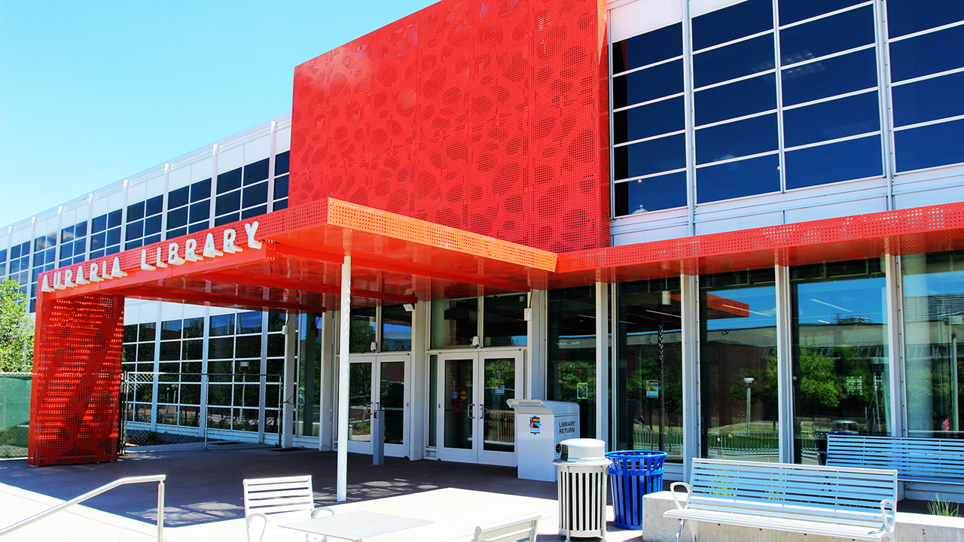
SILLVR Pilot
Between Colorado Alliance of Research Prospector Libraries
Spring 2020 – Fall 2020
2 streaming video vendor partners.
Swank
Films on Demand
Patrons will request streaming videos via Prospector

Slide 6
Vendor Partners
Infobase ( Films On Demand) provides access to more than 35,000 titles from 800+ international producers in a range of subject areas—from award-winning documentaries to A-list performances spanning the arts, and more.
Lenders: Auraria, CC, CMU, UCCS, UW
Swank Digital Campus partners with major movie studios, documentary providers and independent film makers to offer colleges and universities access to a streaming library of over 25,000 films and TV episodes for academic support.
ILL of Swank streaming videos will only be between academic libraries due Swank’s licenses with the movie studios.
Lenders: Auraria, DU, UW

Slide 7
Streaming Video Portals
Swank portal will include current subscriptions. If you have no current subscriptions then Swank will create one for you just for ILL.
Swank portal is where your temporary ILL streaming video will show up.
Same as their normal subscription portal. Same accessibility, features, etc.
FOD is still creating. Using token technology.
FOD portal is where your temporary ILL streaming video will show up.
Same as their normal subscription portal. Same accessibility, features, etc.

Slide 8
ILL Terms and Guidelines
Lending length: 21 days.
Renewals: Renewals will not be granted. If a patron wants to video again, they would have to go through the entire requesting process.
The Lending Library keeps access to the video during this process.
Notes:
The ILL terms and guidelines would be agreed upon by participating libraries and vendor partners.

Slide 9
Statistics
From Prospector (Union Catalog)
Title
Distributor
Copyright Date
Lending Library
Borrowing Library
Patron Type (i.e. Undergrad, Graduate, Faculty)
From Streaming Video Vendors
How many times video watched
Date/time
Subject areas
Plays by device
Notes:
A vital piece to the success of the pilot is the collection of useful statistics for all participants. The types of statistics that are collected and how often would be agreed upon by all participants. Some examples of statistics that the Alliance libraries will collect include:

Slide 10
Swank Streaming Video Lenders

Slide 11
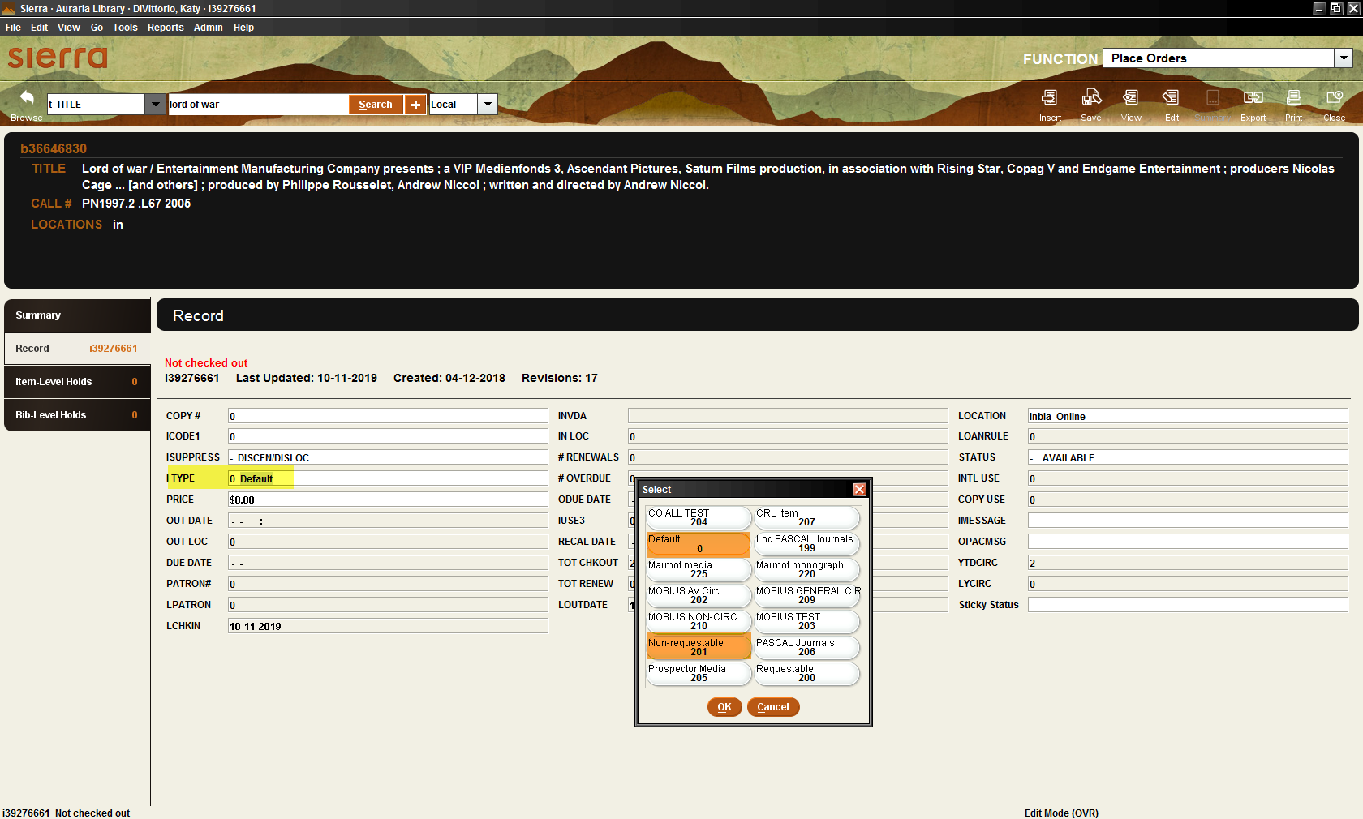
Lending Libraries: Updating Swank Item Records
Change Swank item records to indicate that these streaming videos are available to borrow via Prospector.

Slide 12
Lending Libraries: Updating Swank Bib Records
Add to 856 field “Connect to Streaming Video. This streaming video is only available to academic library patrons. Requests from public library patrons will be cancelled.” Make the note about limited to academic library patrons in red.

Slide 13
Lending Libraries: Updating Swank Item Records
Run a global update to add “Swank Streaming Video” in the barcode field for all Swank streaming videos. This will designate which Prospector slips are Swank videos.
Notes:
The item and 856 field changes will automatically update in Prospector. The keyword indexing can take up to 15 minutes to update in Prospector.

Slide 14
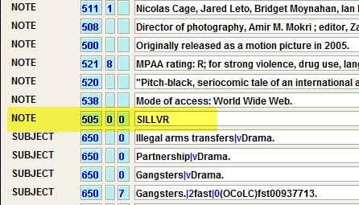
Lending Libraries: Updating Swank Bib Records
Add SILLVR to a Prospector keyword indexed field. For Sierra libraries that means adding SILLVR to Marc 505 field.
Notes:
This will provide another way for patrons to search for streaming videos they can ILL.

Slide 15
Changes in Prospector Look Like This

Slide 16
Swank Lending
Print Prospector Paging Slip
Lending library emails vendor
Vendor adds video to borrowing library’s portal
Lending library let’s Borrowing library know
Check-in streaming video in INN-Reach
Check-out streaming video in INN-Reach

Slide 17
Prospector Paging Slip

Slide 18
Swank Borrowing Libraries
Swank has created portal for all libraries.
Swank emails you access details.
You need to add Swank to your off-campus authentication system.

Slide 19
Swank Borrowing
Patron submits Prospector request
Streaming video shows up in Borrowing library’s portal within 1-3 business days
Borrowing library emails patron temporary link

Slide 20
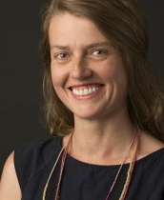
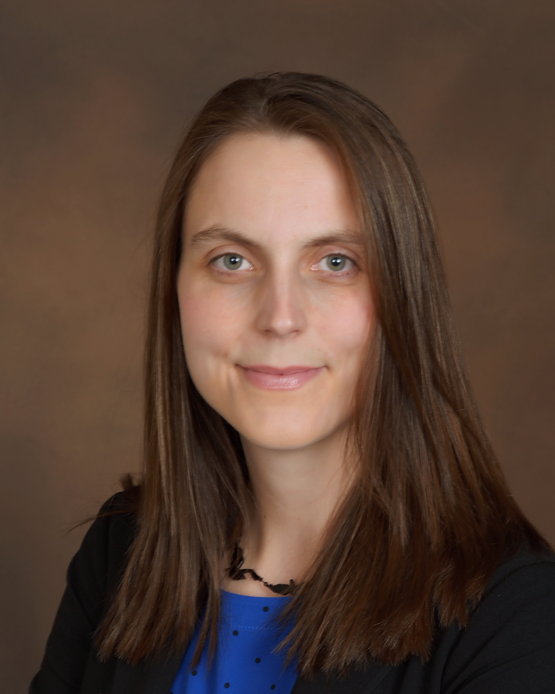
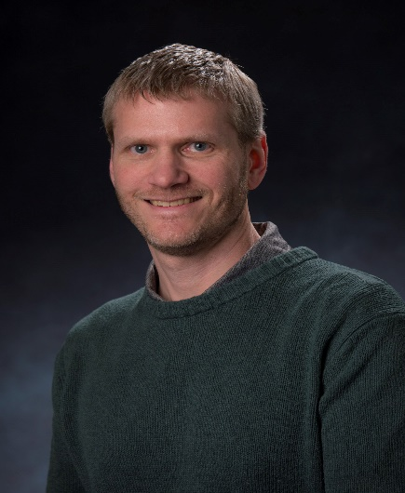
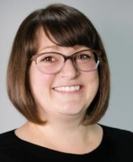
SILLVR Project Team
Sommer Browning | Associate Director of Technical Services sommer.browning@ucdenver.edu
Katy DiVittorio | Collections Strategies, Department Head katy.divittorio@ucdenver.edu
Philip Gaddis | Interlibrary Loan & Acquisitions Manager
philip.gaddis@ucdenver.edu
Charissa Brammer | Metadata and Discovery Systems Librarian
cbrammer@coloradocollege.edu

