Slide 1
Prospector
Director’s Meeting
11-8-2012
Rose Nelson-Assistant Director

Slide 2
Prospector Update 2012
Introduction
Denver Public Library
Prospector by the numbers
Prospector FAQ
What’s Coming?

Slide 3
What is Prospector?
Discovery -- a regional union catalog for many of the major academic and public libraries in Colorado (& Univ of Wyoming)
Requesting -- allows patrons to easily request items from other participating libraries and have them delivered to a nearby local library
Does not replace a local ILS but extends its reach
Operates on INN-Reach software from III
Tool for collection purchases

Slide 5
Participating Libraries
Currently 41* libraries
18 academic libraries
19 public libraries
4 special libraries
*Not counting DPL who will be reinstated in the next couple of months

Slide 6
INN-Reach Architecture: DCB & NCIP
Process circ in DCB
application
Staff
Staff
Polaris
Non-III system
Local
Innovative
System
NCIP
Messages
Local
Innovative
System
INN-Reach Server
DCB
Application
Local
Innovative
System

Slide 7
DPL Update
DCB server is set up with latest version of Millennium
III has provided circulation training to DPL staff (lead trainers)
FTP site configured to send bib, item and patron updates to the DCB server.
Testing of various circulation transactions between DPL and test partner library
Paging and intransit slips have been configured
Determined the best way to handle deletions from Polaris

Slide 8
Outstanding Issues
Problems with consistency in NCIP messaging (sequence of messaging once it goes from DCB to Polaris)
Configuration of due date slip
Display of appropriate fields on paging slips

Slide 9
Did you know?
The smallest population served is Vail at 5,294. The largest is Denver serving 605,000
The number of lends per site ranges from 1291 to 82,000
Student enrollment in the academic libraries range from 2,500 to over 25,000
Prospector extends north to Wyoming south to Durango, east to Deer Trail and west to Gateway
Most unique items-Health Sciences 42% closely followed by U of Wyoming at 41%

Slide 10
Database growth by millions

Slide 11
Database size and uniqueness
Over 11 million unique MARC records
Over 29 million item records
64.06% held by 1 library
14.18% held by 2 libraries
10.66% held by 3 libraries
4.36% held by 4 libraries
2.93% held by 5 libraries
1.76% held by 6 or more libraries

Slide 12
Circulation Policy
Monographs
21 day loan period (monographs)
1 renewal, Holds permitted but no recalls
70 requests/check-outs per person (up from 40)
Helps support increased use of remote storage
Local libraries can keep override for lower levels
Delivery via existing courier
Media
7 days and no renewals
PASCAL Journals
7 days and no renewals

Slide 13
General Statistics
85% fulfillment
Turn around time averages 3.5 days
Annual loss rate ~0.23%
1,312 lost in 2010 out of 576,000 total
Annual reconciliation but no money is exchanged
Courier
Regional routing initiated in May 2011

Slide 14
Prospector lends by year

Slide 15
Top lenders and borrowers 10/11-10/12

Slide 16
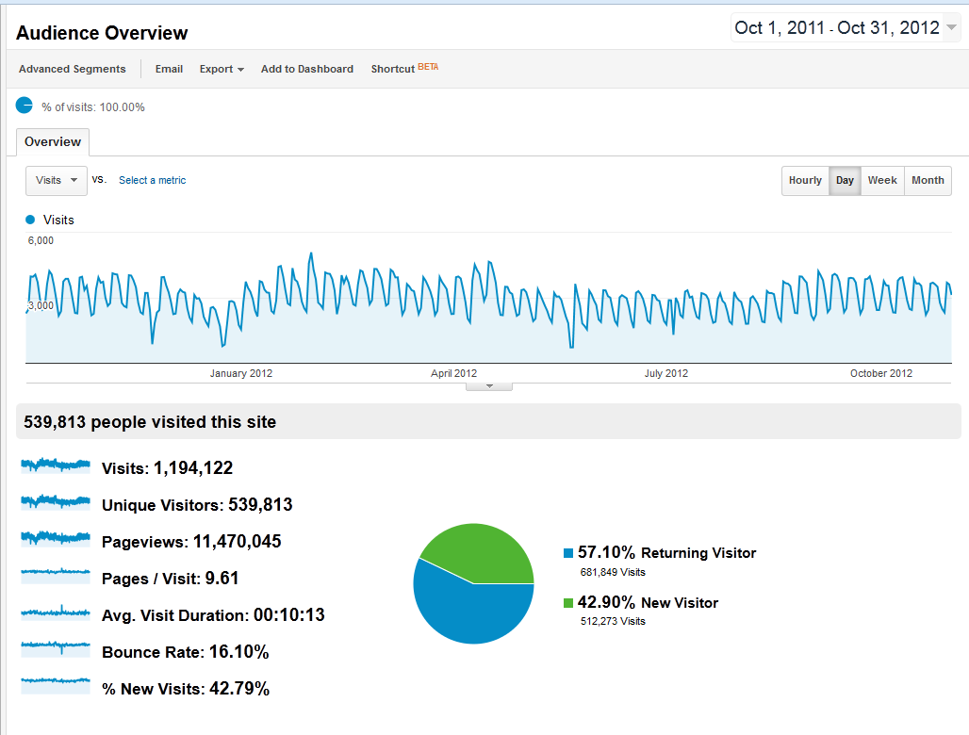
Google Analytics Visits: 10/11-10/12

Slide 17
Mobile Access

Slide 18
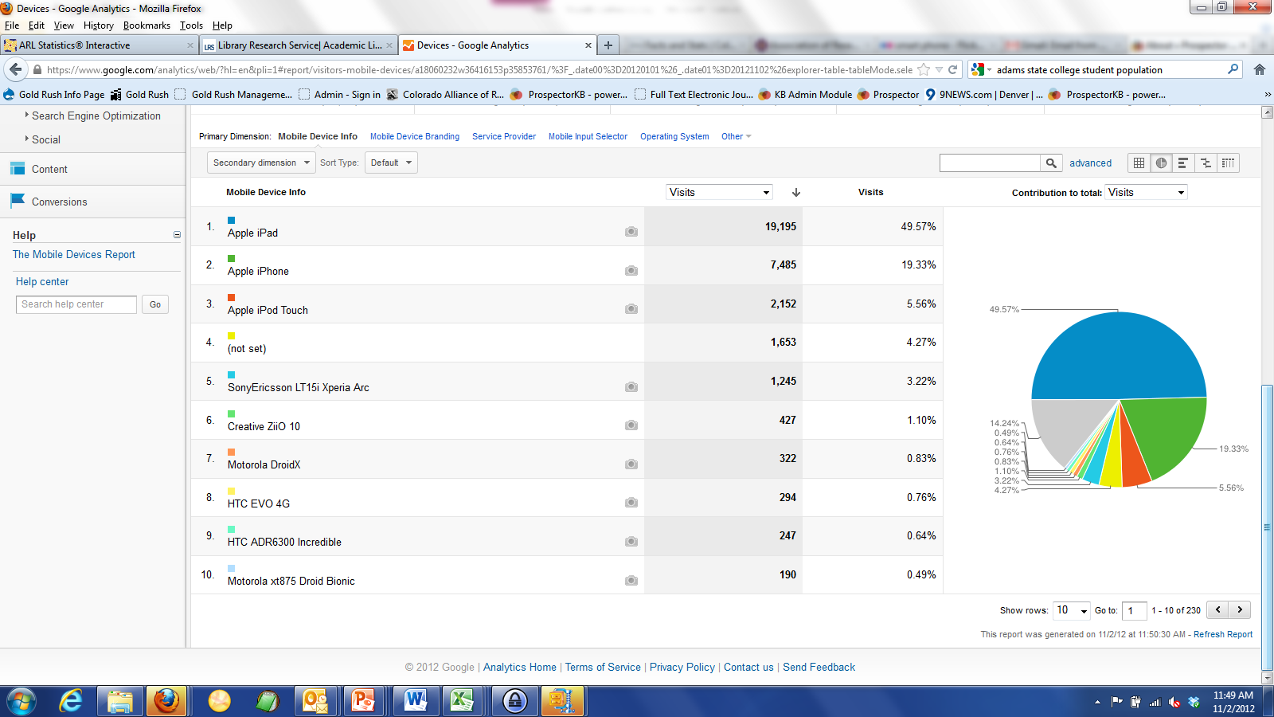
Mobile Devices Accessing Prospector

Slide 19
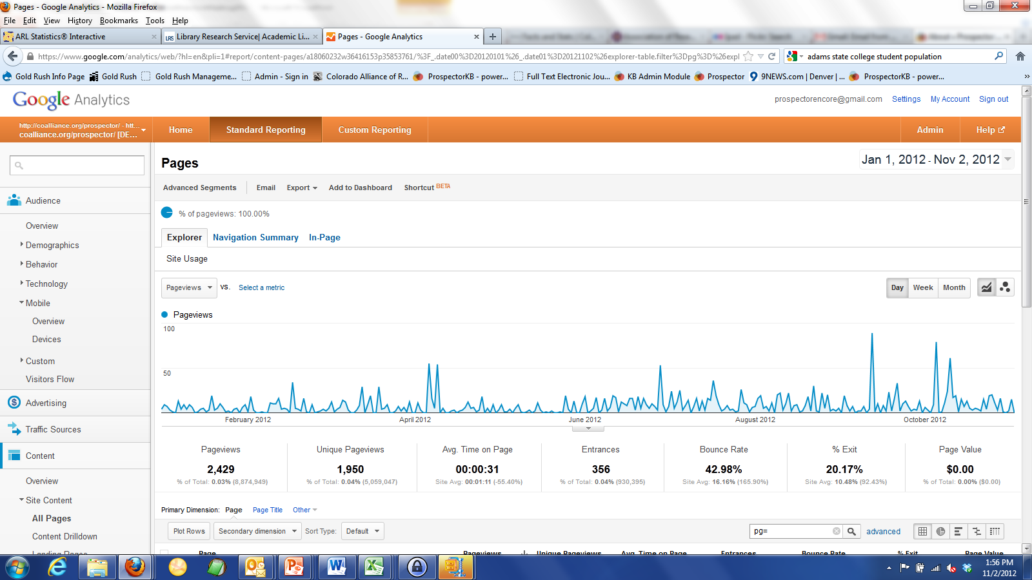
Prospector Mobile Site

Slide 20
Prospector FAQ
Soon to be released Prospector staff website
Place where staff can get answers to Prospector technical and policy questions
Mining Prospector listservs for useful Q & A
Interactive site which can include text, tutorials, screen captures, links to videos
Work with committees to get contribution from Prospector staff at libraries who have expertise in circulation, cataloging, reference, etc…

Slide 21
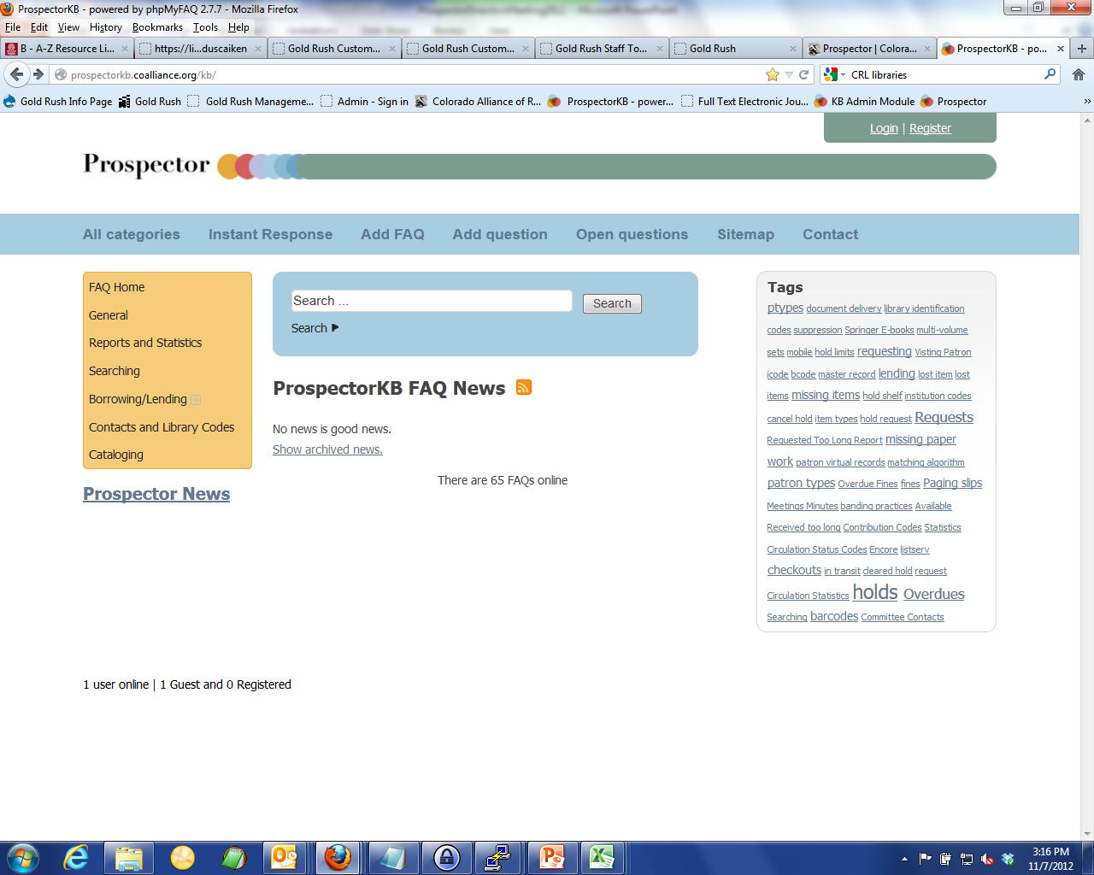

Slide 22
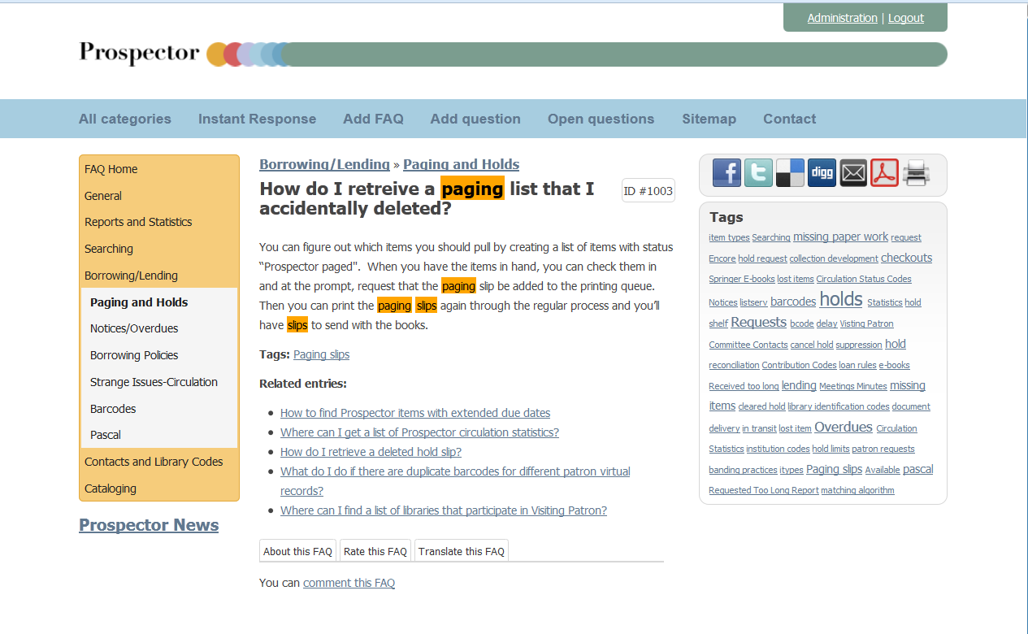

Slide 23
What’s Coming
OAI Harvester to capture metadata from Hathi Trust and display these records in Prospector
Hathi Trust 60 research institutions and libraries
Variety of public domain collections, history, genealogy, science, lots of others.
Metadata extraction export for local discovery systems such as Summon, Primo and VuFind.

Slide 24
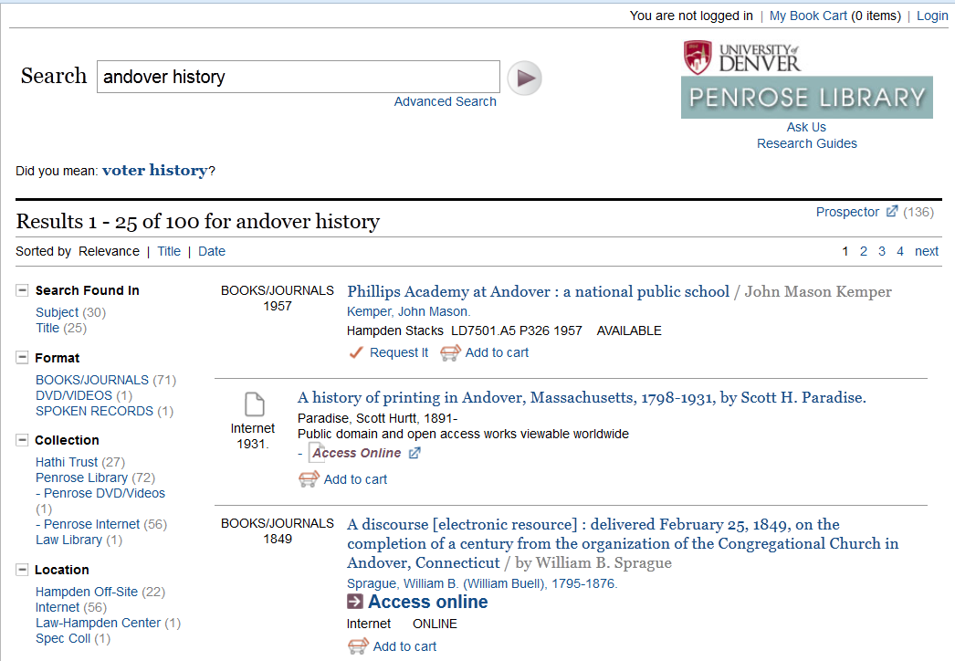
Hathi Trust via Encore at DU

Slide 25
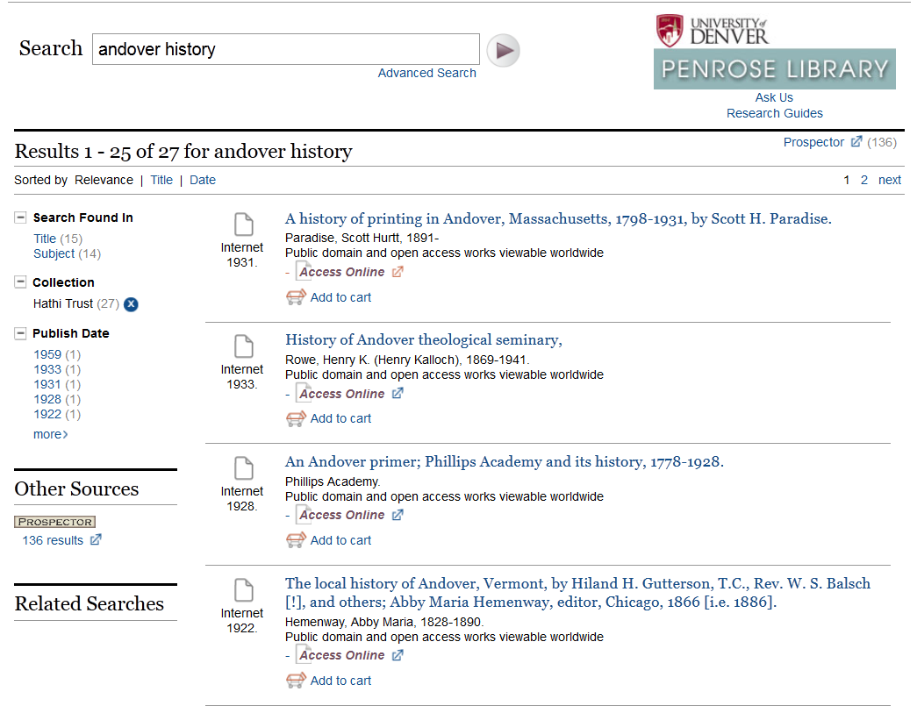

Slide 26
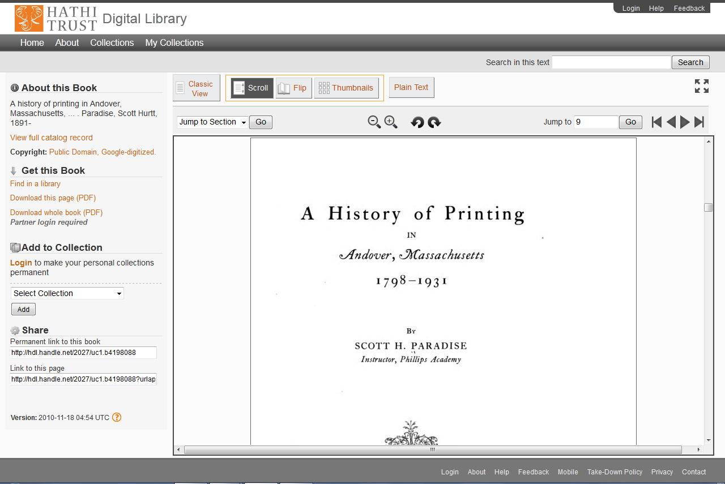

Slide 27
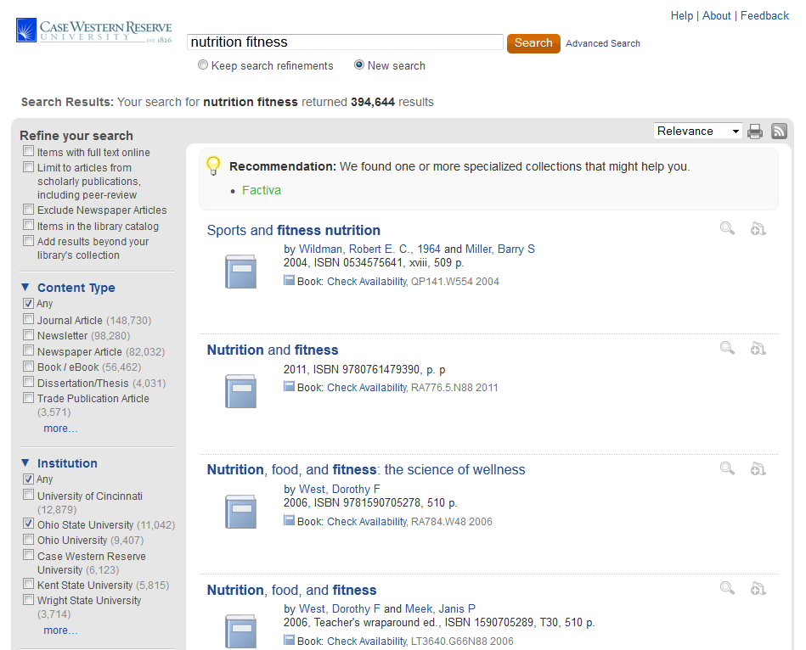
Summon at Case Western Univ.
Export from INN-Reach OhioLink catalog

Slide 28
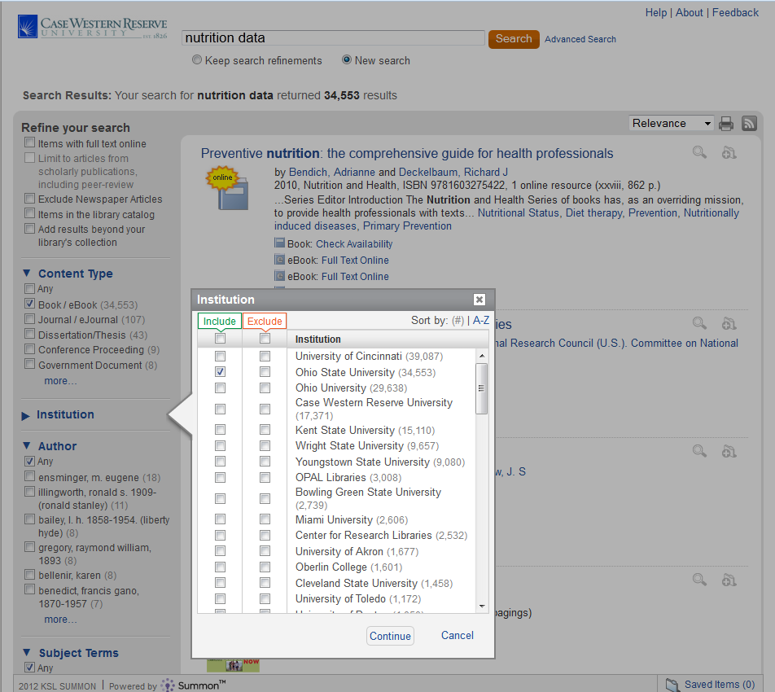
By clicking on more you can include or exclude certain libraries from search

Slide 29
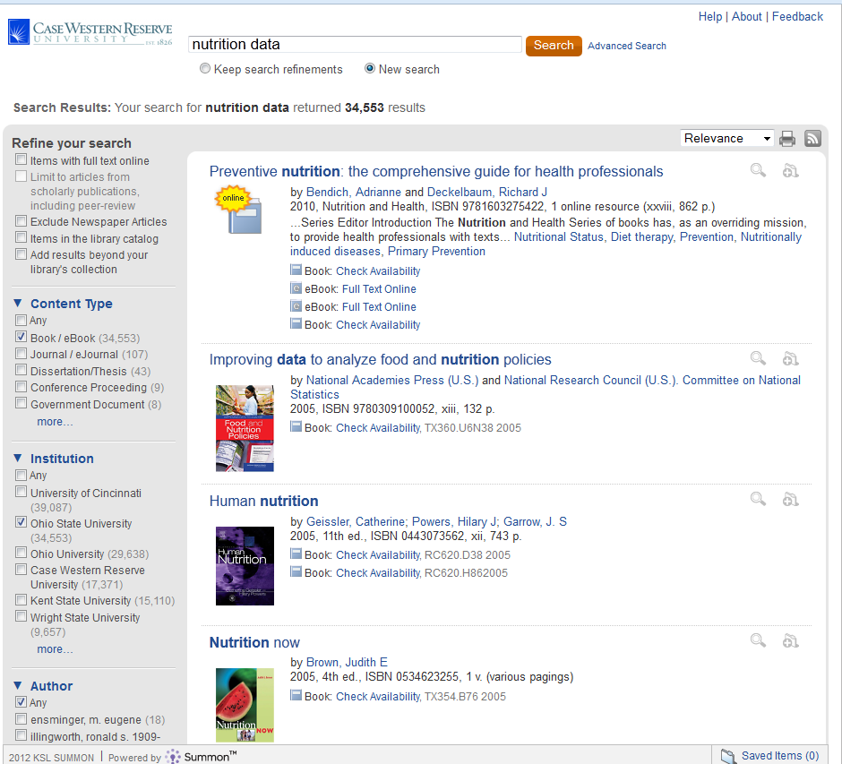

Slide 30
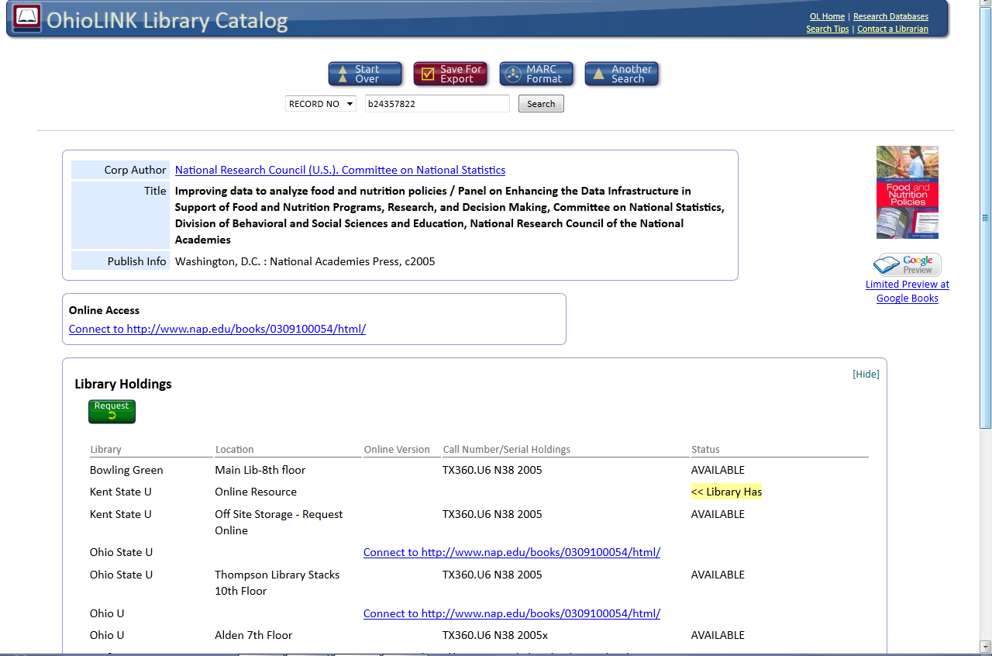
Record from Kent State in OhioLINK catalog

Slide 31
What’s coming?
New Alliance Programmer starting in early December
Longmont Public Library
We have a contract we are just awaiting signatures now.

