Slide 1
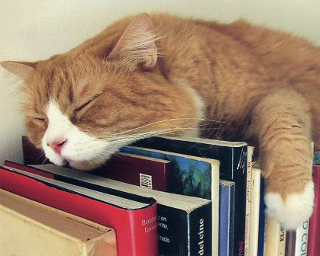


MAKE YOUR CAT(alog) PURR
Optimizing your Integrated Library System
Presented by
Lynn Gates, Director of Cataloging and Metadata Services
Co-Authors
Joel Tonyan, Systems and User Experience Librarian
Federico Martínez-García Jr, Director of Access Services

Slide 2
Objectives
What is an ILS audit?
Getting Started
Data Definition and Clean Up
Streamlining Workflows
Auditing the Security of Your ILS
Future Steps

Slide 3
What is an ILS Audit?
A systematic review of your library’s integrated library system (ILS) with the goal of securing, optimizing, and documenting its configuration.
An excellent opportunity to revisit past decisions to see if they still make sense.
A chance to access, create, and preserve institutional memory around your ILS.
Documentation and understanding of your system in the event of a future migration.

Slide 4
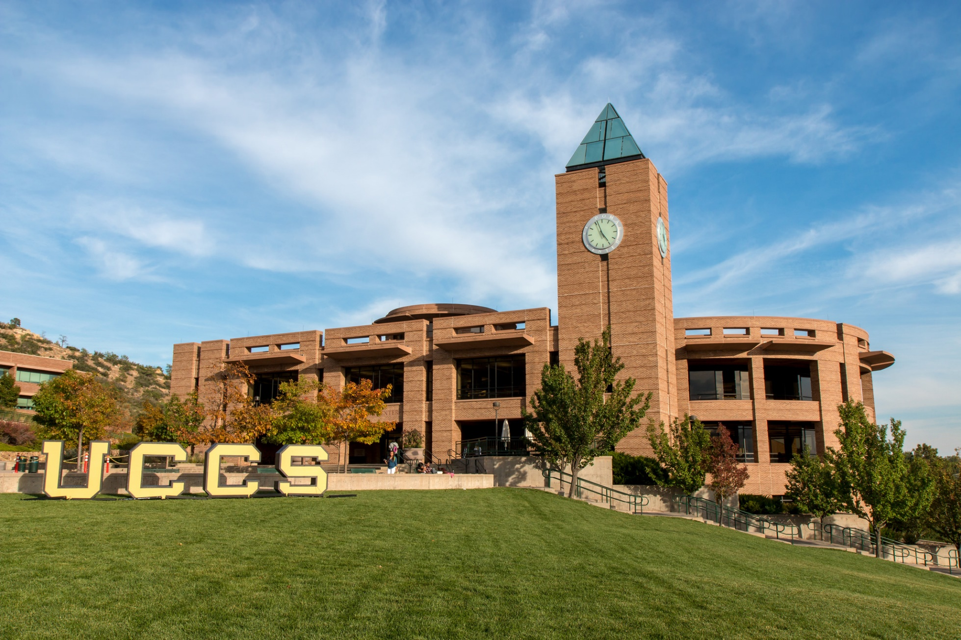
Who We Are
Kraemer Family Library—Midsize academic library serving a community of approximately 12,000+ users
ILS —Currently running Innovative Interface’s Sierra, v. 4.1, hosted.
Longtime Innovative user—Began using INNO-PAC in 1998, then migrated to Millennium, and moved to Sierra in 2012.

Slide 5

Why Did We Need to Conduct an ILS Audit?
Kraemer Family Library experienced a wave of retirements beginning in 2013.
In 2014, we hired a new systems librarian, and in 2017 a new director of cataloging and a new director of access services.
Along the way, we lost a LOT of institutional memory.
Since 2014, upgraded from Sierra 1.6 to 4.1, each release adding functionality that we might not be taking advantage of in long established processes.

Slide 6
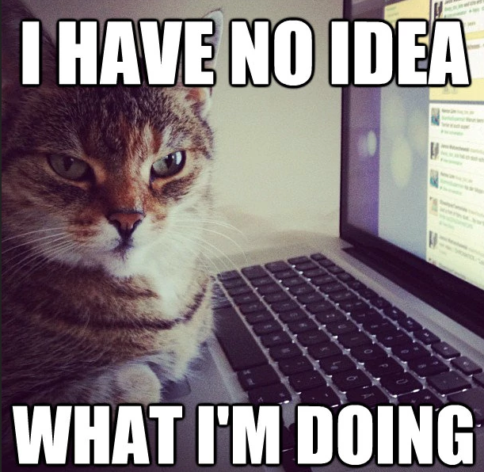
Getting Started

Slide 7
Assembling Your Team
To conduct a sweeping audit of your system, you will need to assemble a diverse group of people:
  Systems administrator
  Head of cataloging
  Head of circulation/access services
  Longtime employees with broad knowledge of past decisions, systems migrations, and institutional history
You may also need to rotate in employees with in-depth working knowledge of specific parts of the system
Notes:
Freddy

Slide 8
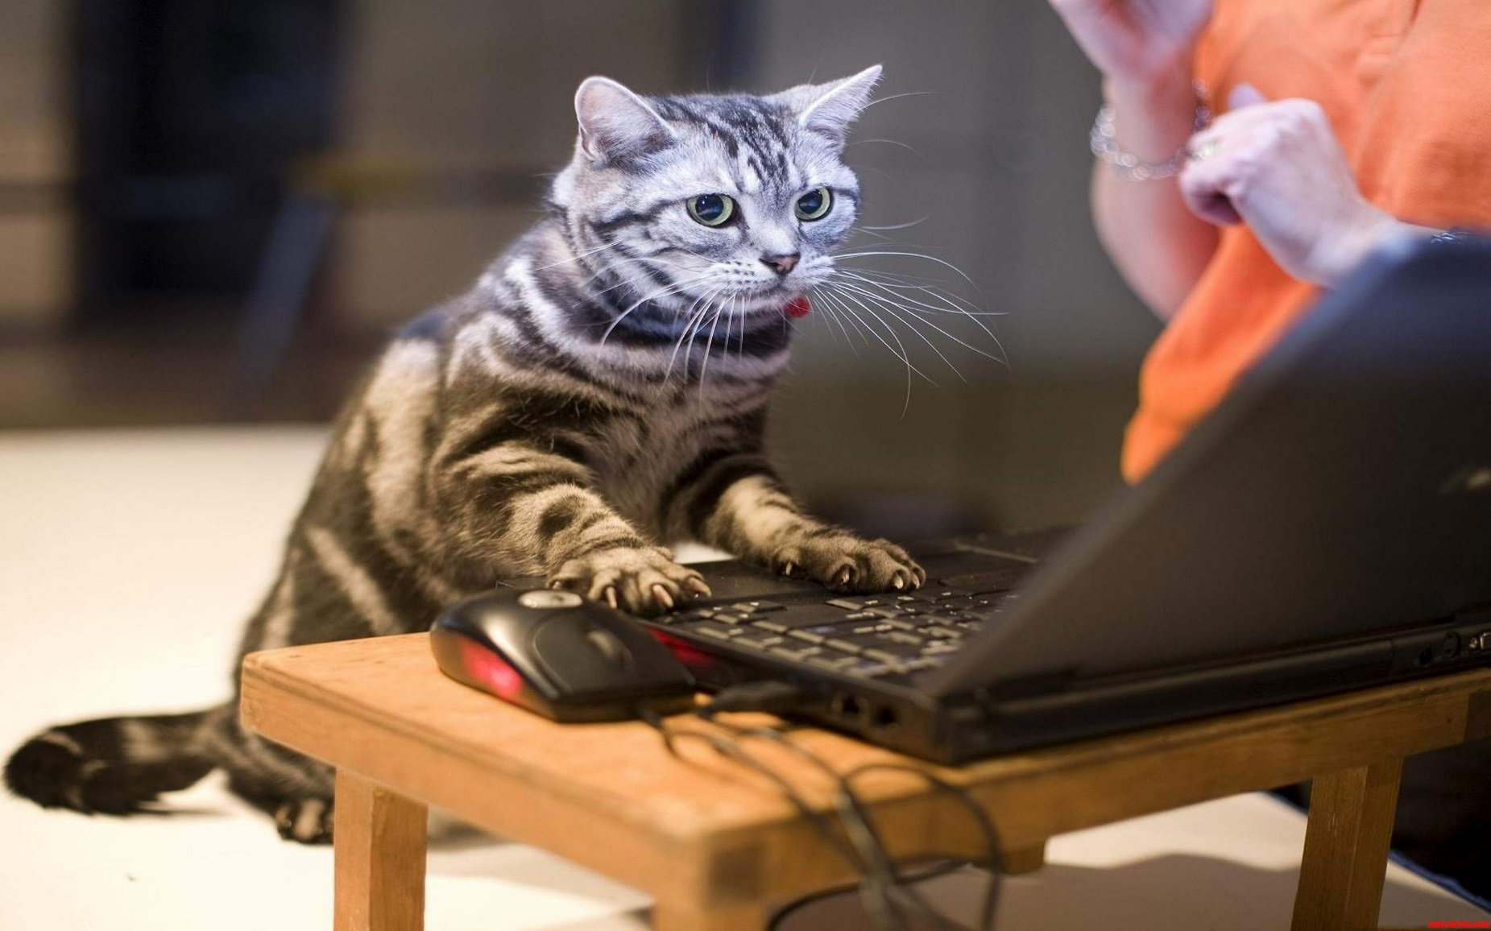
How will you plan, collaborate, and document?
What documentation do you already have about your system?
Is it current?
How and where will you store the
documentation you produce?
Are you going to standardize that
documentation?
Who should have access?

Slide 9
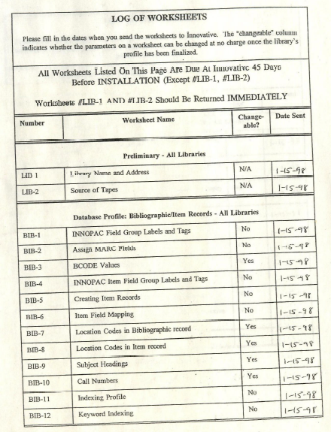
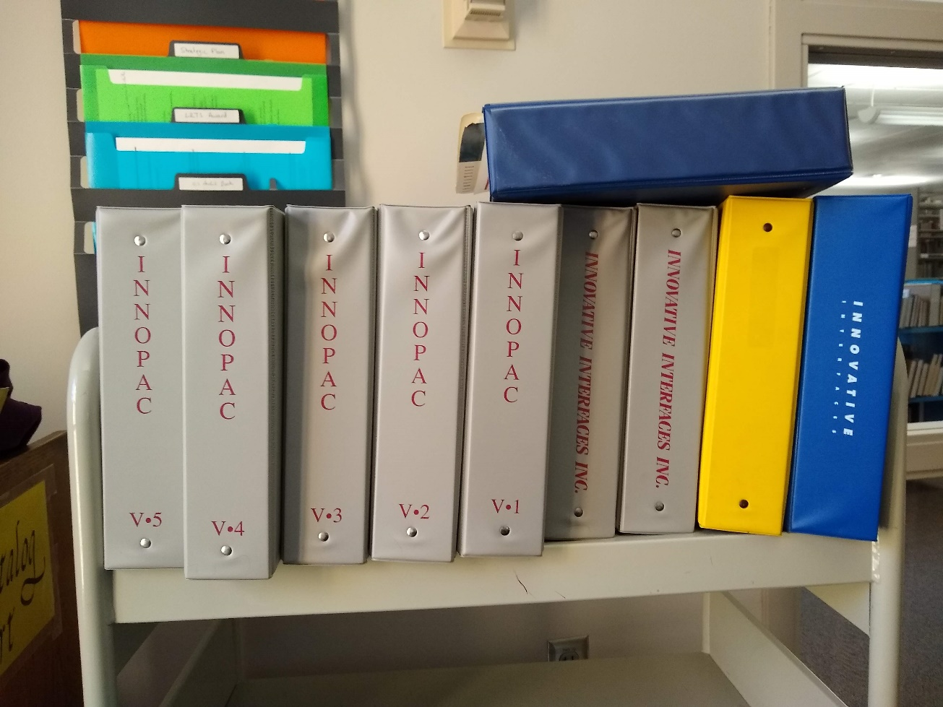
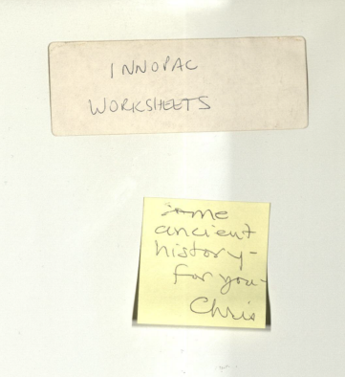
Our Existing Documentation…

Slide 10

Things to Consider Along the Way
Always keep in mind how system changes could affect patrons
An ILS audit is a lengthy project, and one you will need staff buy-in for to do properly
You will need to provide periodic updates to your staff

Slide 11
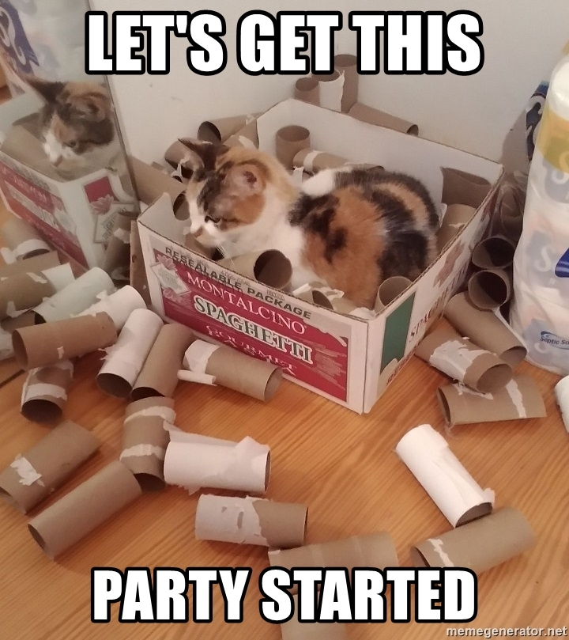
Where to Begin
It depends…
  On your institution’s unique ILS history
  On the political climate at your institution
    How open to change is your library?
We started with item statuses because…
  We knew that big changes, such as changes to our loan rules, would be controversial
  Our item statuses need to be cleaned up anyway, and are far less controversial since they don’t affect loan periods, etc.
Before changing ANYTHING, document your ILS’s data inputs and outputs
Also document your current configuration before changing it

Slide 12
Documenting Your ILS's Data Inputs and Outputs
Creating a chart can help you visualize all the different data flowing into and out of your ILS.
As you make changes to your ILS you can better anticipate how these changes might affect other systems that you send data to or pull data from.
For instance, we recently changed some item status values in our ILS and had to report them to Prospector to ensure the materials still circulated properly.

Slide 13
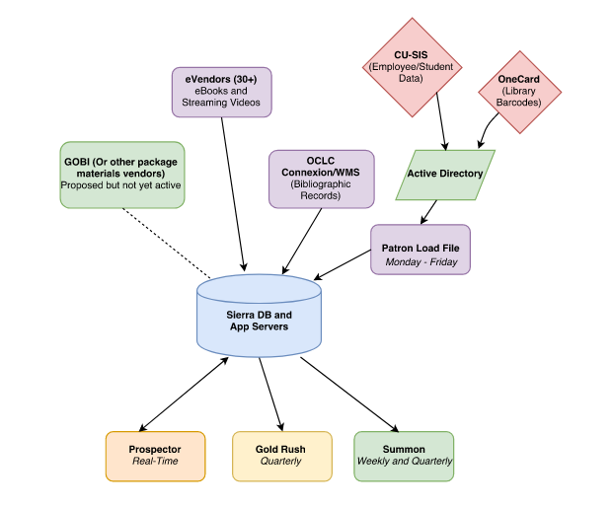
Our Sierra Server’s Data Inputs and Outputs
Data inputs:
  Bibliographic Records
  Patron Records
Data outputs:
  Bib Records to Union Catalog
  Bib Records to Discovery Service
  Bib Records to Union Catalog Overlap Analysis Tool
Created with the free flowchart software Draw.io (https://www.draw.io)

Slide 14
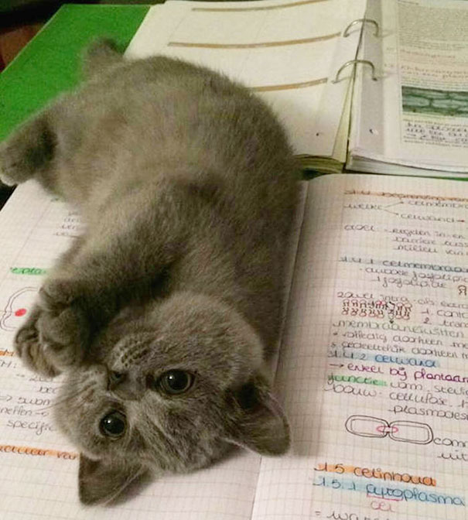
Data Definition & Cleanup

Slide 15
General Procedures
Document current values: label, code, source, definition, purpose, etc.
Gather stats on current usage
Develop shared definitions for consistency across departments
Make recommendations for removing & adding values
Note potential impact on other lists/settings
Create or update documentation

Slide 16
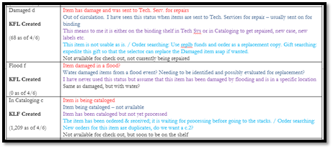

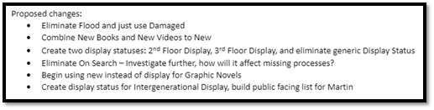

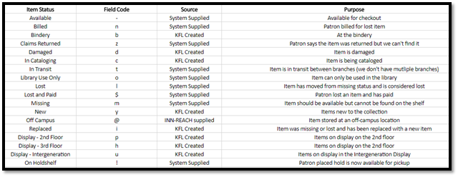
Item Status
Purpose
  System Functions
  Temp. Locations
  Internal Processes
Other Considerations
  Include in documentation which should statuses should not be set manually
  Coordinate code with Prospector
Results
  Started with 25, Ended with 25
    System Supplied: 9
    INNReach: 7
    KFL: 9
  Removed 3 that are no longer used
  Renamed 2 for clarity
  Added 3 to clarify temporary locations & new internal process
  Patron benefits: Easier to locate displays, more accurate shelving locations, etc.

Slide 17
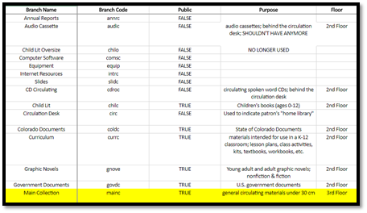


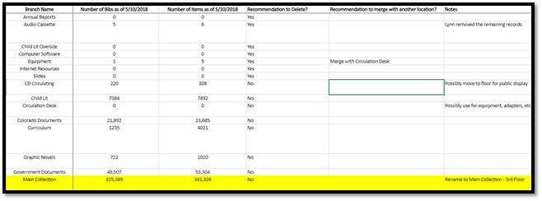
Branches [Locations]
Note: We are a single branch library
Purpose
  Physical location within the library
Other Considerations:
  Locations can impact Loan Determiner Table
Results:
  Started with 38, Ended with 28
  Removed those no longer used
  Merged several
  Added one to clarify and remove information from note in bib. record
Notes:
For multi-branch libraries this would be a good time to review naming conventions; standardizing code creations; etc.

Slide 18
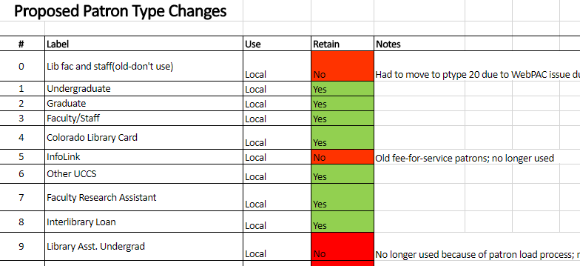

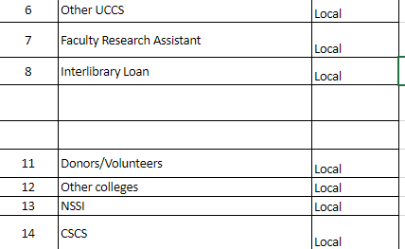

Patron Type
Purpose
  System Functions
  InnReach Statistics
Other Considerations:
  Assigned automatically through patron load
  If changing, do in conjunction with item types, loan rules and loan determiner table
Results:
  Started with 16, ended with 12
  Removed several that were no longer used because of the patron load process, no longer supported by Innovative, and an old fee-for-service agreement
  Renamed two in order to improve statistical gathering from InnReach
Notes:
System functions: Things like loan rules, permissions, etc.
InnReach statistics: Can’t get Pcode 1 info in InnReach statistics so needed to have them separated here

Slide 19
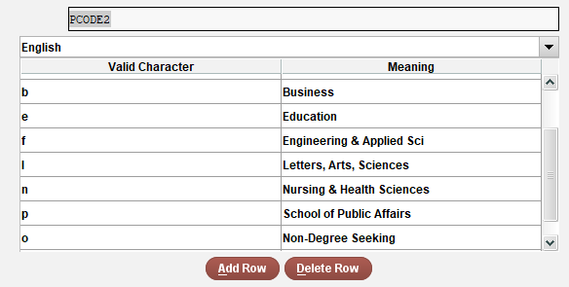

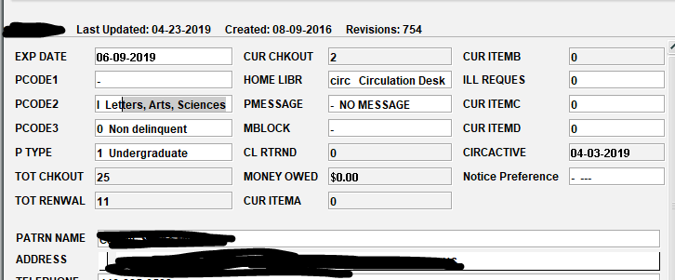
Finishing the Patron Record: PMESSAGE, MBLOCK, & PCODES
PMESSAGE & MBLOCK
  Cleaned up unused values
PCODE1
  Used for statistics and identifying records for fine forgiveness, updating expiration dates, etc.
PCODE2 & PCODE3
  Unused (PCODE3 previously used, but not for several years)
  Decided to use for statistics gathering
  PCODE2 now has academic college
  PCODE3 will have declared major
  Pulled from active directory and loaded as part of the patron load, updated next day if student changes
Notes:
Are they used by the system?
Can we use them for functions we are currently doing manually?
Is there statistical information that can come from any of these?

Slide 20
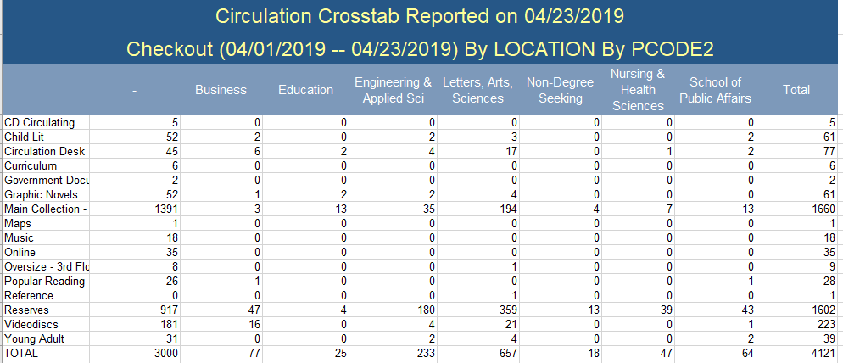
Mapping Academic Colleges to Patron Records

Slide 21
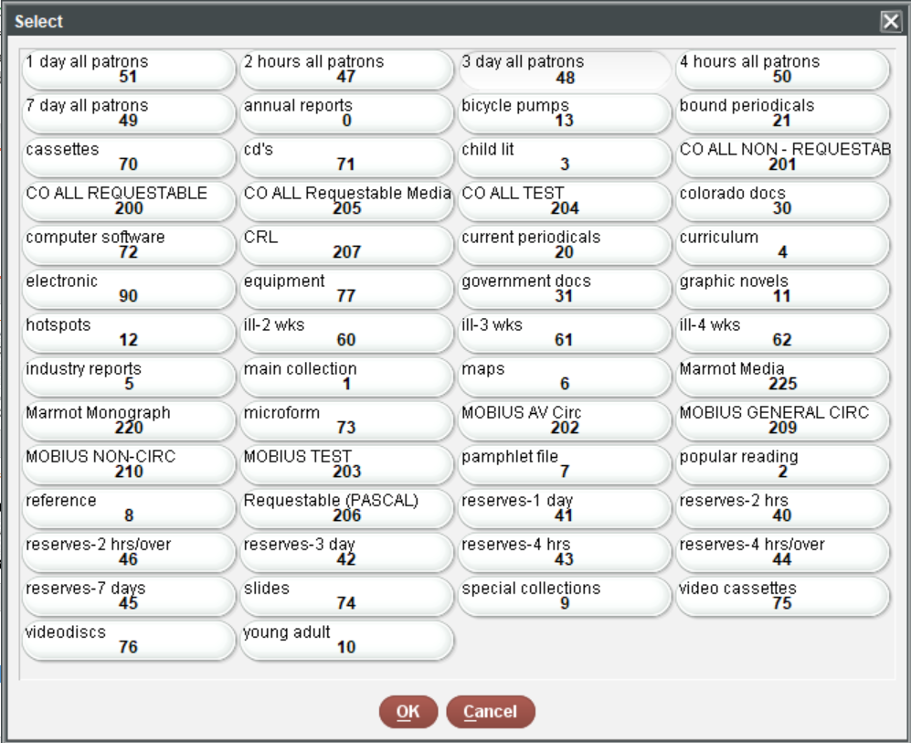

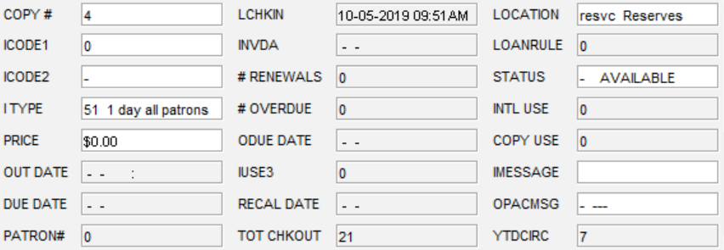
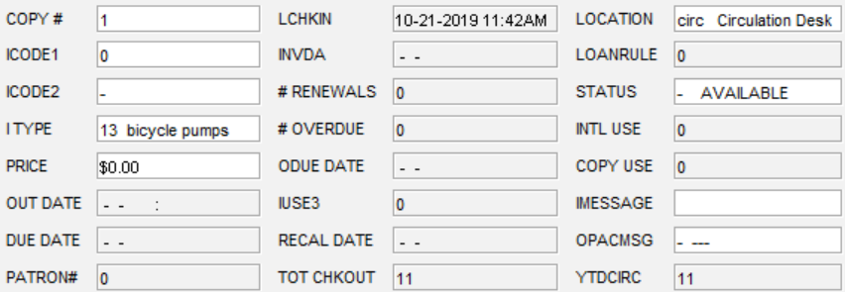
Now Working On: ITYPE
Opportunity to discuss long standing practice
Currently:
  ITYPE is a mix of location and physical material type
  Equipment is part of Reserve Collection
Proposed:
  As much as possible, make the ITYPE what the item is
  Move non-Reserve items out of reserve module
Benefits:
  Streamline loan rules
  Better statistics on what kinds of materials are circulating

Slide 22
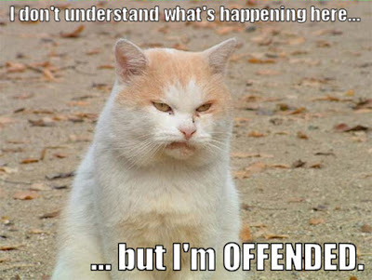
Streamlining Workflows

Slide 23
General Procedures
Document current workflow
Review system documentation (particularly if you have been using the system for a while and have gone through software upgrades)
Determine the desired result of the workflow
Are any steps duplicates? Can any be combined?
Are there batch processes that could be used?

Slide 24
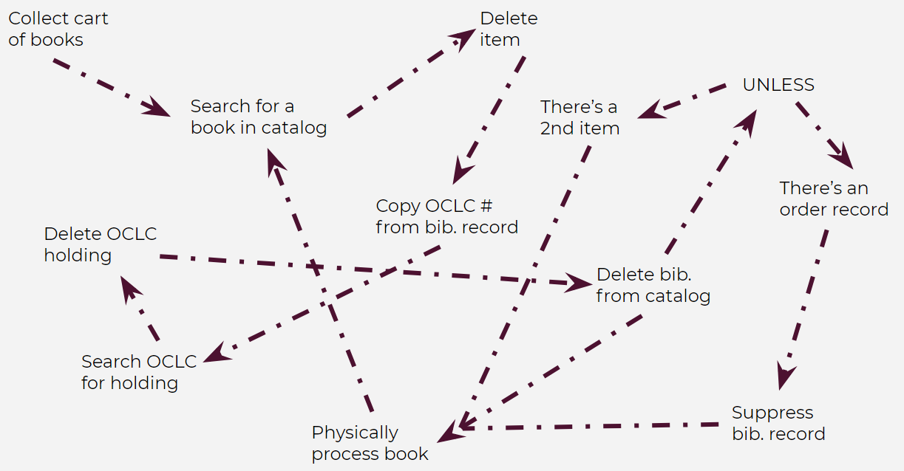
Original Weeding Workflow
1 person working 1/2 time
No other projects or responsibilities
1 cart finished in 2 days
Average of 400 items per month

Slide 25
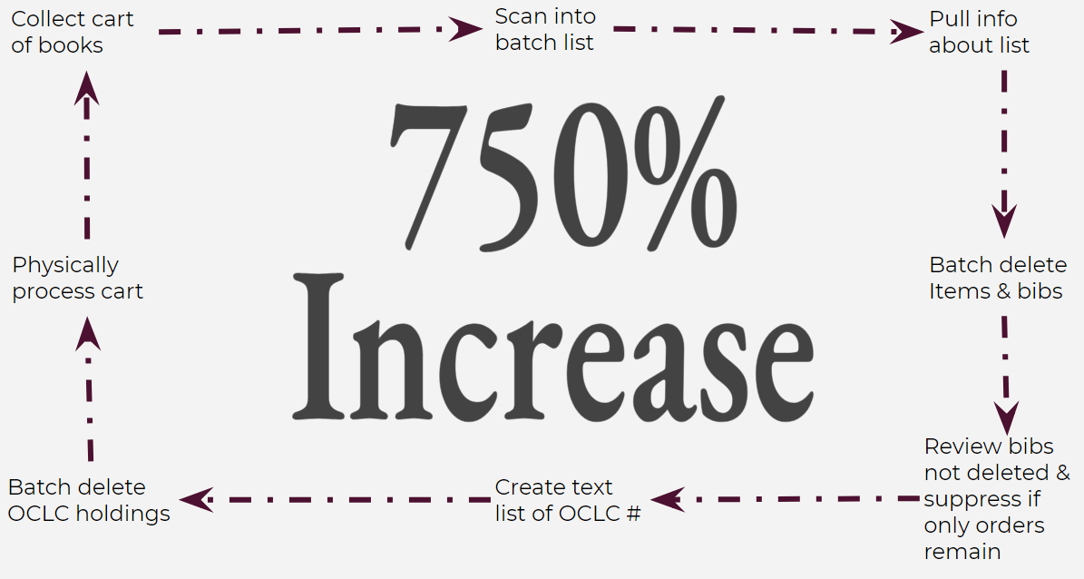
Revised Weeding Workflow
1 person working ¾ time
Lots of other projects & responsibilities
1 cart finished in ½ a day
Average of 3,000 items per month

Slide 26
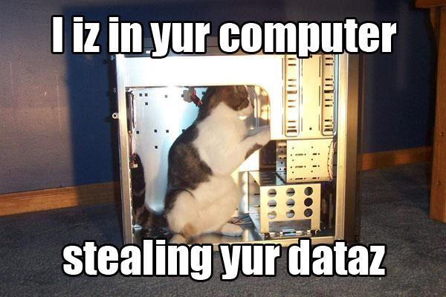
Auditing the Security of your ILS

Slide 27
Basic Principles of ILS Server Security
Grant access only to staff members who absolutely need it
Grant the minimum amount of permissions staff need to do their jobs
Enforce strong password policies
Disable remote access to your server unless it’s absolutely needed
Regularly monitor system logs, login records, etc.

Slide 28
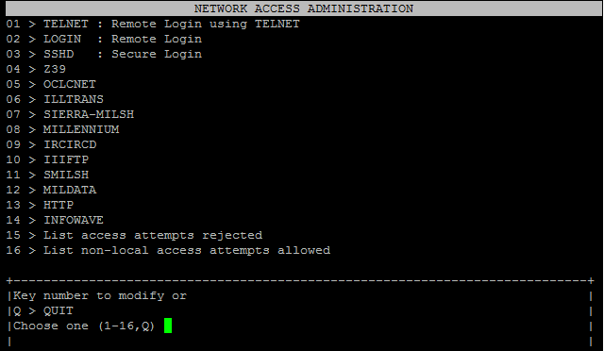
What We’ve Done at the Kraemer Family Library
First, reviewed server logs and noticed repeated attempts to access our server via SSH from outside the United States
Locked down SSH access to our campus IP range, automatically denying access from off campus

Slide 29
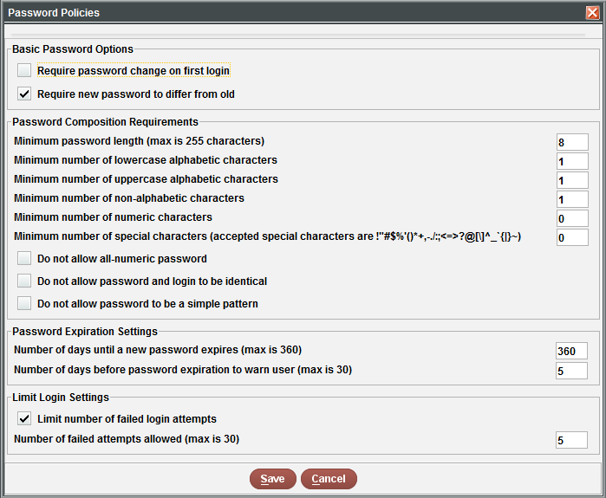
What We’ve Done, cont.
Next, we reviewed the staff password features in our ILS and enabled password policies
We now require:
  8-character minimum passwords
  At least one lowercase character
  At least one uppercase character
  At least one non-alphabetic character
  Passwords to be updated annually
  New passwords to differ from old passwords

Slide 30
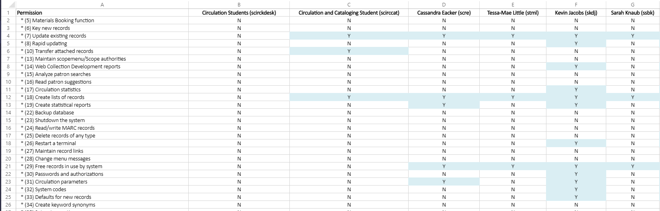
What We’ve Done, cont.
Finally, we began a systematic review of staff permissions in Sierra.
We produced a spreadsheet listing every available permission and who it’s assigned to as a first step to removing unneeded permissions.

Slide 31
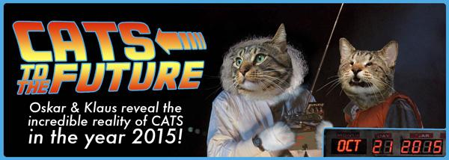
Future Steps
Review loan rules
  Why you need to do preparatory cleanup of components that determine your loan rules, for instance, patron types, shelving locations, etc. first
Need to speak to users about loan rules
Update SCAT table
And much, much more

Slide 32
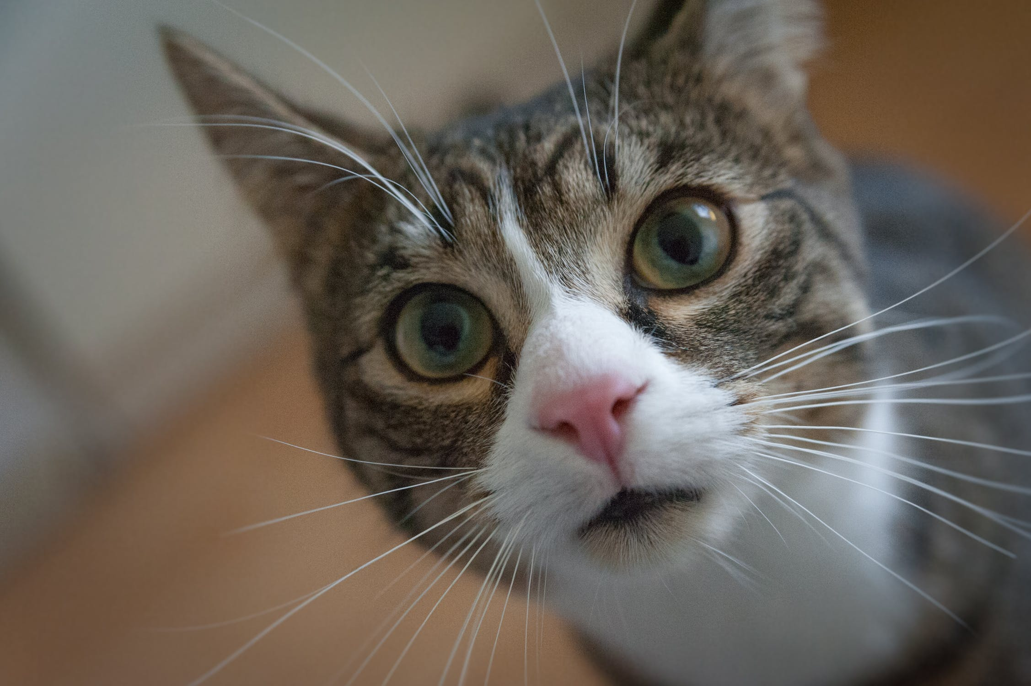
Thank You! Questions/Comments?
Joel Tonyan: jtonyan@uccs.edu
Lynn Gates: lgates@uccs.edu
Federico Martínez-García Jr: fmartin3@uccs.edu

