Slide 1
DIVERSITY IN COLLECTIONS
CHARISSA BRAMMER MA, MLIS, COLORADO COLLEGE
MCKINLEY SIELAFF MLS, MPA, COLORADO COLLEGE
JANETTE RUIZ MLIS, UNIVERSITY OF DENVER

Slide 2
In the spirit of healing, we acknowledge and honor the Cheyenne and Arapaho Tribes, and all of the original Indigenous peoples of the land upon which University of Denver stands.
Whose land are you on?
Notes:
In the spirit of healing, we acknowledge and honor the Cheyenne and Arapaho Tribes, and all of the original Indigenous peoples upon whose land we stand. We remember and honor the hundreds of indigenous languages spoken in the Americas that have been lost due to colonization, genocide, and policies created for cultural assimilation. Part of our work is remembering and acknowledging the injustices and silences created throughout our history.

Slide 3
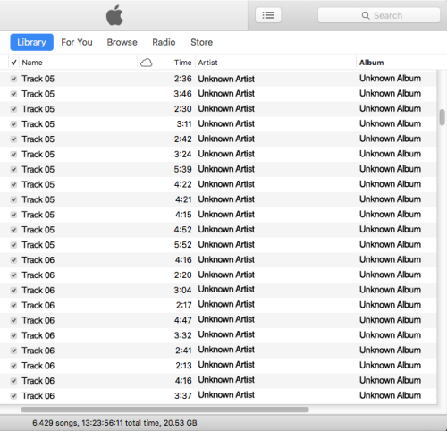
WHAT IS METADATA?
Constructed, constructive, and actionable.
Carefully and thoughtfully constructed standards-based metadata allows people to access the information they need.
kcoyle.blogspot.com
nometadata.org
Notes:
Metadata is much of the data that we handle in the library on a day to day basis, including descriptive metadata, which includes cataloging and the holdings in discovery; Administrative data, including patron data and usage data, and structural, which is that which we use on the back end to manage data. Most of the data that we collect in libraries is metadata. I will be talking mostly about cataloging metadata today, which is interesting, because when it’s done right – which takes an enormous amount of effort – it feels invisible to the user, but when it’s done wrong as in this example, it is super noticeable (and scary!).
At its heart, metdata is “constructed, constructive, and actionable.” It is constructed using a rules-based system that allows for its retrieval, it is constructive because it adds to the meaning of the collections that it reflects, and it is actionable because it is literally the only way that our users can access the materials that we collect.

Slide 4
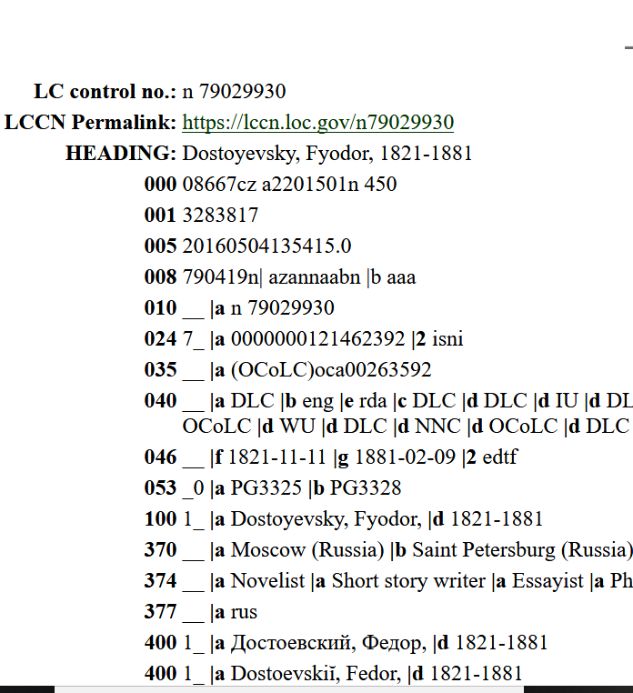
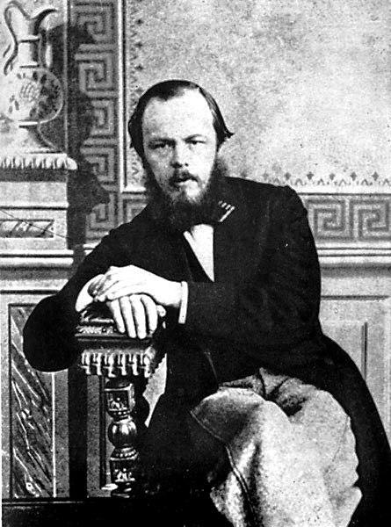
AUTHORITY METADATA
LOC name authorities
  Fixed
  Controlled
  Link all versions of the name together
  Link works together under one name
Notes:
The Library of Congress currently has a vast database of authority records for names and subjects. These authorities work really, really well for a lot of things. They make it possible to keep all of the works created by one author under one, authoritative name. They make it possible to keep the name together in all of the languages that it appears in. This works really well for people like our friend Dostoyevsky. He is not writing books any longer and all of his books were published under one name, he might be the use case for what Authorities were designed to do – fix one person’s unchanging identity into a system for finding resources.

Slide 5
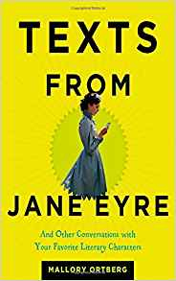
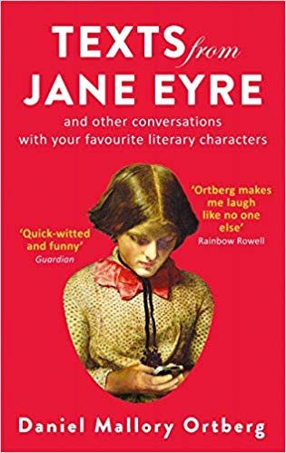
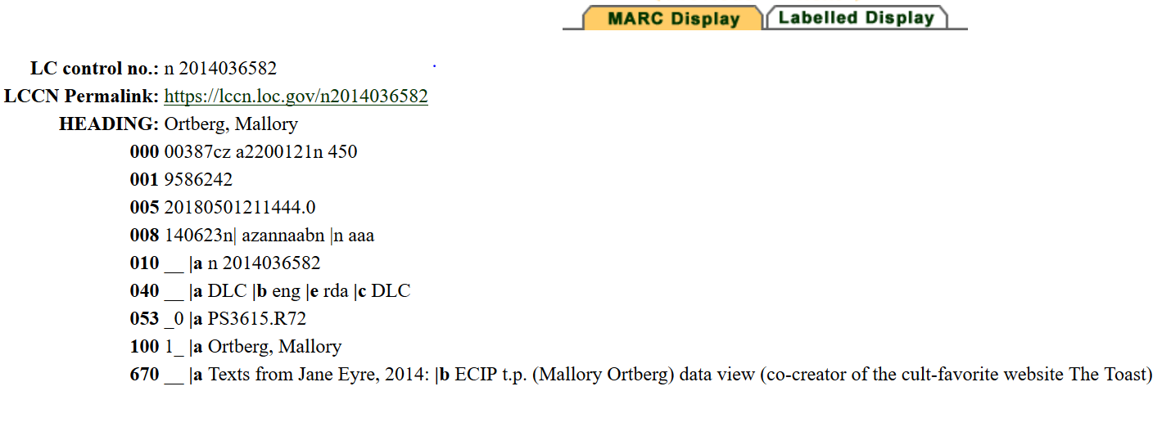
March 2018: Merry Spinster is published
Also March 2018: Daniel Ortberg announces his transition
December 2018: authority record pulled
Notes:
But is identity fixed?
If you’ve heard of the Toast or Dear Prudence, you have probably heard of Daniel Ortberg, who was known as Mallory Ortberg prior to his public transition this year. In the authority file, the identity that is tracked by the Library of Congress is still Mallory Ortberg, with no fixed timeline for when it will be changed by a NACO certified cataloger. This can be changed quicker by the request of the person in the record, but this is not a well-known solution to this problem.

Slide 6
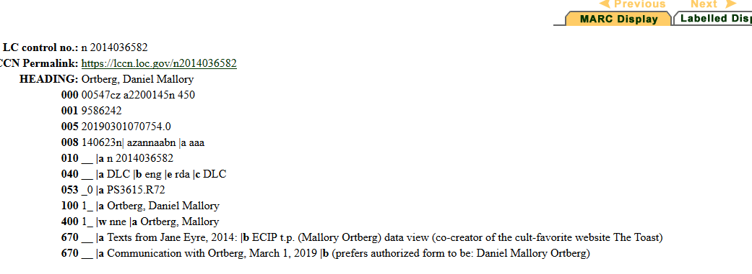
March 2019: Authority Record updated

Slide 7
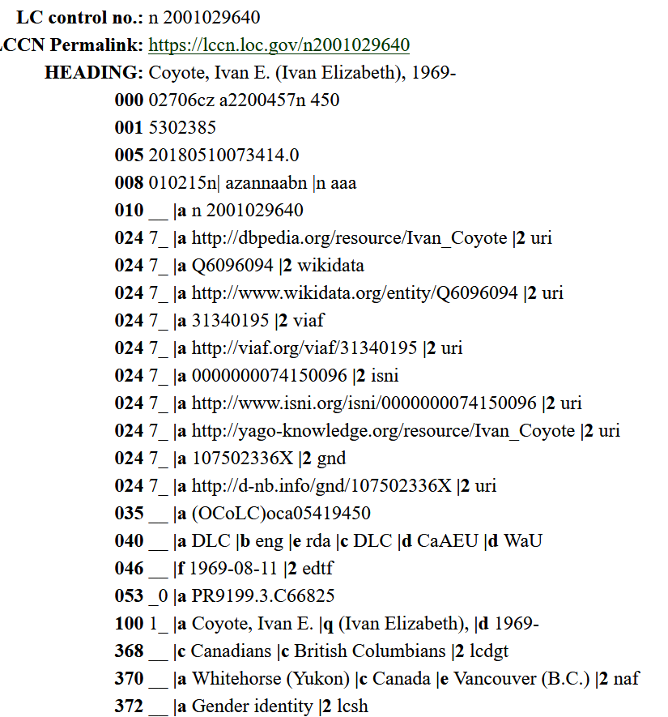
“I changed my name in 1990. That was 22 years ago. Some of my family still call me by my birth name, and I let them do this only because they are my family. I cash cheques and do business and perform and publish and live and f*** and talk to my neighbors as Ivan. Because this is my name. It feels good to be called who I am…
Call us what we wish to be called”
“Coyote’s words express the core issue at stake here: a person’s agency to find a way of being in the world that affirms their identity and sense of self.”
More than a Name: A Content Analysis of Name Authority Records for Authors who Self Identify as Trans, Kelly J Thompson
Notes:
It is also possible that a person’s changing identities might be linked without their permission, as in this record from Ivan E. Coyote. As shown in the quote here, their birth name has not been in use for decades and they have never published under that name, but their birth name was added to the Authority record in 2016, so every cataloging record in the country will include this additional name.
I’m going to try and demonstrate a way that linked data might solve a current problem in cataloging metadata – I will also be making some assumptions about what will be possible, so the solution might look different than what I am positing here.

Slide 8
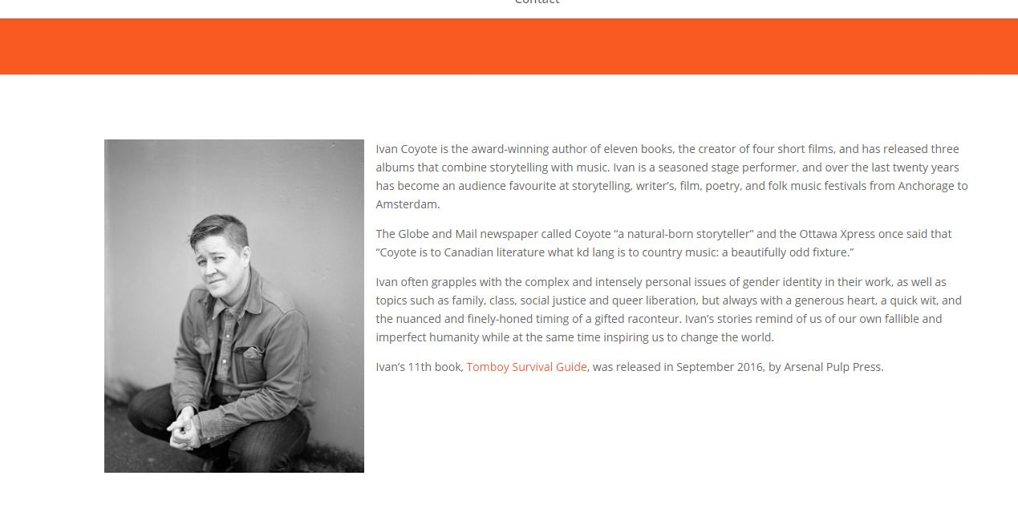
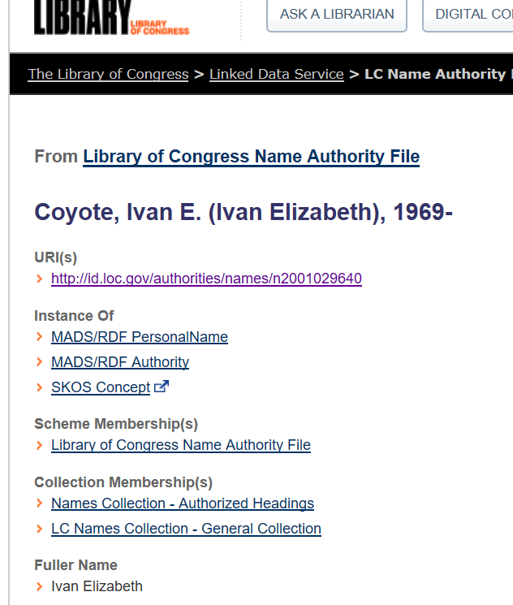
AUTHORITY IN LINKED DATA
URI: http://www.ivancoyote.com/
Authority can come from any URI
People can be in control of their own identity, if we link to a source that allows them to define it.
Notes:
There are potentially many more instances where the traditional way that we assign authorities is problematic. This is one instance where linked data might have a solution: In linked data, everything is in URIs that can come from anywhere – Library of Congress has chosen to use the URI to their authority file, but they could choose to use the author’s own website, or any other site that they deem authoritative, to provide the authoritative information. This would likely be extremely complicated to achieve because authority data has to be structured, but linked data at least makes it possible for libraries to turn put people in control of their own identities directly.

Slide 9
THE POWER TO NAME AND THE POWER TO NORM
Allowing people to be in control of their identity, even in the library ecosystem
Deciding which identities are welcome and ensuring that marginalized people have a seat at the table as creators, researchers, and students
Marginalized identities exist in the scholarly community
Research is easier if we are using the words that are currently being used in the academic discourse
Notes:
For our academic communities, I think that this moves us toward the world described in the Framework for Information Literacy, where Authority is Constructed and Contextual. Linked data will provide opportunities to assign authority in a less top-down way, creating the records that best support our academic community, both the creators and the students and researchers.

Slide 10
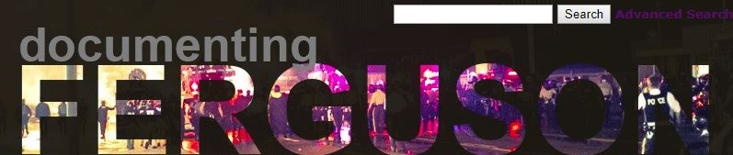
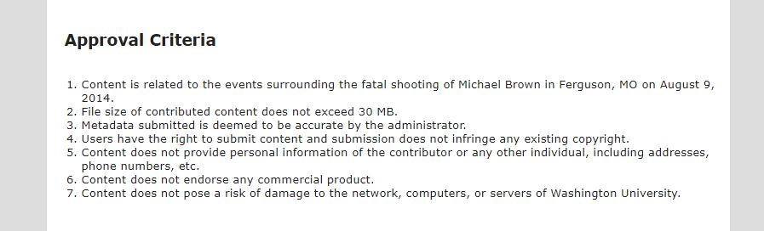
COLLABORATIVE METADATA AND ARCHIVES
Involving people from the community in the archiving of their own history
Community-created metadata that meets archival standards
© Washington University in St. Louis
Notes:
Another trend in metadata is taking place in archives and special collections. Traditionally, metadata was assigned by the archivist essentially in isolation, without input from the community. This can lead to misunderstandings and outright problems with how things are described and then how they are accessed, potentially alienating the members of the culture that produced an artifact. There is a growing trend in archival metadata to involve the members of the culture in the production of the classification and description metadata for these collections.
There are archives coming together that specifically involve the community in all steps of the archival process. An example of this is the award-winning Documenting Ferguson project from Washington University in St Louis. This project has a specific scope: to collect content related to the shooting of Michael Brown in Ferguson, MO in 2014.
The administrator checks and approves the metadata – this step is very important when crowdsourcing metadata because to be useful, it has to be a controlled vocabulary, and, ideally would use a schema like MODS/METS or Dublin Core.
Then the rules that protect the infrastructure of the university and the members of community are delineated.
This is an extremely simple system for the user, which is probably the key to its success as an archival project.

Slide 11
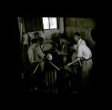
INCREASED CONNECTION WITH THE COMMUNITY
“Ethical challenges of assigning both descriptive metadata and controlled vocabularies to photographs based on the assumptions or interpretations of metadata specialists who may not have experience with the culture”
Imposing or presuming relationships
Misunderstandings of the culture
Crowdsourcing metadata
Working with members of the community to create archives metadata
Werner von Boltenstern Shanghai Photograph and Negative Collection
https://issuesandadvocacy.wordpress.com/
Notes:
Then, there are collections that were put together traditionally, like the Werner von Boltenstern Shanghai Photograph and Negative Collection held by Loyola Marymount University Special Collections and Archives. This collection depicts the experience of Jewish refugees in Shanghai between 1937 and 1949. The archivist, Rachel Wen-Paloutzian recognized that this collection could present an ethical concern due to potential misunderstandings of the cultures depicted. She decided to crowdsource the metadata, which led to rich metadata for the collection that could not have been achieved by the employees of the archive itself.

Slide 12
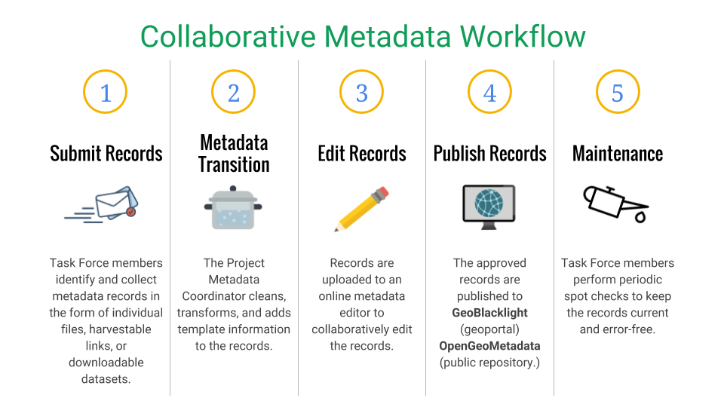
Notes:
The OpenGeoMetadata project, which is an attempt to use crowdsourced metadata to increase the findability of geospatial metadata, which then increases the ability of researchers to use it, has a really good workflow that could be adapted to library use. First, the data is submitted, then cleaned and cataloged by a professional, the records are put up for collaborative editing, then they are finished, published, and maintained by professionals. This workflow has professional interventions at the pivotal moments, while still allowing for many people to contribute to the data.
These projects brings two types of experts together: archivists and special collections librarians AND members of the community who can help to build understanding of the culture that produced and artifact and thus the artifact itself.

Slide 13
CONSIDERATIONS
Cataloging metadata is standards-based and it works well
Library metadata is changing along with the wider world of searching
Critically looking at the ways in which we catalog information benefits the entire academic community
Working with our communities to improve knowledge helps to center the library within the information ecosystem and to build productive relationships

Slide 14
CLASSIFICATION:
CASE STUDIES
HISTORIC VS. MODERN – COMMUNITY & SOCIAL JUSTICE
Notes:
Collections are only useful if the people are able to find what they need.
This simple principle has guided the cataloging and classification of materials, often in Library of Congress or Dewey, for decades.
These systems, far from being neutral, embed the cultural biases of their creators and the people who have been tasked with maintaining them into the subject headings, call numbers, and the physical placement of the materials in the collection.
Dewey Decimal and Library of Congress Classification systems organize resources by concept, in part for the purpose of assigning call numbers.
These two systems account for over 95% of classification in libraries in the US, and are used widely around the world.

Slide 15
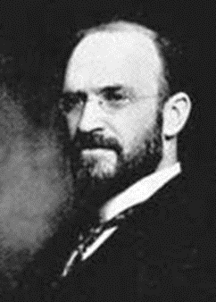
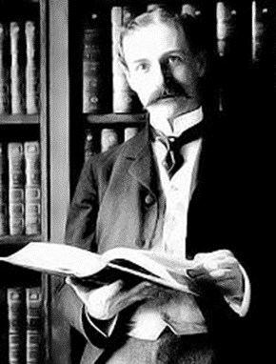
CATEGORIZING BOOKS
G. HERBERT PUTNAM
1861 – 1955
LIBRARY OF CONGRESS 1897
“MELVIL DUI”
1851-1931
COPYRIGHTED
HIS SYSTEM 1876
Notes:
Dewey work in the library as an undergraduate at Amherst College. After graduating he was hired to manage the library and reclassify its collections.
While the Chief librarian at Columbia University, he established the first program for training librarians. He was also director of the New York State Library.
Putnam went to Havard and studied law at Columbia University.
City Librarian for Minneapolis where he created the Putnam Classification System and director of the Boston Public Library. Before being appointed to Librarian of Congress
Both born mid-19th century. Educated at prestigious institutions. Had a big impact on the field of librarian. White men who married and procreated.
Dewey Decimal system
Dewey created a new scheme of knowledge based on one by Sir Francis Bacon 300 years earlier.
Bacon developed a system for the cataloging of books by dividing them into 3 categories —history, poetry, and philosophy that could be further divided into more specific subjects and subheadings.
DDC organizes library materials by discipline. Into a few more divisions include philosophy, social sciences, science, technology, and history.
The scheme comprises 10 classes, each divided into ten divisions, each having ten sections.
Library Of Congress - LC
LCC has been criticized for lacking a sound theoretical basis; many of the classification decisions were driven by the practical needs of that library rather than epistemological considerations. That is, it provides a guide to the books actually in one library's collections, not a classification of the world.

Slide 16
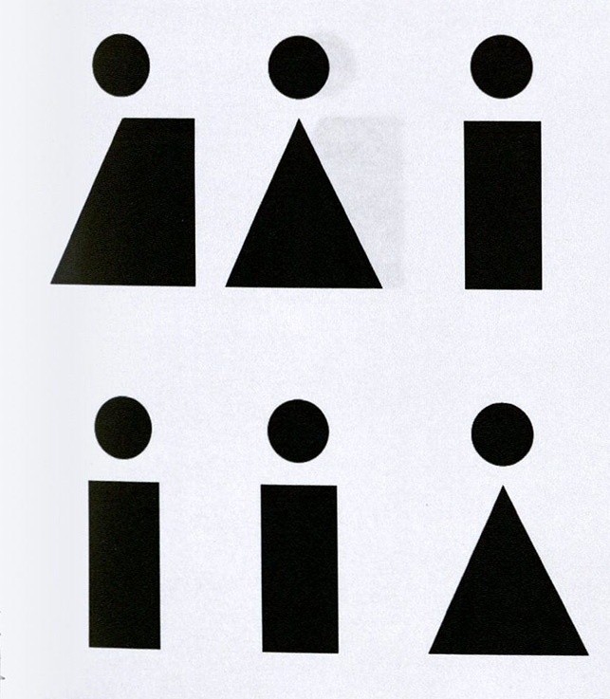
BIAS IN CLASSIFICATION SYSTEMS
- Bias towards the language, culture and perceptions of founders
- Treatment of topics
Trans (New York, N.Y.: Jarret Key, 2017)
Notes:
These classification schemes reflect the perspectives of their white, cis male creators and, far from being neutral, also embed the cultural biases of the people who have been tasked with maintaining them into the subject headings, call numbers, and the physical placement of the materials in the collection.
DDC treatment of homosexuality
In 1932 topics relating to homosexuality were first added to the system under 132 (mental derangements) and 159.9 (abnormal psychology).
In 1952 homosexuality was also included under 301.424 (the study of sexes in society).
In 1989 it was added to 363.49 (social problems), a classification that continues in the current edition.
In 1996 homosexuality was added to 306.7 (sexual relations) which remains the preferred location, although books can also be found under 616.8583 (sexual practices viewed as medical disorders),
DDC treatment of religion
The subject of religion heavily favors Christianity by designating nearly the entire 200s for it with only the 290s set aside for all other religions,
Islam is DDC 297 - a single digit associated with it
DDC treatment of women
The topics of women have had bias in them as well. Originally, the topic on women was next to etiquette. Those two adjacent associated women with etiquette rather than etiquette being gender neutral. This has subsequently been changed (DDC version 17).

Slide 17
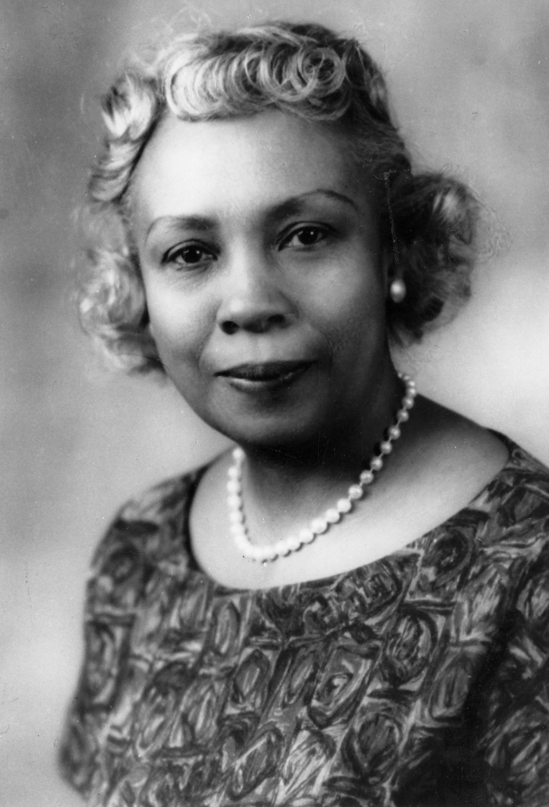
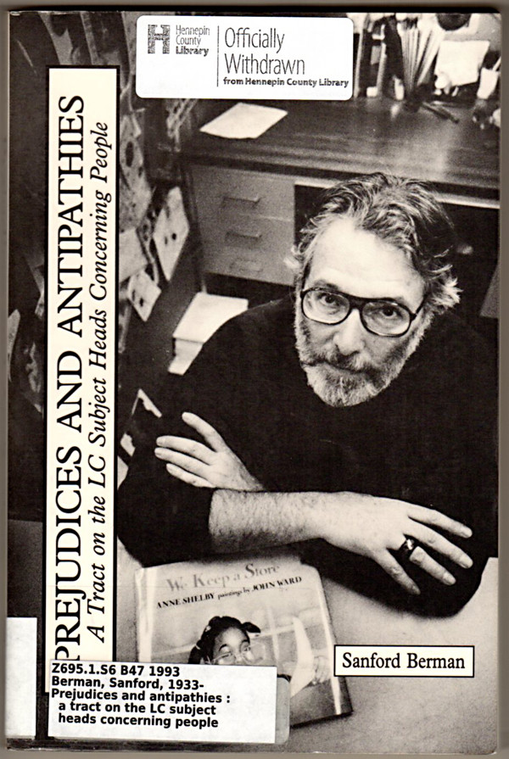
INCLUSIVE METADATA
Dr. Dorothy B. Porter Wesley
Howard University
Sanford Berman
Hennepin County Libraries
Notes:
Dr. Dorothy Porter was put in charge of the growing collection of African-American works at Howard University’s Moorland- Springarn collections, but found that works by African Americans were put into only two Dewey classes: 325 for “international migration and colonization” and 326: Slavery and emancipation. She recognized that this wouldn’t work for her collection, and developed a new classification specifically for their collection, working on the effort of women working in the library before her.
Sanford Berman’s 1971 monograph Prejudices and Antipathies: A tract on the LC Subject Headings concerning people” has been responsible for at least 145 changes to the LC Subject Headings, including things like the “Jewish question” which was deleted, and “Gipsies, rogues, and vagabonds” which now is “Romanis”. These changes helped to eliminate some really egregious subject headings and matched the changes in discourse that have taken place over the decades.

Slide 18
BIAS IN LCSH
Interdisciplinary concerns & what is shelved together
Default assumption is person is male & white
  “Astronauts”
  - “Women astronauts” and
  “African American women astronauts”
  but no subject heading for male astronauts
Trans (New York, N.Y.: Jarret Key, 2017)
Notes:
I. Browsing
Common practice for librarians to tell patrons to scan the shelves surrounding a book that is of interest for other similar books -- a valuable technique for finding materials one might have passed over in a catalog search.
Not a robust option for interdisciplinary research where materials are scattered across LCC and therefore also scattered across the physical space of the library
Nearly impossible to browse
May ultimately result in abandoning library resources altogether
Examples include African American studies, women’s studies, cultural studies, Sociology, Anthropology and so on. The dispersement of there resources makes it more difficult to visualize the scope of a topic.
II. Search terms
Selecting keywords and determining subject headings are even more important for obtaining results in interdisciplinary research.
Choosing search terms can be a difficult decision and highlight historical terms that are no longer acceptable.
Terms may conflict with personal identity of the researcher.

Slide 19
BIAS IN LCSH: PART 2
Outdated and biased terminology
“Negro,” “miscegenation,” and “Black Muslims”
“Colonial orientation”
“Employment of minority women”
Prioritizing certain subjects over one another
Reliance on “literary warrant”
Headings that may cause offense to some members of a group, but not others
Grouping people and cultural references under an umbrella term legitimizing their marginalization
Trans (New York, N.Y.: Jarret Key, 2017)
Notes:
Catalog records offer many features that full text scanning do not.
Authority controlled subject headings and names, alternate titles, scope notes, and marc – ensuring reliable fields and relevant data.
These aid in the ranking of resources.
And there are some issues …

Slide 20
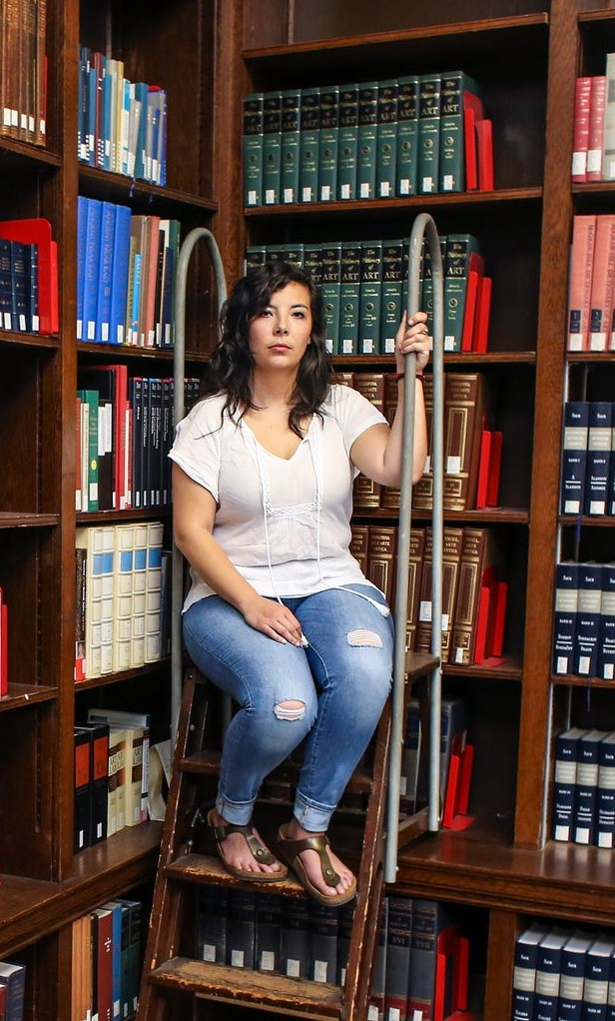
2014 – Dartmouth students at Coalition for Immigration Reform, Equality
and Dreamers, work with librarian to develop a proposal to the Library
of Congress to change the subject heading “Illegal Alien”
March 22, 2016 – Library of Congress decides to replace “Illegal Alien”
with “Noncitizen”
June 10, 2016 – Congress passes an appropriations bill that requires the
Library of Congress to continue to use the subject heading “illegal alien”
2016 – Librarians are adding subject headings to the catalog either in
addition to this heading or replacing it to make the change locally
Notes:
This trend ebbs and flows since the inception of the catalog, and I think we are currently in a time where it is again coming to the forefront of cataloging practices in academic libraries. A current case that is the case of the use of “Illegal Alien” as a subject heading for unauthorized immigrants. A group of students at Dartmouth noticed this offensive subject heading and, with the help of a Dartmouth librarian and the support of the library community, successfully petitioned the Library of Congress to change the subject heading to “noncitizen.” Four members of Congress then stepped in and used language in an appropriations bill to bar the change to the heading. BUT libraries were undeterred and there is an effort to make the change locally in library catalogs around the country. In many cases, in accordance with PCC rules, the original heading is left in place, but it is supplemented by the more inclusive heading, although some non-PCC libraries are opting to replace it entirely.
Libraries strive to welcome everyone, and I think by finding out the identities that might be marginalized in your community, concrete actions can be taken to ensure that the library is welcoming to them. Part of that is making sure that they aren’t taken to outdated or offensive subject headings when doing research.
According to Steven Knowlton, “By utilizing the language and perspective of a particular group of readers, rather than seeking a more neutral set of terms, LCSH can make materials harder to find for other users, stigmatize certain groups of people with inaccurate or demeaning labels, and create the impression that certain points of view are normal and others unusual” (p. 125).
In addition, updating the subject headings allows us to keep up with the movements of language within the research communities that we serve. These changes can come from our knowledge of the community and we can also find out about them by pulling the common searches in our systems and comparing them to the subject headings that we are currently using.

Slide 21
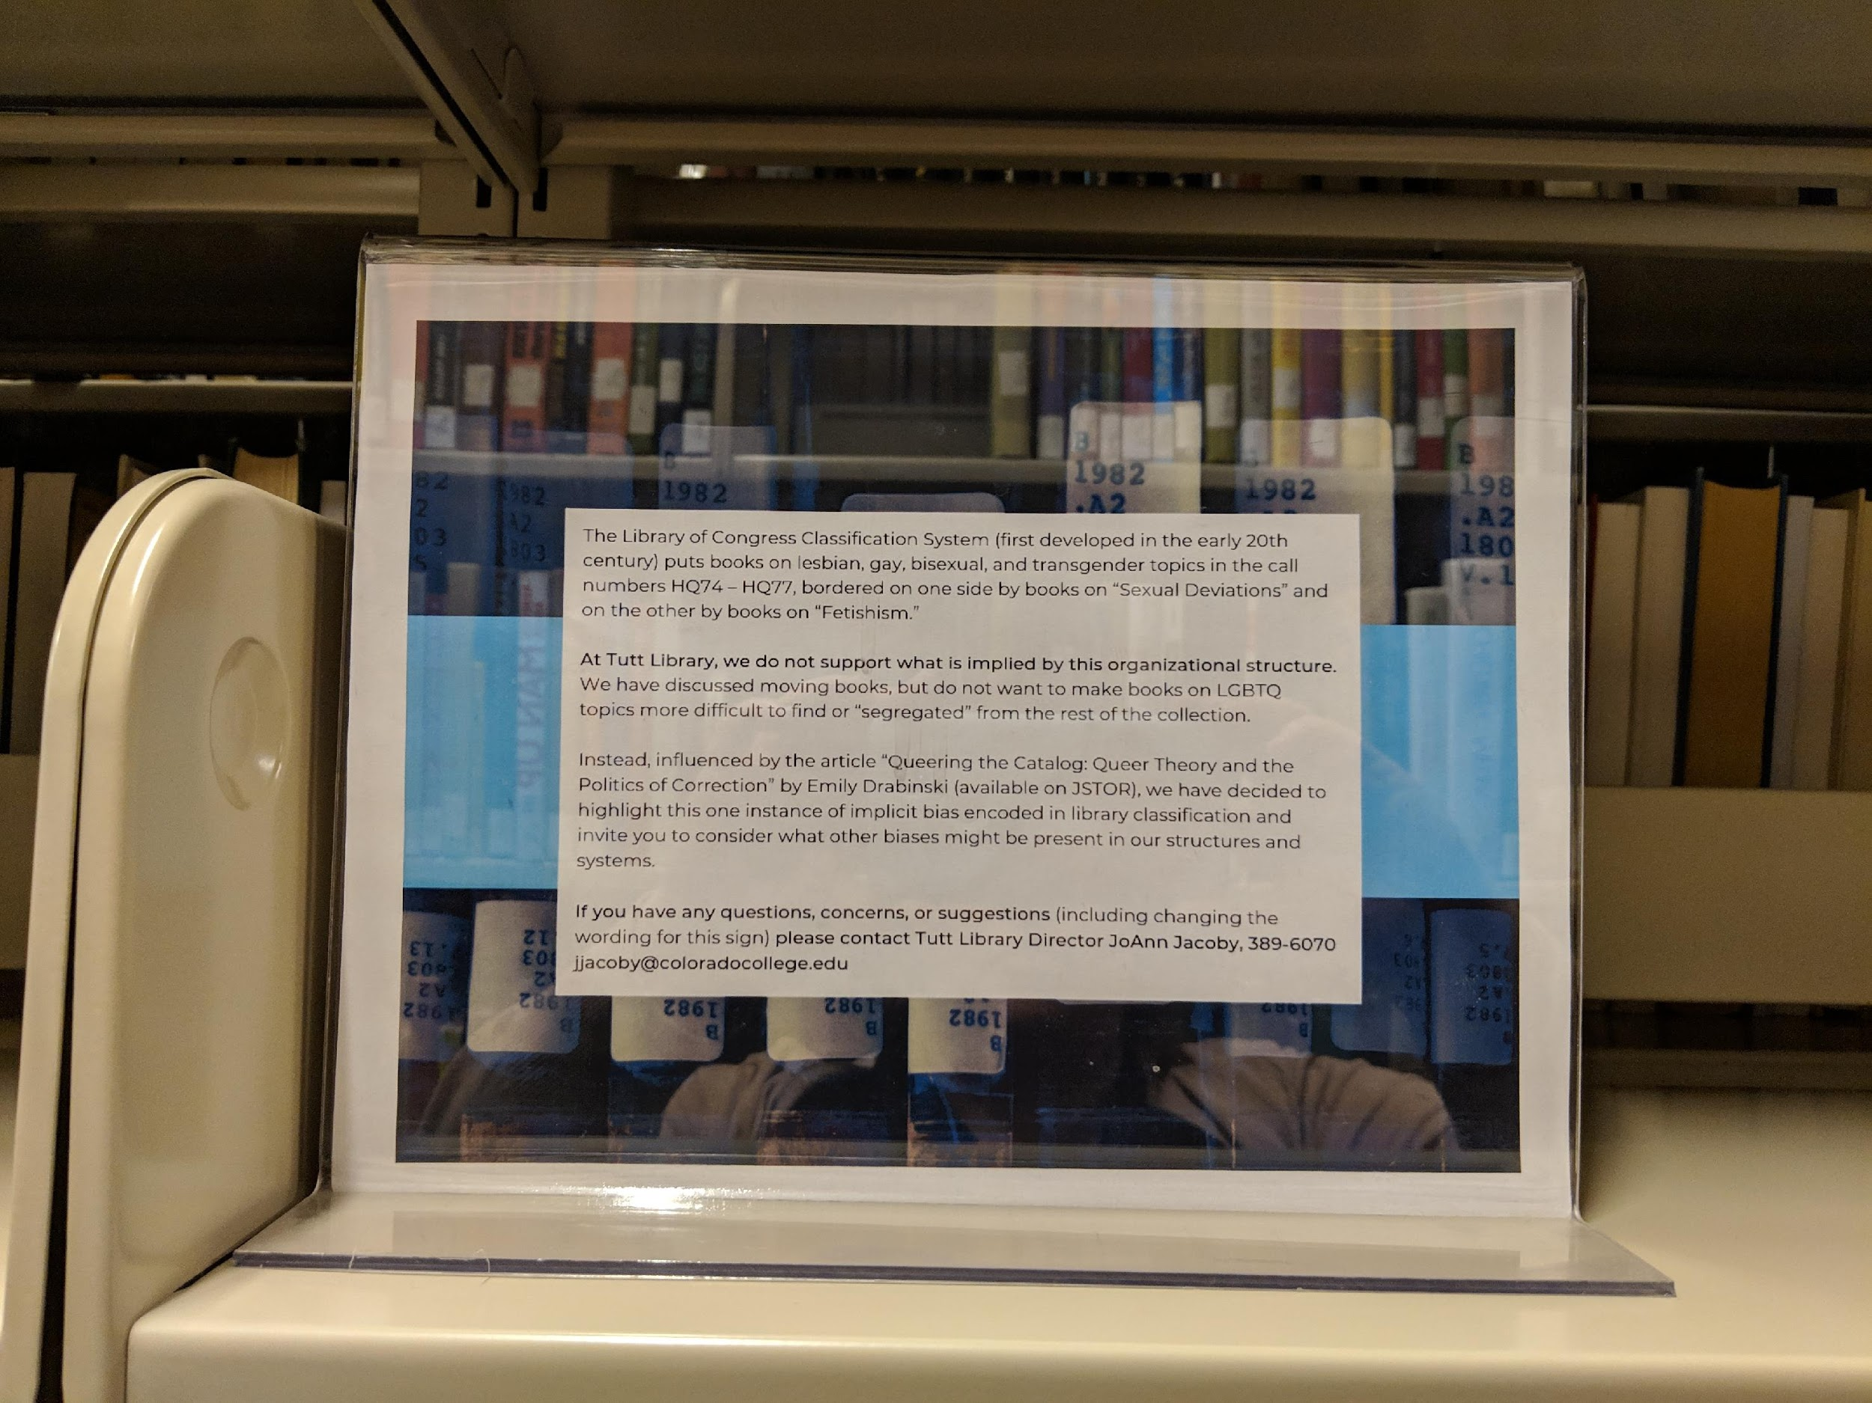
CLASS H CONTAINS THE SOCIAL SCIENCES. SUBCLASS HQ IS LISTED AS “THE FAMILY. MARRIAGE. WOMEN.”
HQ1-2044 The Family. Marriage. Women
HQ12-449 Sexual life
HQ19-30.7 Sexual behavior and attitudes. Sexuality
HQ31-64 Sex instruction and sexual ethics
HQ71-72 Sexual deviations
HQ74-74.2 Bisexuality
HQ75-76.8 Homosexuality. Lesbianism
HQ77-77.2 Transvestism
HQ77.7-77.95 Transexualism
Notes:
CC & student case
This past fall, students at Colorado College noticed that the books on LGBT issues were shelved next to books on sexual deviations.
Working with the students and the Butler Center, the campus center dedicated to equity and inclusion, the Library decided to keep some books in their current locations and reclassify some others.
Interpretive signage was also posted to educate the library users about biases and to highlight the problematic placement in the classification schema as well as to reassure students.
This allows the materials to still be findable, highlights our focus on supporting all of our patrons, and brings patrons into the larger conversation taking place in the library field about how our classification and cataloging choices can help to support diversity and inclusion if we are willing to interrogate the system.

Slide 22
CHANGES TO THE LCSH
1972, LGBT subjects have been distinguished and classed under “Sexual minorities” rather than “Sexual deviations,”
[“Sexual deviations” no longer exists as a subject heading]
in the late 1970s, “Afro-Americans” replaced “Negroes”
and replaced by “African Americans” or “Blacks” in 2000
2001, “People with mental disabilities” replaced “Mentally handicapped” and “Retarded persons”
Notes:
Even when subject headings are updated using current socially acceptable terminology, these terms still fall into the gap between representation and meaning. Categorization separates that thing from something else and thus creates an other.
In addition to Illegal alien which has been discussed here are a few more LCSH.

Slide 23
COMMUNITIES
Subject Authority Cooperative Organization of the Program for Cooperative Cataloging (SACO) - allows multiple cataloguers to weigh in on subject heading changes in an attempt to make the language of cataloguing more inclusive
Mashantucket Pequot Thesaurus of American Indian Terminology Project
- controlled vocabulary restoring authority to marginalized communities
Truth and Reconciliation Commission (TRC), Canada
- integrate Indigenous knowledge into information retrieval systems in a respectful and culturally appropriate way -- access information about the culture according to how and when it is meant to be accessed
Notes:
Naming other cultures grants authority to the group who has the power to name them.
Naming is a means of controlling the subject being represented.
It shapes the other’s identity by imposing experiences and reality onto a group of individuals. And it controls access through the process of naming.
In order to decolonize marginalized peoples and cultures, these cultures must be invited to participate in naming themselves so that they can be properly represented in organizational systems.

Slide 24
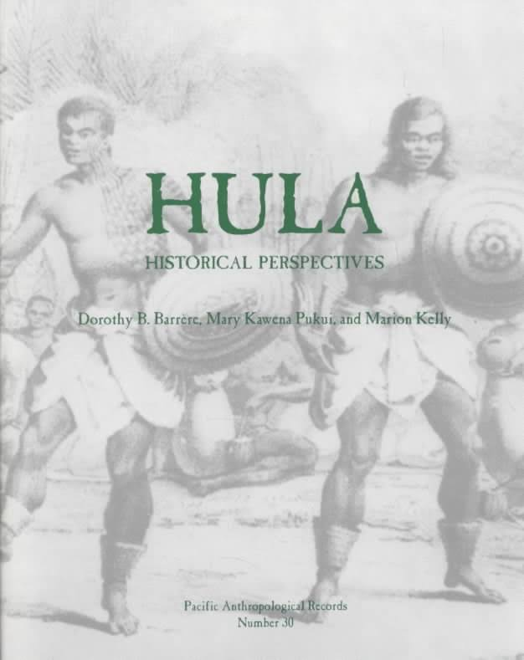
The Kanaka Maoli (Hawaiian) Hula
Provides a cultural memory and history to be passed on through generations
Has a political significance in Hawaiian history
So how do we classify materials on the Hula?
Notes:
The Kanaka Maoli (Hawaiian) Hula dance holds historical, cultural, and even genealogical significance in Hawaii’s history. Stillman (2001) states that “Hula is inherently a site of cultural memory, not only in the act of performance, but in the entirety of its practices of archiving knowledge of the past (p. 188). Imada (as cited in Hajibayova and Wayne, 2017, p. 1138) noted at “Hula dances were guardians of Kanaka Maoli historiography, cosmogony, and genealogies, undergoing ritualized training to reproduce and transmit knowledge for high-ranking chiefs.”
When Calvinist missionaries arrived in Hawaii, the Calvinists made attempts to suppress the Hula, but were met with resistance from Hawaiian monarchs (Kamahele, 1992). Given the complexity of the Hula, cataloger can easily misrepresent and “[diasporize] the representation of Hawai’i” (Hajibayova & Wayna, 2017, p. 1144).
An excerpt from the introduction of this title reads: "An exposition of the hula as described and depicted from the period of first European contact to modern times, including: the hula in myths and legends, with particular attention to Hi`iaka; records of performances in the 18th and 19th centuries, with contemporary illustrations; essays by Mary Kawena Puku`i, with texts of ancient chants and descriptions of early 20th century performances; an assessment of the Kë`ë sites, traditionally associated with hula, and of their use by present-day performing groups on Kaua`i, the island that receives considerable emphasis in this volume."

Slide 25
Hula, Historical Perspectives
Would you classify it under:
The Bible—General—Texts and versions—Modern texts and versions—Non-European languages—Languages of Oceania and Australasia (Austronesian, Papuan, and Australian), A-Z—Hula (BS335.H8)
Recreation. Leisure—Dance—Special dances, A-Z—Hula (GV1796.H8)
Languages of Eastern Asia, Africa, Oceania—Languages of Oceania—Austronesian, Papuan, and Australian languages—Austronesian—Oceanic languages. Eastern Austronesian—Micronesian and Melanesian languages—Special languages—Halia - Iai—Hula—Language (PL6248.H84-.H8495)
Notes:
The class numbers listed on this slide were returned after searching ClassWeb for the keyword “Hula.” In a record created by the Library of Congress, the LC call number used is in the GV1796.H8 classification.

Slide 26
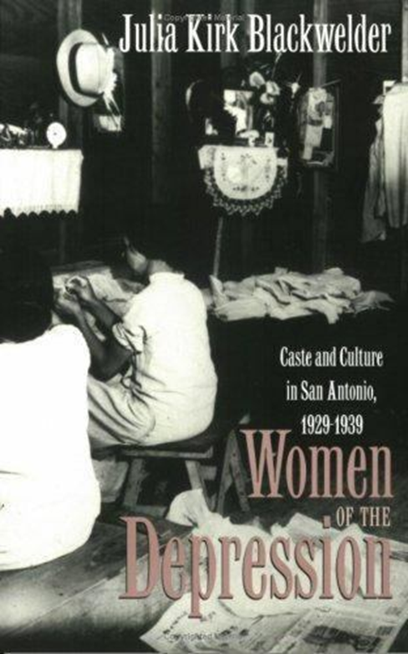
“WOMEN OF THE DEPRESSION: CASTE AND CULTURE IN SAN ANTONIO, 1929-1939”
Would you classify it under:
women’s history,
Depression of 1929,
Texas history
or somewhere else?
Notes:
Libraries and information seekers are more connected than ever.
Resource discoverability is the essential function of the catalog.
Think of Amazon and it’s ranking, relating and recommending.

Slide 27
AS PEOPLE INTERACT WITH A LIBRARY,
NOT ONLY WILL THEY LEARN FROM THE MATERIALS THEY ARE USING,
BUT THERE CAN ALSO BE THE SIDE EFFECT
OF LEARNING FROM SIMPLY BROWSING
FOR THEIR MATERIAL.
Can We Avoid Biases in Library Classification Systems?
By keneilb, LIS Theory
Notes:
Academics is about learning,

Slide 28
DISCUSSION:
Cataloging collections for discoverability without insult.
Group decision:
a. Small groups share ideas and report to the whole group,
creating a list of best practices
b. Or entire group discuss

Slide 29
Familiar ourselves with the different collections and classification systems
Engage staff in critical self-reflection to understand our biases and the effect they have on work and organizational contexts
Attune to biases, hierarchy and conflict - do certain books fit their categorization? are books missing?
- do books de-legitimize their classification systems or reinforce them?
Awareness of cultural differences and sensitivities when choosing words for both subject headings and descriptions
Listen to people of marginalized identities in order to create an environment that will not alienate, be they as library professionals, library users, or potential library users
Partner with groups and people from the community to better understand collections and materials
Employ an ethics of “information justice” that includes caring and benevolence not to erase power dynamics but rather embraces individuals with marginalized identities to feel cared for in what may be difficult dialogs surrounding their experiences
Acknowledging libraries’ institutional histories in the US and understanding racism and oppression as systemic phenomena, including individual, institutional, and cultural interconnected levels of racism

Slide 30
REFERENCES
L Byrne, L Kassir, H Khaireh, and H Lamara. (2019). “The library examined: A workshop collaboration between OOMK, Thick/er Black Lines and Senate House Library”. Art Libraries Journal. Retrieved from cambridge.org
A. K. Stillman. (2001) Re-Membering the History of the Hawaiian Hula. In J. M. Mageo (Ed), Cultural Memory: Reconfiguring History and Identity in the Post Colonial Pacific (pp.187-204). Honolulu: University of Hawai’i Press.
E. Drabinski. (2013). “Queering the Catalog.” The Library Quarterly: Information, Community, Policy. 83 (2), pp. 94-111.
D. Floegel, and L. Jackson. Recasting an Inclusive Narrative. Retrieved from ala.org
L. Hajibayova and W. Buente. (2017). “Representation of Indigenous Cultures: Considering the Hawaiian Hula”. Journal of Documentation. 73 (6), pp. 1137-1148.
S. Howard and S. Knowlton. (2018). “Browsing Through Bias: The Library of Congress Classification and Subject Headings for African American Studies and LGBTQIA Studies”. Library Trends 67 (1), pp. 74-88.
H. Kamahele. (1992). “Hula as Resistance”. Forward Motion. 2 (3), pp. 40-46. Retrieved from http://hegemonystudies.org/wp-content/uploads/2018/07/Kamehele-Hula-as-Resistance.pdf
C. Vaughan. (2018). “The Language of Cataloguing: Deconstructing and Decolonizing Systems of Organization in Libraries.” Dalhousie Journal of Interdisciplinary Management. 14. Retrieved from djim.management.dal.ca

Slide 31

QUESTIONS?
THANK YOU!

