Slide 1

Creating a Diversity, Equity & Inclusion Mini Collection
Lisa Blake Head Reference & Instruction Librarian
Arapahoe Community College
lisa.blake@arapahoe.edu
@librarianlisaCO
#CODIworkshop
#DEIminicollection

Slide 2

How It All Began…
The Inclusive Excellence Council (IEC) was looking for a space to provide resources for council members and the ACC community
How about the Library?!?!

Slide 3
The Next Steps…
Asked members of the ICE for resource recommendations
Assessed our current collection holdings
Allocated grant money to the purchase
Invited to collaborate with the Ethnic Literature class in the Fall 2018 semester

Slide 4
Creating the Collection...
Assessed what we already owned with strong emphasis on History, Social Sciences & Fiction
Decided what we wanted to highlight in the DEI mini collection:
Non-fiction on all groups
Non-fiction resources for allies
Narratives of people from underrepresented groups
1st Generation College Student & Immigrant stories
Educational resources surrounding the learning of underrepresented & marginalized groups
Fiction, Literature & Biographies
Still added to the collection in the main stacks

Slide 5
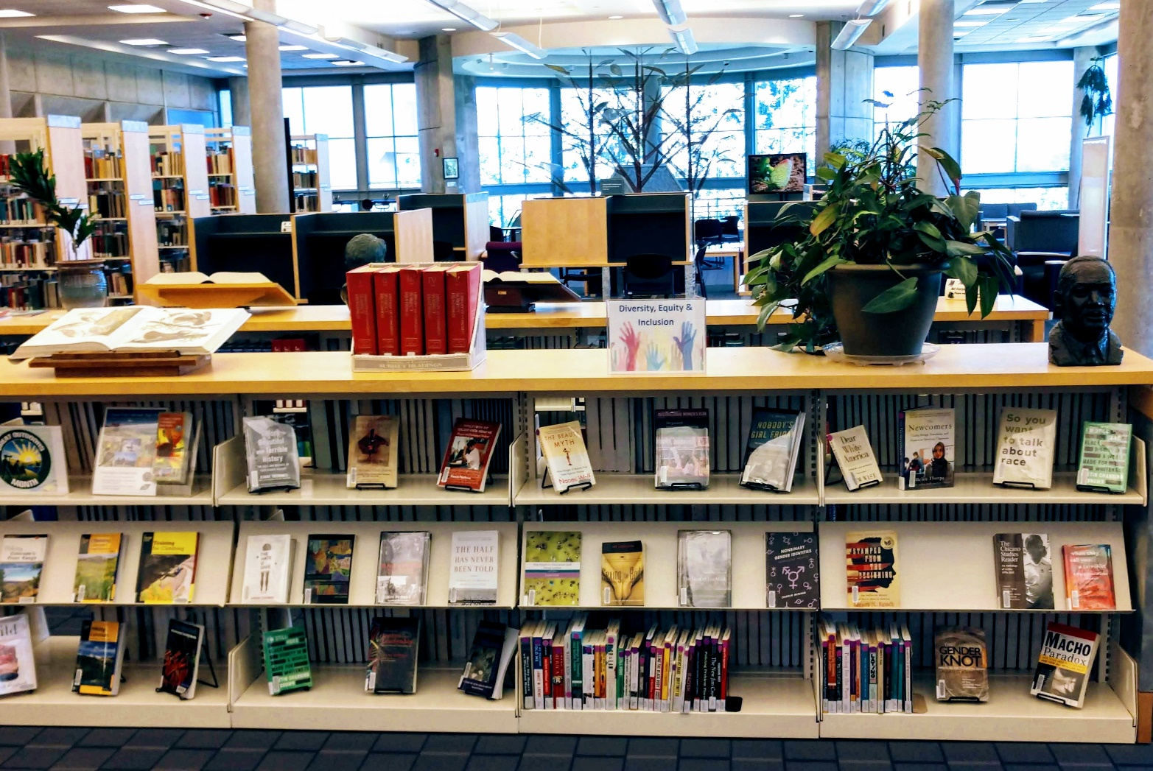
The Diversity, Equity & Inclusion Mini Collection was born!

Slide 6
Moving Forward
Continually adding titles and resources to the DEI Collection
Creating a Diversity & Inclusion Statement for the Library that will include a collection development procedure
Evaluating our criteria for selecting new resources
Continued collaboration with the Ethnic Literature class
Attending awesome summits, conferences, workshops & webinars ☺

