Slide 1
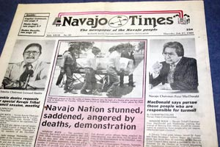
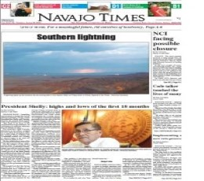
American Indian Newspapers
In defining our approach to terminology, we consulted many sources such as the First Archivists Circle ‘Protocols for Native American Archival Materials’ and took advice from indigenous editorial board.
Project intended to be a resource from the perspective of the nations and communities represented
Developed in close collaboration with consultant editors and archivist Erin Fehr (Yup’ik)
Development Editors met with dozens of Tribal Councils in order to secure copyright and community support
Resource available for free to all Tribal Colleges and Universities in North America.

Slide 2
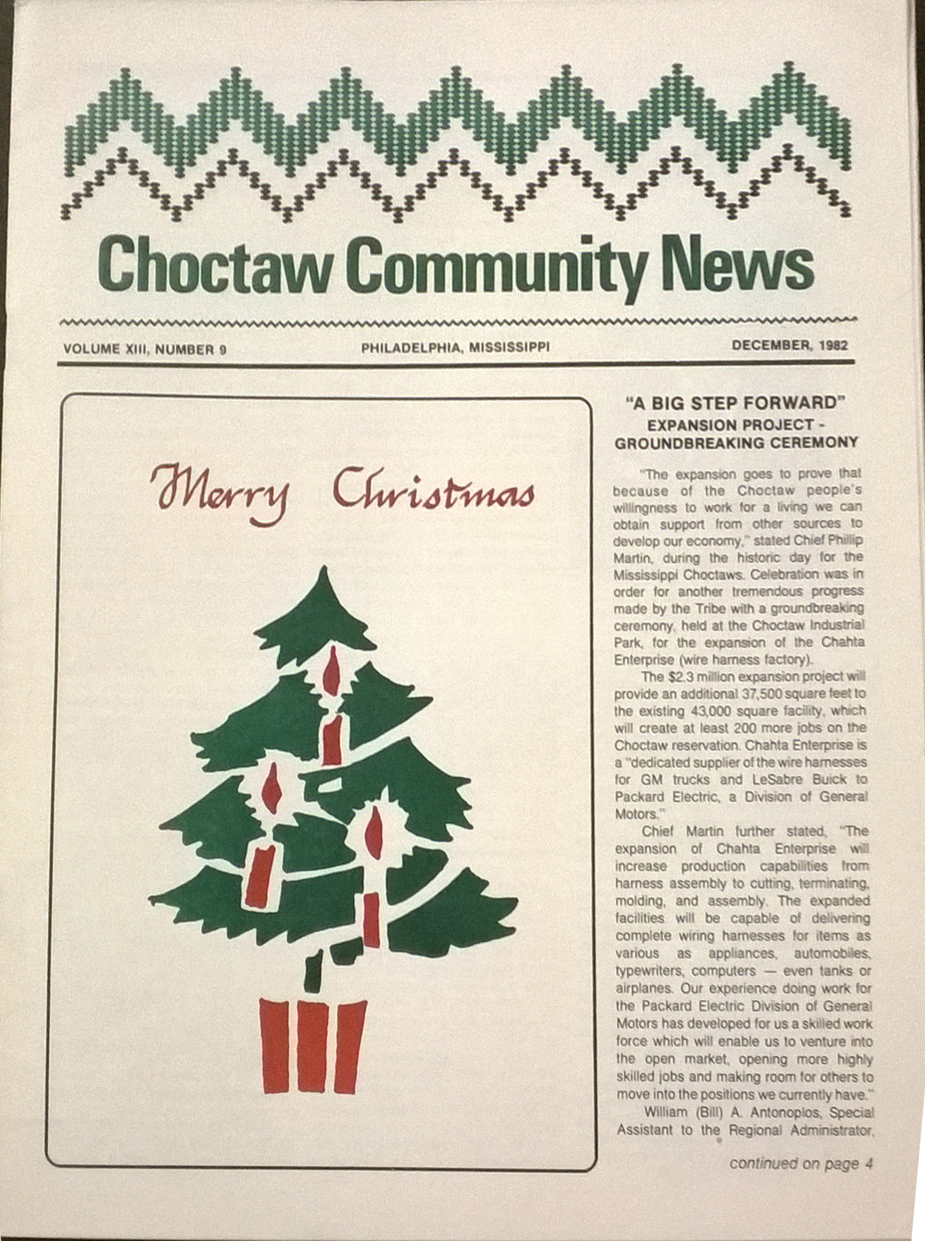
AIN Highlights
Community support
Huge runs of newspapers such as the Navajo Times (3291 editions)
Large date range (1828-2016), evolution of representation and political climate
High profile nations – Sioux, Cherokee, Navajo, Osage, Chippewa
Marginal perspectives – small nations/communities, Hawaiian language, Indian schools, political publications
Indian Trader – American Indians’ views of American Indians on film and television

Slide 3
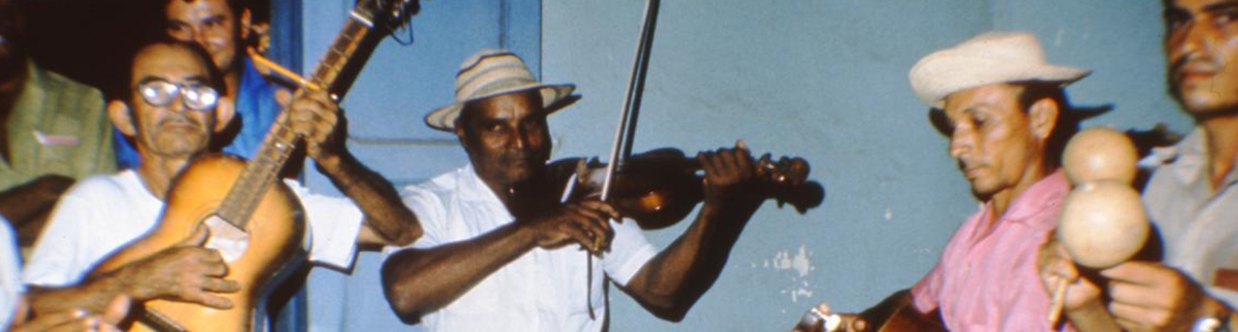
Ethnomusicology
Adam Matthew are digitising a large portion of UCLA’s Ethnomusicology archive recordings (Publishing Fall 2019)
Over 4,000 recordings from c. 60 collectors, plus associated field notes and photographs
Digital repatriation provides access for associated institutions in Uganda, the Philippines, Alaska, Puerto Rico, Nigeria and Ghana
Promotional events organised by the archive and Adam Matthew

Slide 4
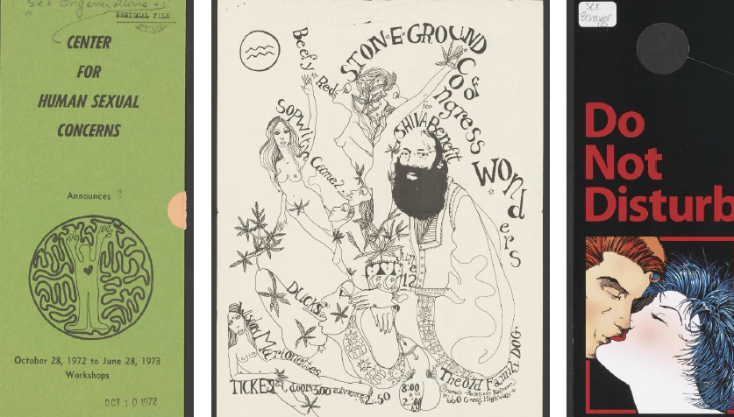
Sex and Sexuality
Key Research Topics:
LGBTQAI+
Transvestitism
Sexual preferences & identities
Gender identities
Polyamory
Gender reassignment
Sexual health
Reproduction
Contraception and Birth control
Sexually-transmitted diseases

