Slide 1
Library Content Comparison
Analyze Diversity & Inclusivity in the Collection

Slide 2
Why collection analysis when we have Prospector?
Prospector works well for looking up individual titles
Prospector doesn’t work well for identifying trends in collection
Prospector shows detailed information about a particular title-availability, circulation status

Slide 3
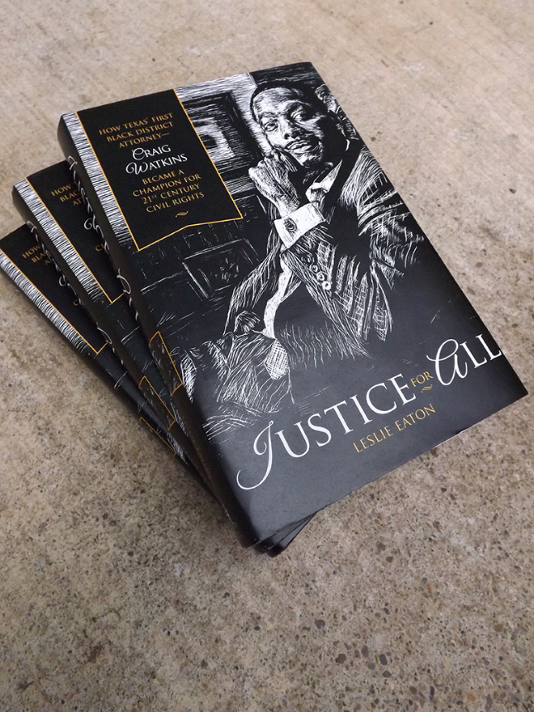
African American Literature-CU vs All
Call number range PS 153-PS 154
Publication 2010-current

Slide 5
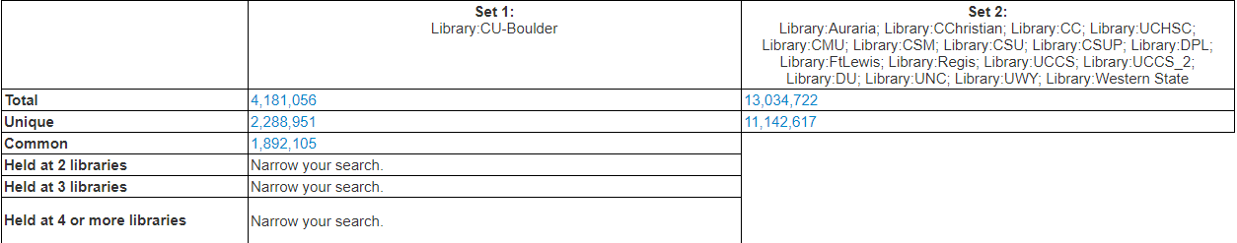
CU Boulder vs. All

Slide 6
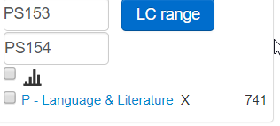
Narrow search to LC call # PS 153-PS 154 & 2010-current

Slide 7
…And Publication Year 2010-2020

Slide 8
645 unique items held by other libraries not owned by CU-Boulder

Slide 9
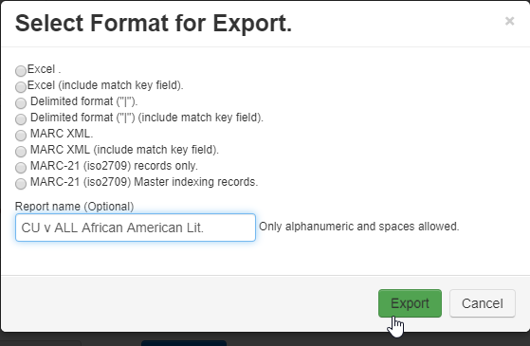
Export Record Set

Slide 10
Results-Excel Spreadsheet

Slide 11
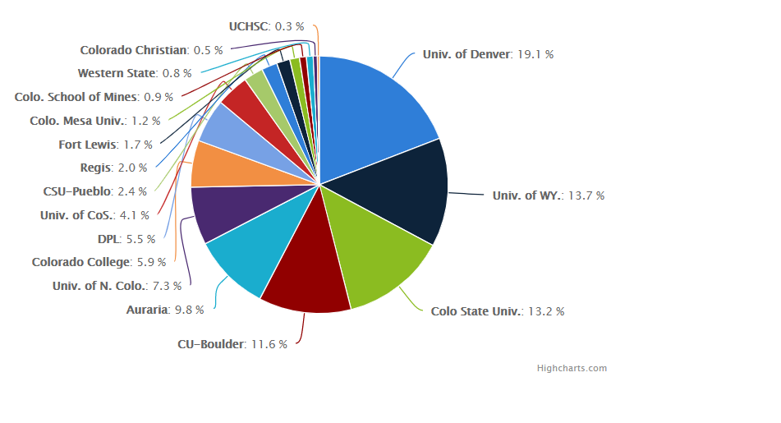
Alliance Libraries-HQ 74-HQ 76.8 Bisexuality & Homosexuality

