Slide 1
Sharing Colorado’s Unique Collections
The Landscape – Opportunities and Challenges

Slide 2
Who Are the Players…
Types of Institutions
Archives
Public Libraries
Museums
Consortia
Universities & ARLs
Community Colleges
Government Agencies
Special Libraries
K-12
Consortia & Societies
CO Alliance
Marmot
CLiC
CSL
CWAM
SRMA
…

Slide 3
What Are the Tools…
CMS/DAM
CONTENTdm
Dspace
DigiTool
Fedora
File Maker Pro
Content Pro
Islandora
Omeka
Past Perfect
Locally Developed
Existing Collections
ADR
Digital Commons
Marmot (in the works)
AspenCat
CHNC
…

Slide 4
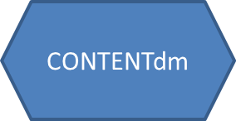
C
C
L
L
L
ADR
Islandora
MARMOT
C
CMS/DAM
L
L
Digital Commons
Aggregator
w/wo discovery layer
SobekCM
CONTENTdm
CONTENTdm
DigiTool
Digitool
CONTENTdm
DPLA
?
DPLA API

Slide 5
ADR
Islandora
C
L
L
CMS/DAM
MARMOT
C
C
L
Digital Commons
Aggregator
w/wo discovery layer
SobekCM
CONTENTdm
CONTENTdm
DigiTool
Digitool
CONTENTdm
DPLA
?
DPLA API

Slide 6
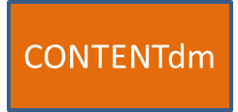
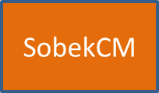
ADR
Islandora
Mountain West Digital Library
Digital Commons
CONTENTdm
?
DPLA
?

