Slide 1
Prospector
Director’s Meeting
10-31-2013
Rose Nelson-Assistant Director
CO Alliance of Research Libraries

Slide 2
Prospector Update 2013
Prospector by the numbers
Denver Public Library update
Longmont Public Library update
Prospector Everywhere
Peer-to-Peer with Mobius consortium

Slide 3
Participating Libraries

Slide 5
Database growth by million

Slide 6
General Statistics
85% fulfillment
Turn around time averages 3.5 days
Annual loss rate ~0.23%
Annual reconciliation but no money is exchanged
Courier
Regional routing initiated in May 2011

Slide 7
Database size and uniqueness
Over 12 million unique MARC records
Over 29 million item records
64.06% held by 1 library
14.18% held by 2 libraries
10.66% held by 3 libraries
4.36% held by 4 libraries
2.93% held by 5 libraries
1.76% held by 6 or more libraries

Slide 8
uniqueness
60%
Held by 1 library
19%
Held by 2 libraries
8%
Held by 3 libraries
4% 4 libraries
2% 5 libraries
1% or less 6 libraries
LC 155.5
MA 649.5
363.3 ME
FIC
MER
121.5cas
QE 313

Slide 9
Prospector lends by year

Slide 10
Top lenders and borrowers 11/12-10/13

Slide 11
Top lenders and borrowers 11/12-10/13
*-also a top lender

Slide 12
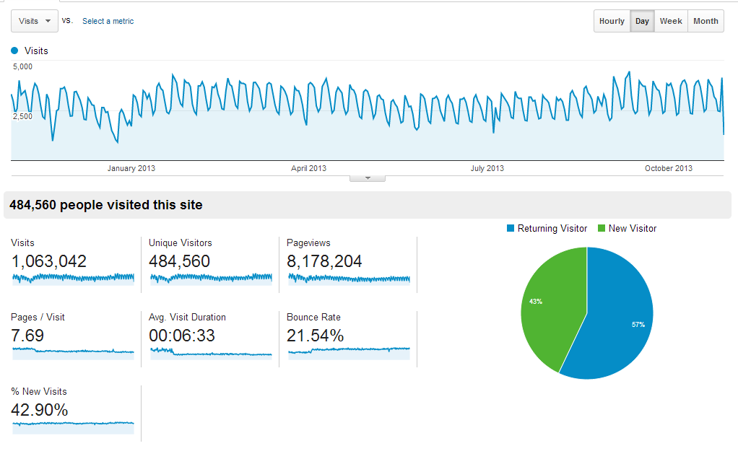
Google Analytics Visits: 11/12-10/13

Slide 13
Mobile Access

Slide 14
Visits by device

Slide 15
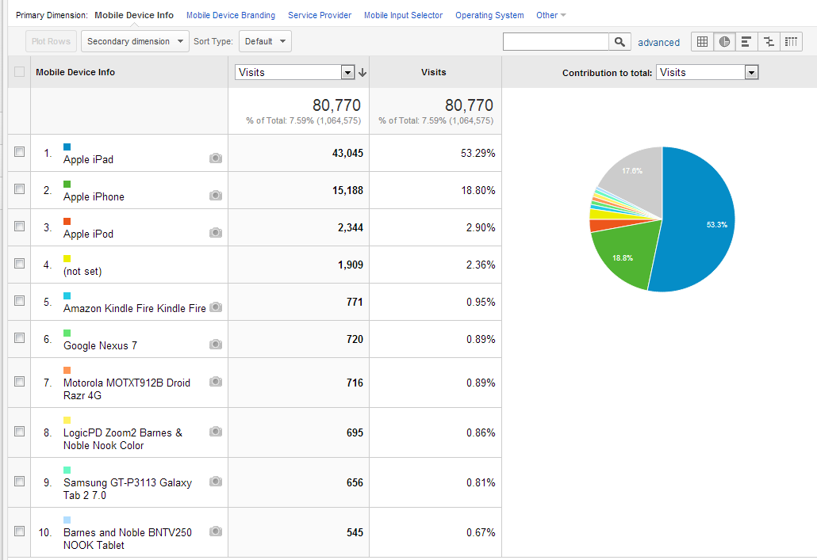
Mobile Devices Accessing Prospector

Slide 16
Denver Update
Denver Public Library adds close to 800,000 items
58% of items are unique
Test borrowing and lending right now
Hope to go live in mid-November

Slide 17
Longmont Update
Live April 2012
SirsiDynix use DCB to connect to INN-Reach
Single library no branches
Adds over 231,000 bib records to Prospector
Net lender in Prospector

Slide 18
Prospector Everywhere
MARC export of Prospector database
Harvests by discovery interfaces-Summon and EDS, available to others
Search from discovery links back to Prospector to authenticate and place hold

Slide 19
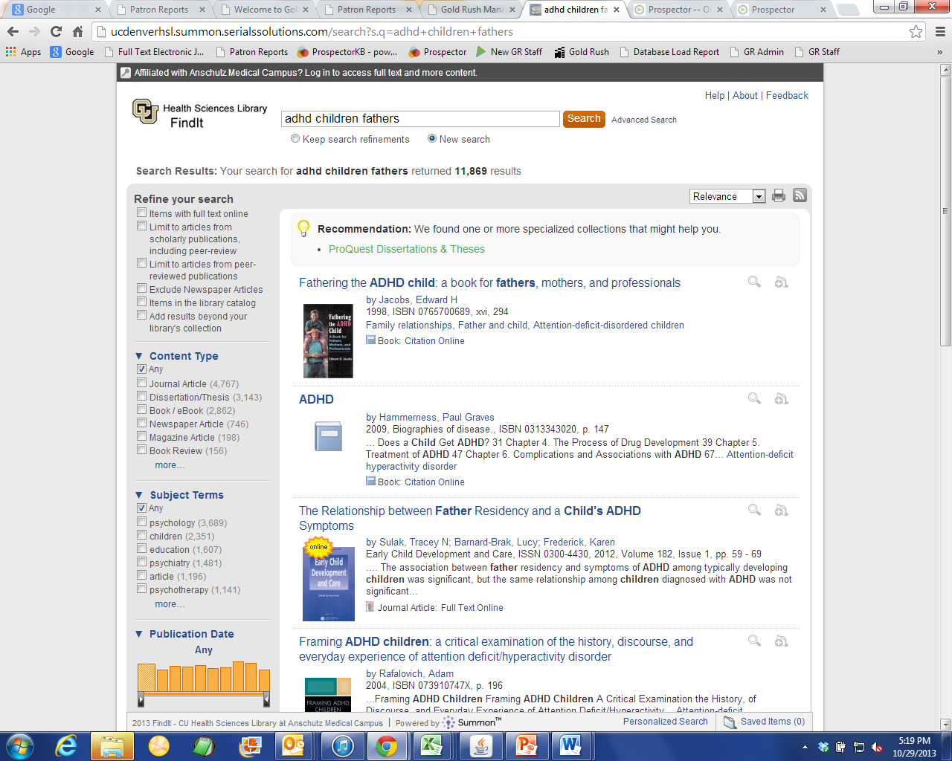
Click on search result from within Summon

Slide 20
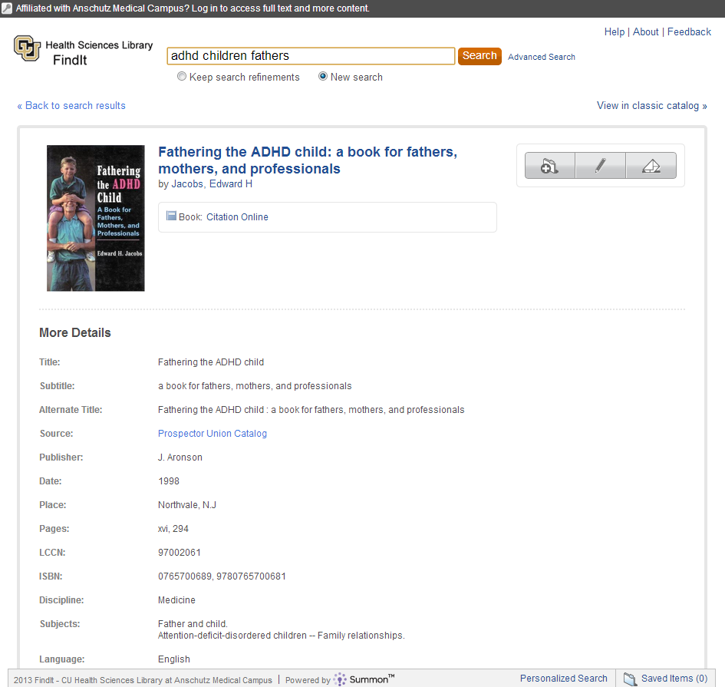
Full record in Summon

Slide 21
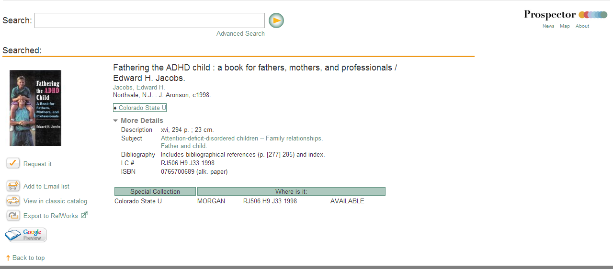
Link to Prospector to request item

Slide 22
Peer-to-Peer with Mobius

Slide 23
What is Mobius?
INN-Reach consortium in Missouri
Non-profit 501c3
61 academic libraries
4 public
2 special
Actively seeking more public libraries

Slide 24
Considerations of Peer-to-Peer
Policies
Courier
Technology

Slide 25
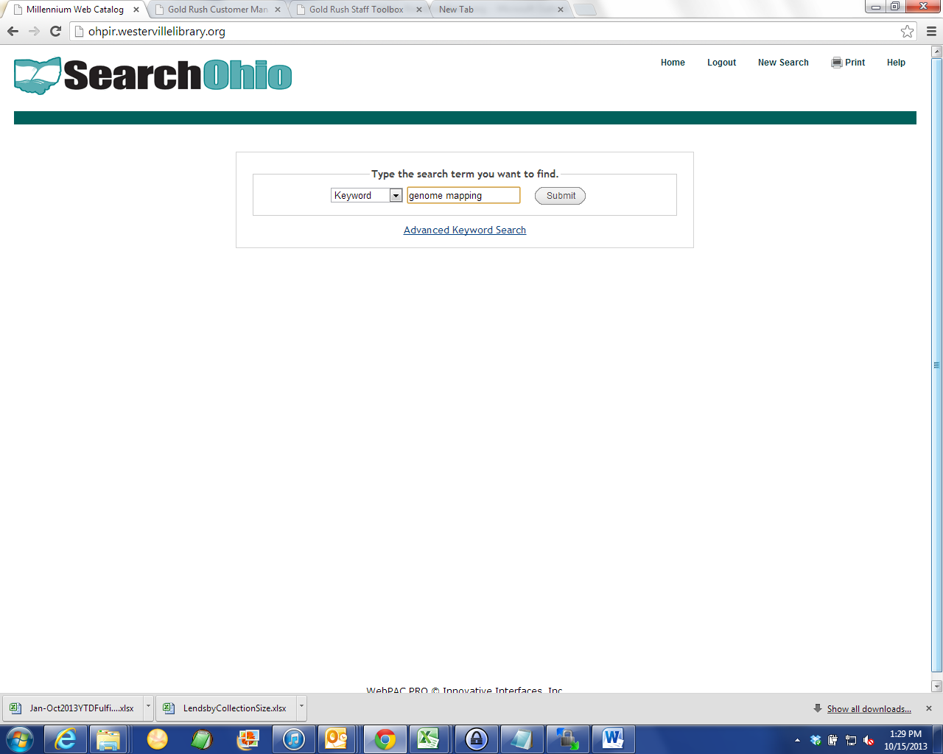

Slide 26
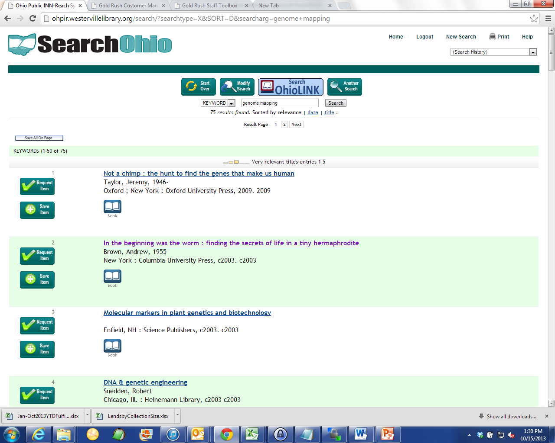

Slide 27
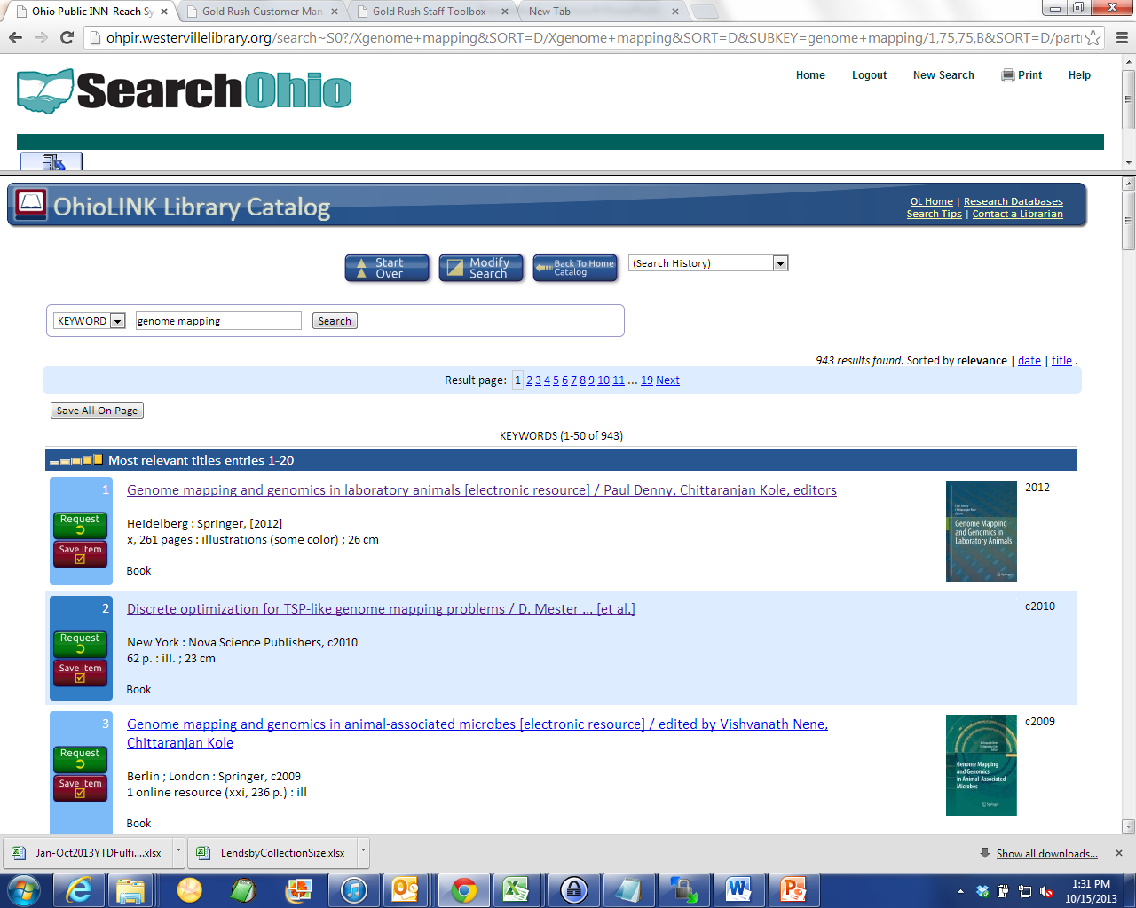

Slide 28
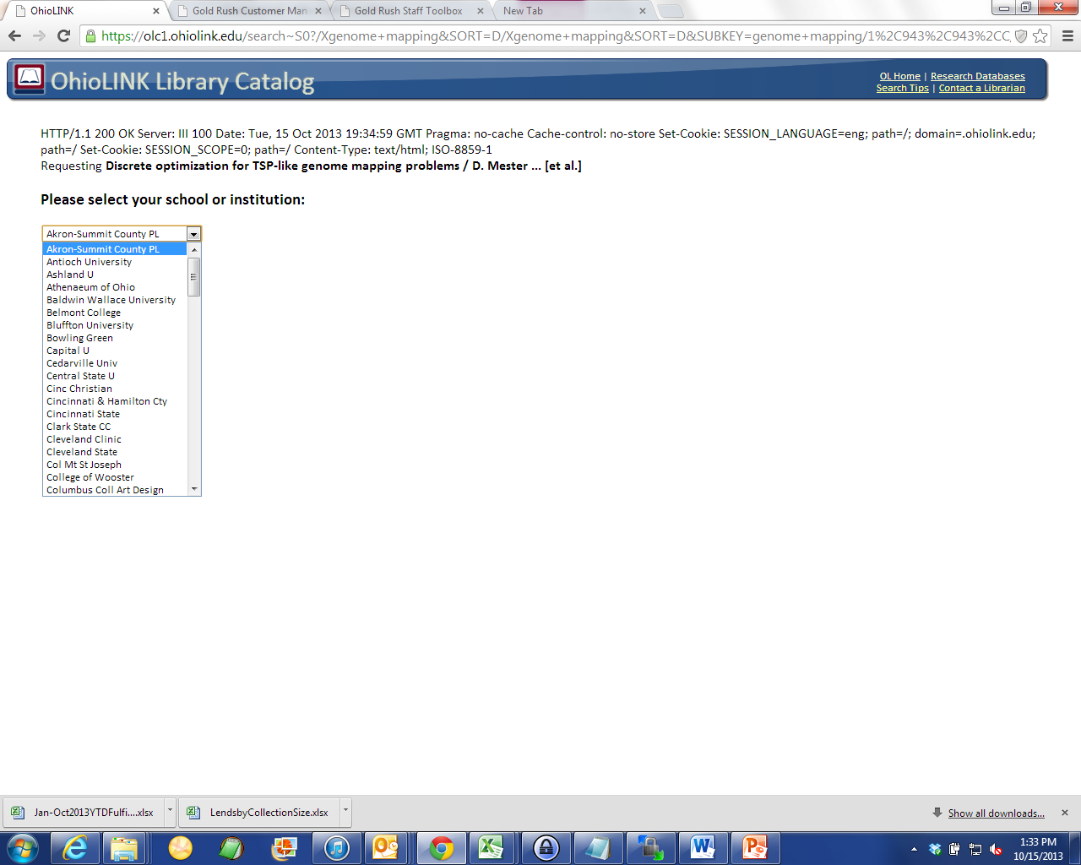
SearchOhio Libraries in drop down box

Slide 29
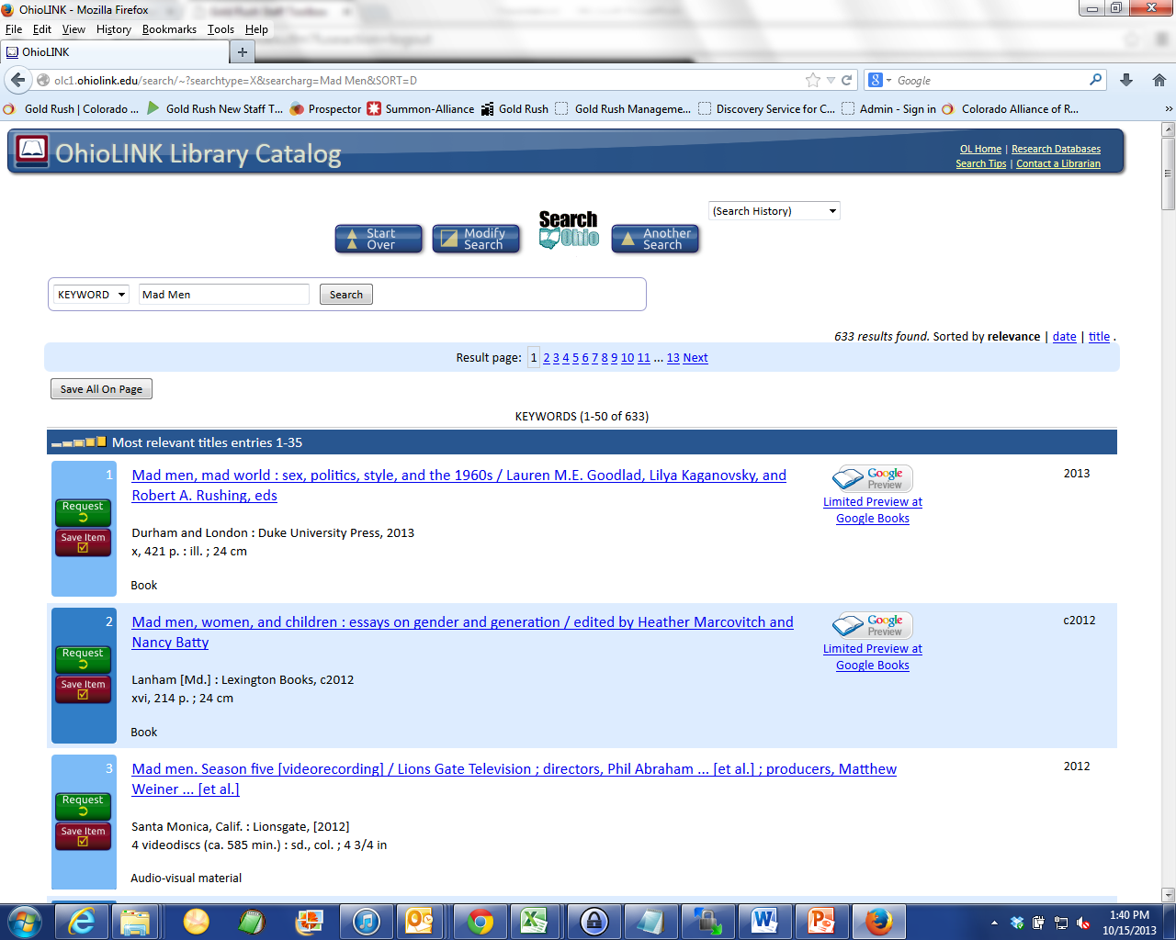

Slide 30
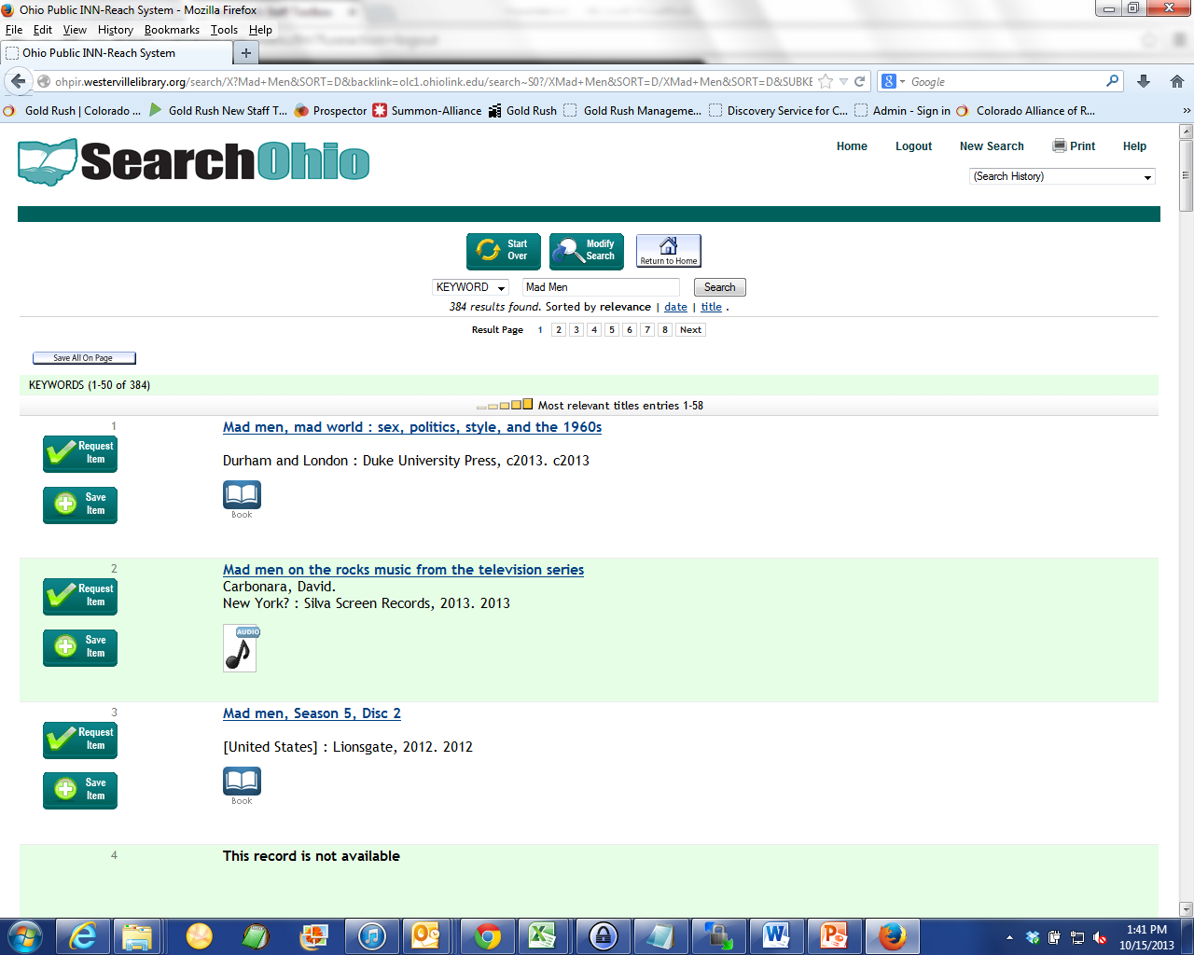

Slide 31
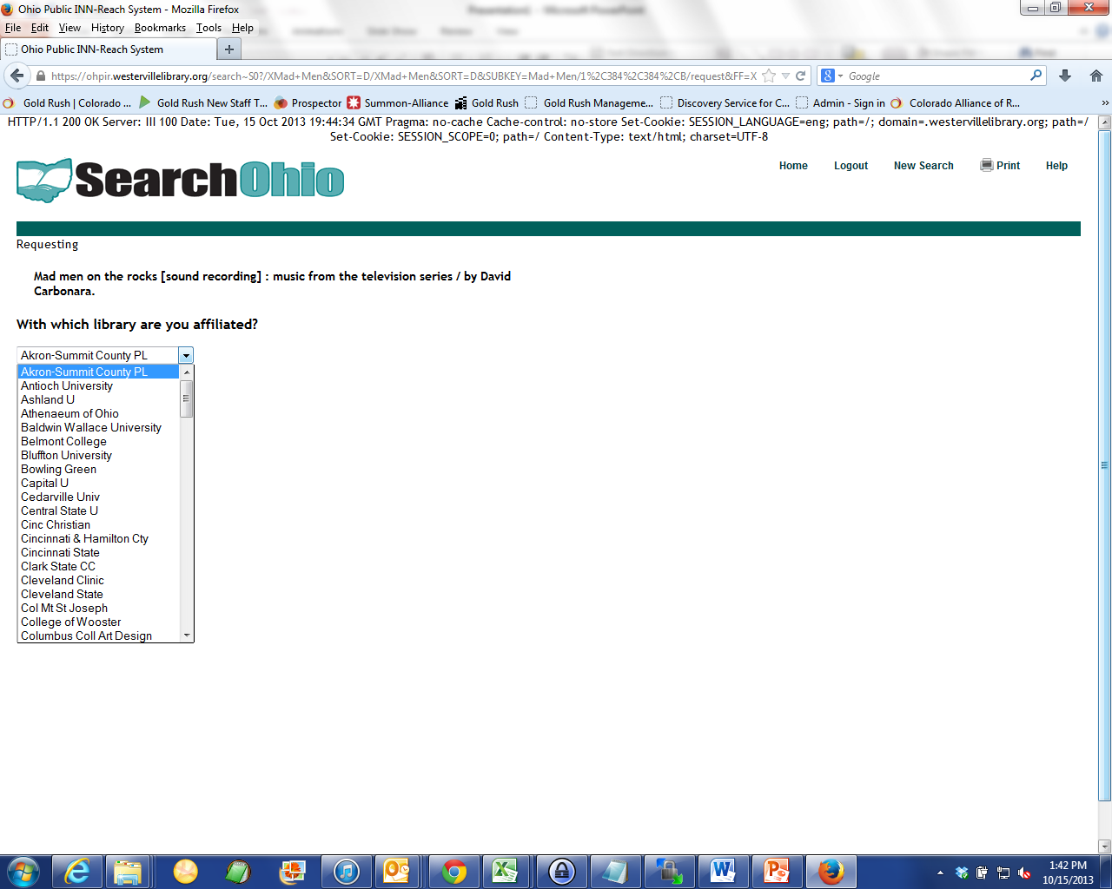
OhioLINK Libraries in drop down box

Slide 32
Thank You Questions?

