Slide 1
Alliance Shared Print Trust
George Machovec, Executive Director
Colorado Alliance of Research Libraries
September 12, 2016
george@coalliance.org

Slide 2
Colorado Alliance of Research Libraries
Incorporated in 1981
15 member libraries (14 academic, 1 public) – one out of state library (University of Wyoming)
Programs include
E-resource licensing – 250 contracts (>$14 million)
Prospector union catalog – 44 libraries, 14+ million unique MARC records
Gold Rush (ERMS, link resolver, content comparison)
Shared Print (Policy Framework approved 2015)
A history of innovation and software development

Slide 3
Why Establish a Shared Print Trust Here?
Not everything is digital
Some may never be digitized
Can a library or consortium afford to re-acquire digital surrogates?
Some users still prefer print
Personal preference
Some areas still have print preference (e.g. art, photography, architecture)
Prospector provides a fast discovery and delivery platform
Preservation of the intellectual record with a local emphasis
Keep materials in the region for our users
We control our own policies and destiny. Don’t have to rely on other groups

Slide 4
History of Alliance Shared Print Trust
2011-2013 – early discussions at the Shared Collection Development Committee
2014 – Member Council (library deans/directors) encouraged the establishment of the initiative
Began working on policy documents
2015 – Member Council/Board approve the MOU, Monograph, Disclosure and Serials Policy
Serious work on the Gold Rush Library Content Comparison System to support programmatic needs
2016 – Further work on comparison analytics tool and work at some libraries on tagging records in the program

Slide 5
Building on the Work of Others
Many organizations and policies consulted in building the program
Print Archive Network (PAN)
Work from Sam Demas (formerly Carleton College) who consults and had written in this area
Work form SCS (Sustainable Collection Services) with Rick Lugg and Ruth Fisher
WEST policies
ConnectNY policies
GWLA serials policy
Others
Starting with the excellent work of others expedited our program

Slide 6
Some Lessons Learned from Others
Develop policy agreements first without trying to do initiatives at the same time
Follow national standards and recommendations when possible
For example, use of appropriate MARC fields for recording retention decisions
Disclose retention decisions locally and nationally
Participate in the national conversation
Keep users at the forefront of our decisions
Don’t get bogged down to the point where the initiative gridlocks

Slide 7
Current signatories on the Trust
Colorado School of Mines
University of Colorado, Colorado Springs
University of Colorado Boulder
University of Colorado Health Sciences
University of Denver
University of Wyoming
Western State Colorado University
Encourage your Institution to sign if they haven’t already

Slide 8
General Principles in Alliance Trust
Distributed
Each library maintains holdings
No central shared storage facility shared by all although a shared storage facility for 4 CU campuses exists
Voluntary
Libraries can participate as much or as little as they wish
No one is ever forced to keep or discard a volume
Flexible
Can expand as needed
Allows libraries to participate in other programs
Non-Exclusive
Libraries may participate in this regional program and participate in others (e.g. WEST, GWLA)

Slide 9
Policy Agreements
Memorandum of Understanding
Establishes the framework for all other agreements
Official participation in the program requires a signature on this MOU
Last Copy Policy for Circulating Monographs
Disclosure Policy
Alliance Serial Distributed Print Policy

Slide 10
Memorandum of Understanding
Signed by participating institutions
But every institution benefits (herd protection)
Can bring in non-Alliance partners as needed
Establishes the Alliance Shared Print Trust
Participants agree to retain materials on behalf of the group and disclose retention decisions
Provides a framework for specific projects, which can be established as needed
Guidelines for withdrawal
Costs borne by each participant for retention and disclosure
25-year commitment, reviewed every five years

Slide 11
Last Copy Policy for Circulating Monographs
Focus on circulating monographs, not special collections
If a circulating copy is not a last copy you may weed it as desired
Defines procedure for offering a last copy to other libraries
Provides exceptions for discarding last copies
Superseded editions, textbooks, outdated manuals, beyond repair
Recommendations for replacing lost or damaged unique last copies
Exceptions
When will ebooks be a recommended replacement? When archived by a reliable entity and can be shared

Slide 12
Disclosure Policy
Establishes procedures for recording retention decisions
Required: recording retention commitments in the 583 MARC field
Required: sharing the updated MARC record in Prospector (this will be happen automatically unless you go out of your way to stop it)
Optional: sharing decision in OCLC WorldCat to more easily be seen nationally
Optional: sharing serial decisions in the Print Archives Preservation Registry (PAPR) when appropriate
Provides details on how the 583 field should be constructed with recommended language
Guidance on participating in multiple shared print programs

Slide 13
Alliance Serial Distributed Print Policy
Modeled after GWLA Serials Policy
Storage Obligations
Maintain journals in original form, Damage or Loss notice, Replacement, Distributed
Repairs and restorations
Ownership and Maintenance of Retained Journals
Transfer of ownership if serial run is given to another library
Condition
Procedures if unable to retain a journal run
Access and Use
Made available for use according to institutional policies (light archive)
Fulfillment preference to Trust participants if competing requests
No specific projects or journal sets are defined for retention but left open for future initiatives

Slide 14
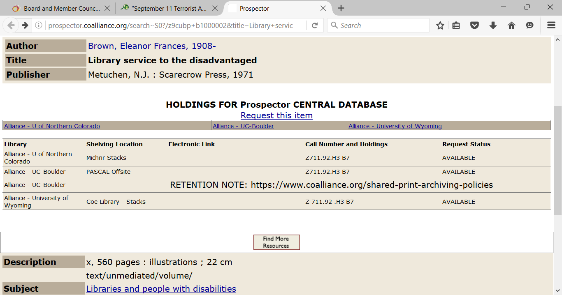

Slide 15
Determining collection overlap
Prospector can be used to easily determine if a single item (or small number) is unique or has a retention commitment associated with it
Gold Rush Library Content Comparison System
Developed for large scale analysis of your collection in comparison to others
Works in real-time and overlapping (or unique) content may be quickly determined
May tailor comparison sets by elements in the MARC record, super easy to use
Lists may be exported in MARC 21, MARC XML or delimited lists
Batch updates to 583 may be done in MARCedit or through the loader after identification in the analytics tool
Available at no cost to Alliance libraries

Slide 16
Practical Considerations & Thoughts
Some libraries are just declaring certain portions of the collection for long-term retention and so noting in the MARC record
Fast and something you were planning anyway
Helps others to know your retention plans
Some libraries have renovation or building programs which may expedite weeding or storage needs
Weed smarter and help ensure you aren’t getting rid of the last copy in the region
Get the political monkey off your back! As you weed, if questioned by your constituents you can state that is a coordinated activity and your users can be assured continued access
Now is the time to start thinking about specific initiatives – discussions this afternoon between collection development and subject specialists

Slide 17
Questions?
George Machovec
Executive Director
Colorado Alliance of Research Libraries
george@coalliance.org

