Slide 1
Building the Collective Collection: An Overview
Alliance Shared Print Trust Workshop
September 12, 2016
Michael Levine-Clark

Slide 2
The Problem
Overlapping collections (nationally, regionally, locally)
Take up valuable space
Often are unused
Often are duplicated electronically

Slide 3
The Concern
Libraries, faced with space needs will inadvertently discard a “last copy” while keeping relatively common materials

Slide 4
Many Projects

Slide 5
Western Regional Storage Trust (WEST)
A focus on retrospective journals
74 members in 18 states
35 archive holders/ 5 builders
Store entire run
Over 500K volumes stored
41% print only
CSU, DU, UCHSC, UW

Slide 6
Eastern Academic Scholars’ Trust (EAST)
Newly formed
Journals and monographs
48 libraries
Major collection analysis of monographs
Preliminary study of overlap/uniqueness
Validation sampling (condition and availability)

Slide 7
Other Projects
Florida Academic Repository (FLARE)
ASERL Cooperative Journal Retention
Research Collections and Preservation Consortium (ReCAP) – Princeton, NYU, Columbia
Maine Shared Collections Collaborative
And many others . . .

Slide 8
Keeping Up
Print Archive Network (PAN) Forum
Coordinated by CRL
Held at ALA and ALA Midwinter (Friday AM)
https://www.crl.edu/programs/print-archive-network-forum-pan

Slide 9
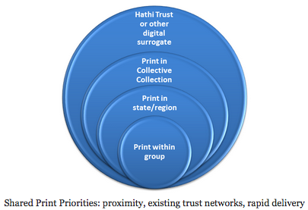
Distributed Model

Slide 10
Four Models – Lavoie, et al
Hub Model – shared use, physical consolidation (PASCAL)
Flow Model – shared use, virtual integration (Prospector)
Stock Model – shared back-up, physical consolidation (JSTOR Backfiles – CDL)
Distributed Model – shared back-up, virtual integration (WEST)

Slide 11
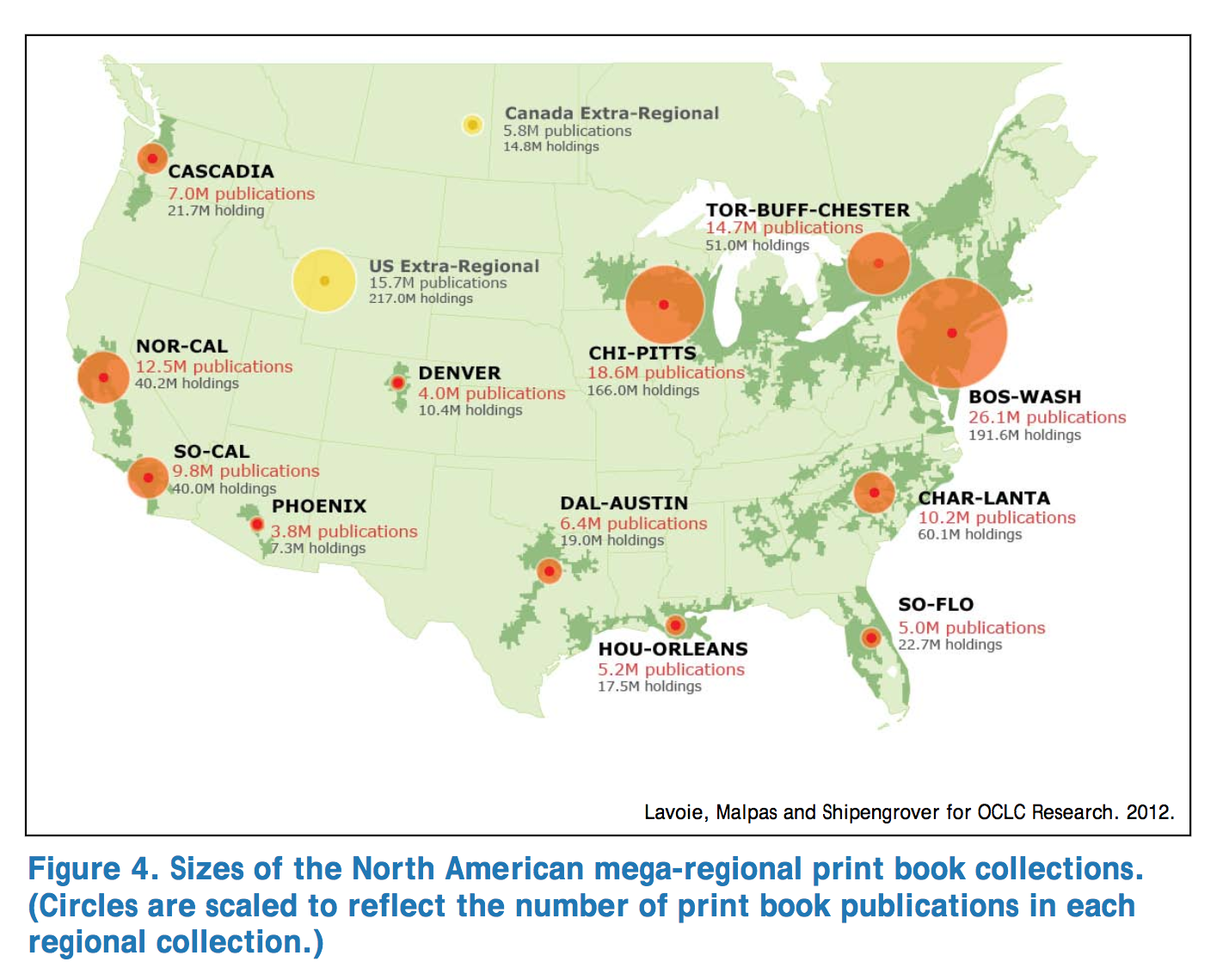
“Mega-Scale”

Slide 12
The Alliance shared print trust

Slide 13
Alliance Shared Print Trust
MOU and supporting documents
Infrastructure that allows collaboration
Participation can be passive
Participation can be moderate
Can overlap with other programs

Slide 14
It’s Easy To:
Declare an intent to retain a particular title
Especially if it’s already committed (PASCAL, WEST, GWLA)
Especially if it’s already important
In a circulating collection that is an area of emphasis and/or connected to special collections
(Cookbooks at DU)
Especially if it’s already in high-density storage

Slide 15
It’s Much Harder to:
Decide to keep secondary materials for the good of the group
To make coordinated retention/de-accession decisions

Slide 16
Next Steps

Slide 17
Moving Beyond a Reactive Response
Can we identify projects to intentionally rightsize collections together?
One library retains, while others discard
Can we set duplication targets?
Should we focus on subjects, dates, languages, something else?
Monographs or journals?
Prospective as well as retrospective?
In conjunction with digital access?

