Slide 1
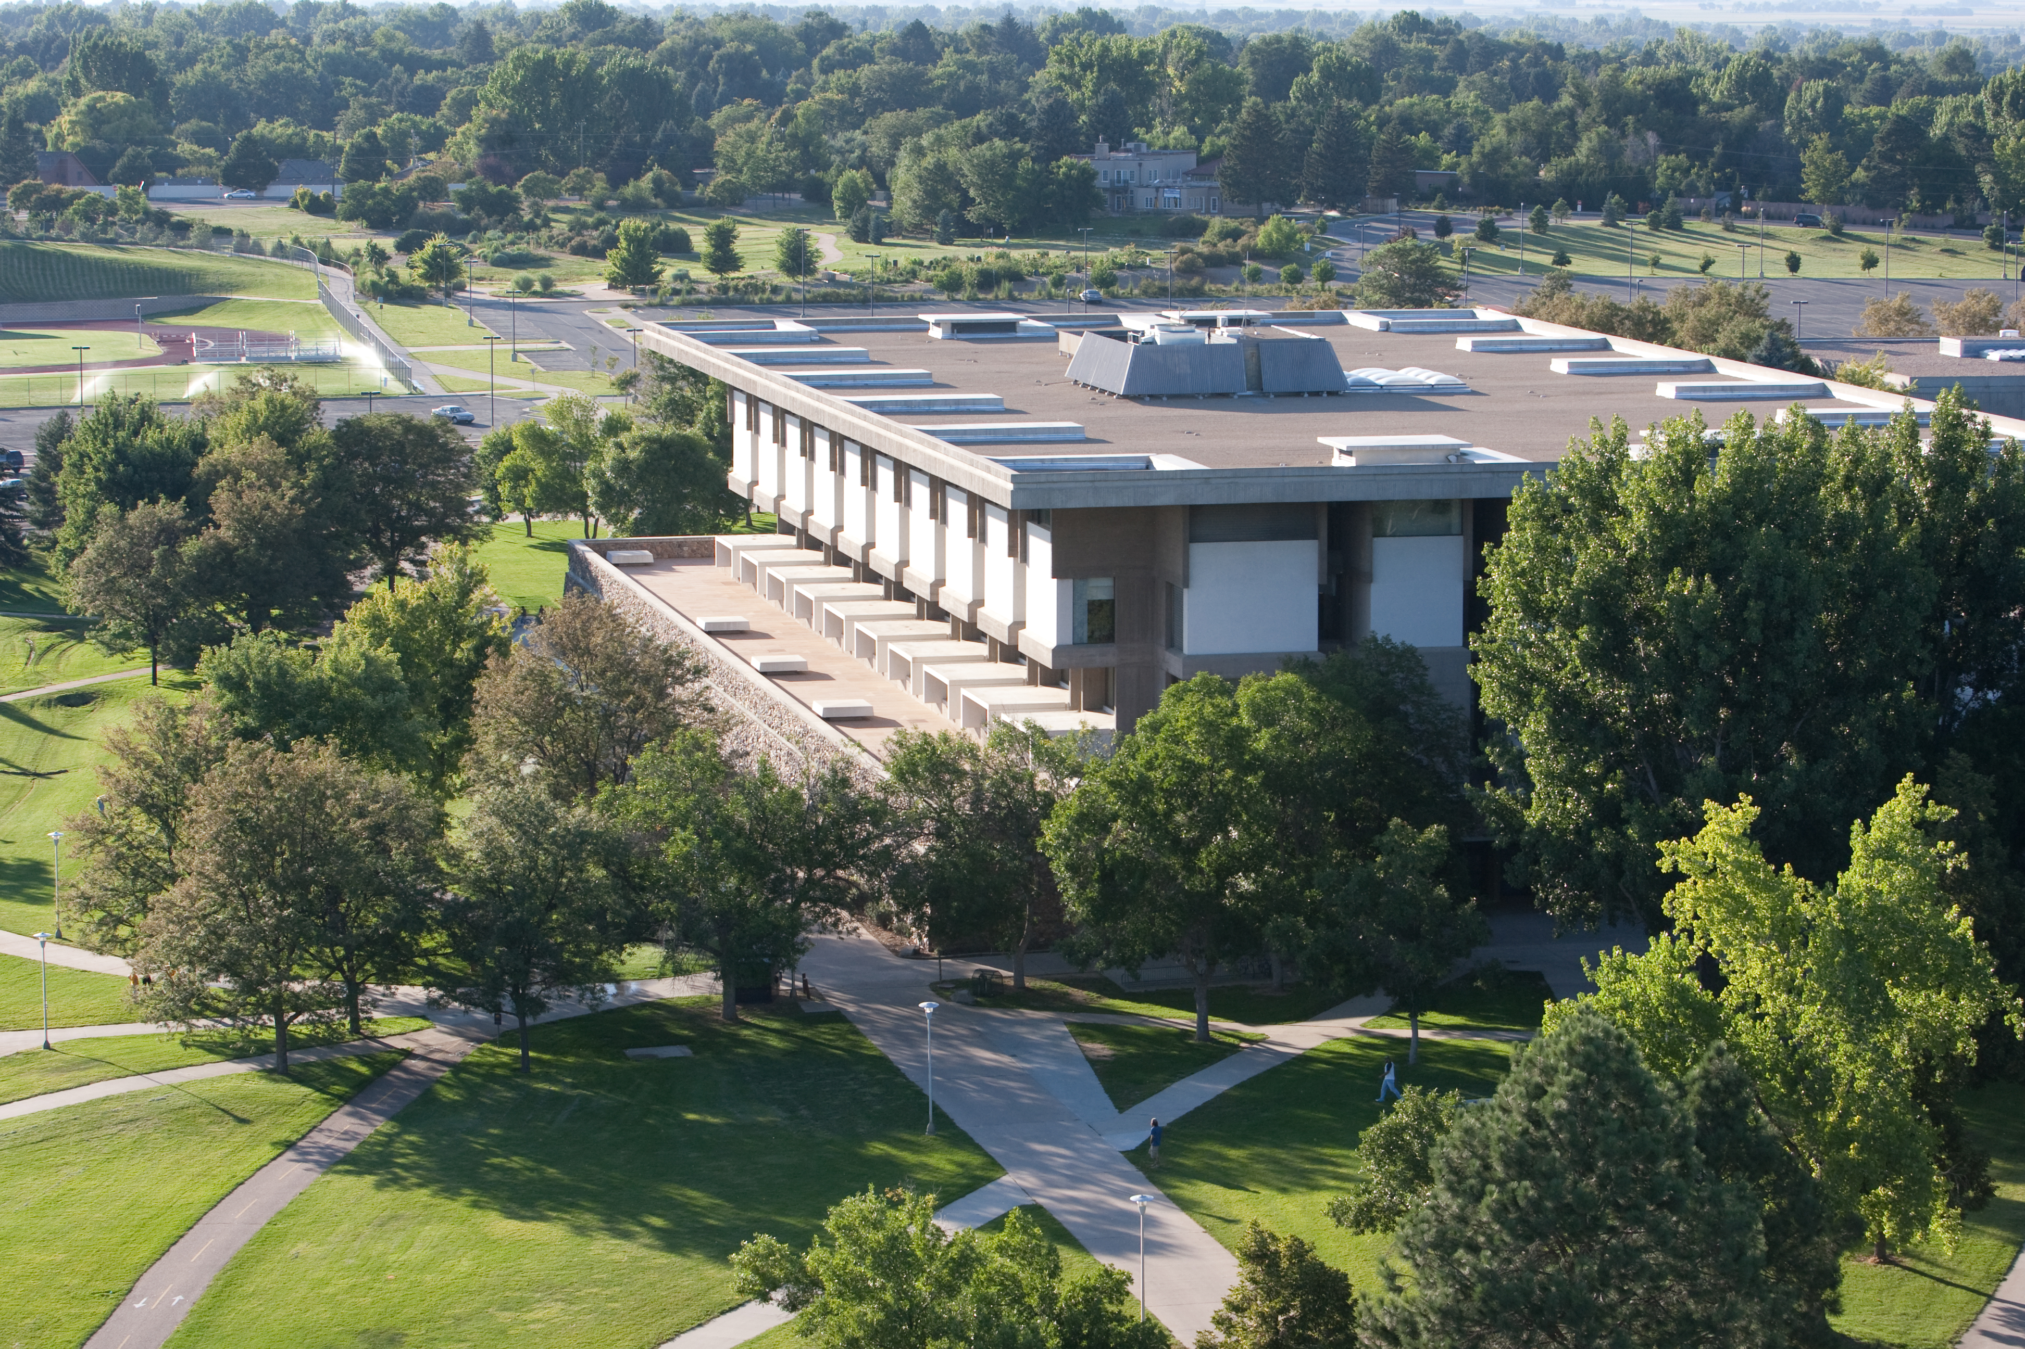
Market Reach & Advertising Medium
Assessing How Students Learn about Research Services
Stephanie Wiegand
Colorado Alliance of Research Libraries
November 18, 2016

Slide 2
Of respondents
20% were distance students
83% were full time
20% were nontraditional
13% were transfer students
22% were first generation

Slide 6
“It was difficult to find the librarian contact n the website, that is the one improvement I would make - a link with the librarians email/contact and their research specialty so students can easily find who to contact for what.”

Slide 7
Thank you.

