Slide 1
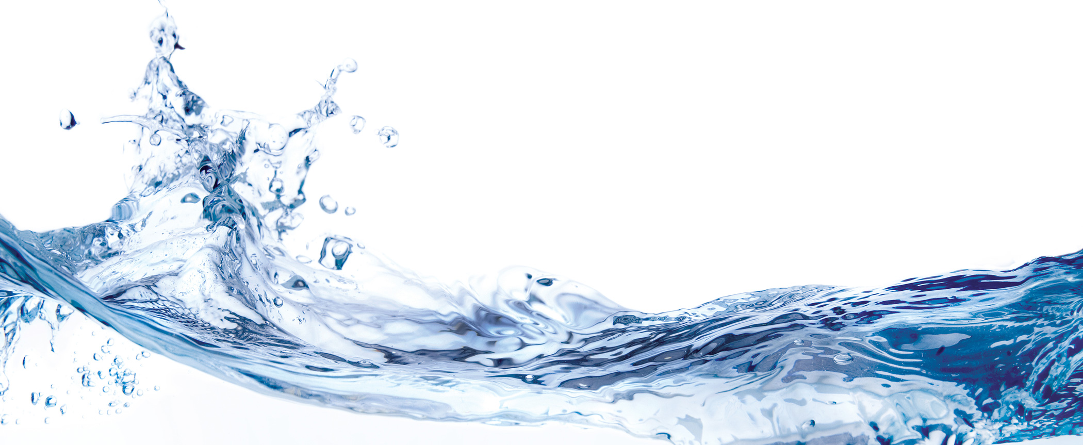
The Western Waters Digital Library:
Building a Resource Through Multi-State Collaboration and Technology
Dawn Paschal
Assistant Dean, Digital Library and ePublishing Services
Morgan Library, Colorado State University

Slide 2
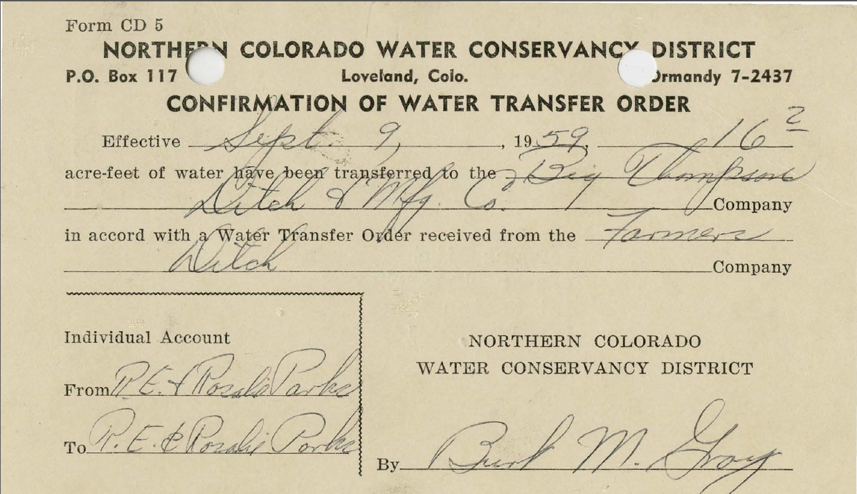
What is the Western Waters Digital Library?

Slide 3
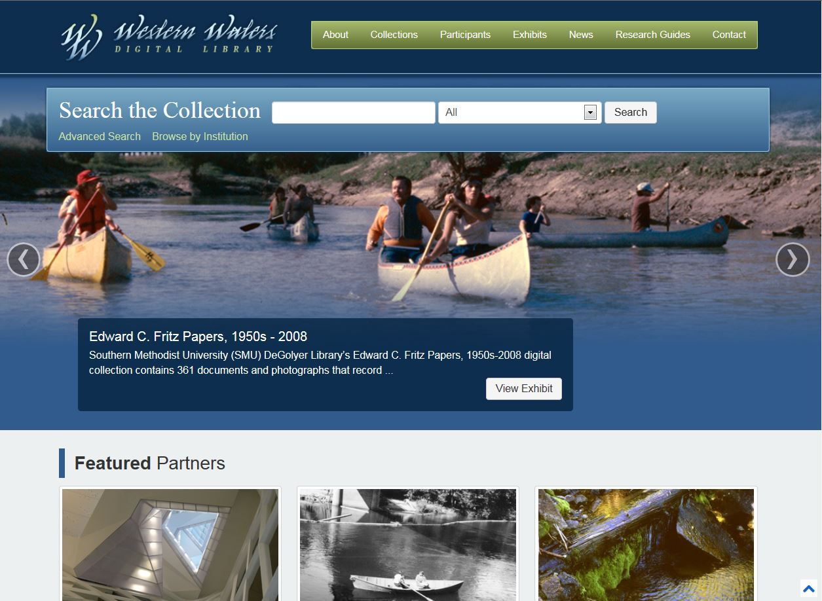
“The Western Waters Digital Library (WWDL) provides free public access to digital collections of significant primary and secondary resources on water in the western United States.”

Slide 4
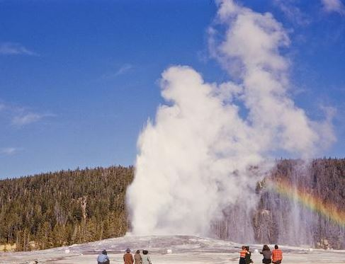
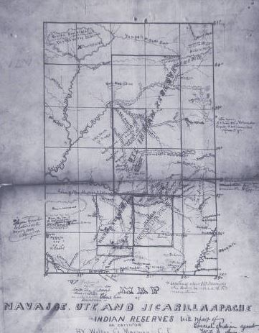
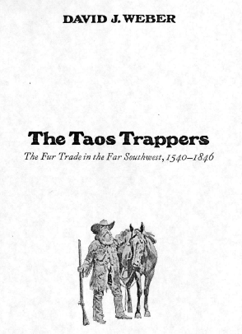
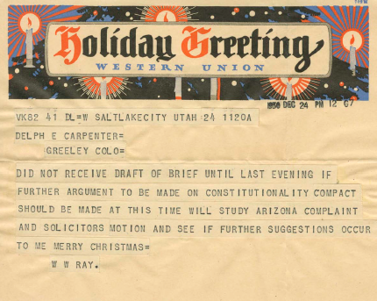
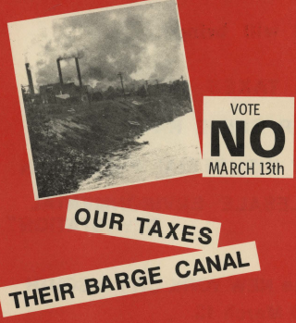
Classic water literature, legal transcripts, maps, reports, personal papers, water project records, photographs, audio recordings, video, selected finding aids

Slide 5
History of the Western Waters Digital Library
Collaborative regional project of 12 research libraries in the Greater Western Library Alliance (GWLA)
Funded by IMLS (2003-2005) and NEH (2007-2010) grants

Slide 6
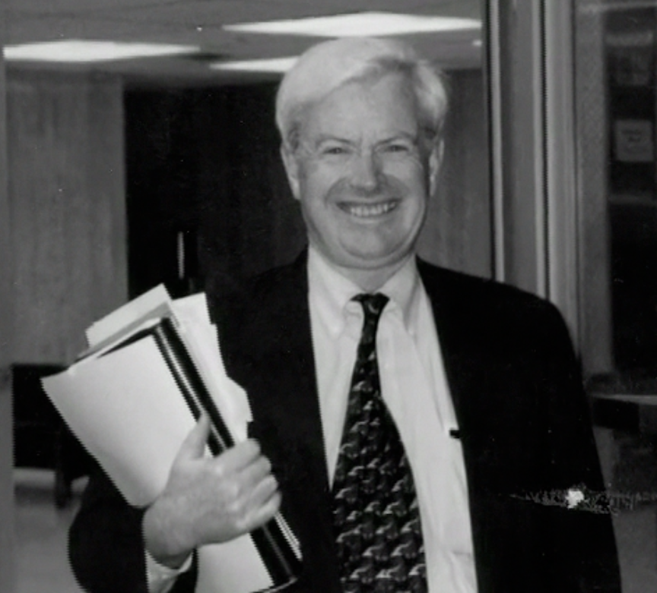
Dr. Gregory Thompson
Associate Dean, Special Collections

Slide 7
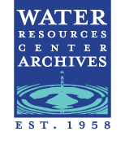
Participants

Slide 8
Participants
Engaged team of 16 archivists, librarians, technical experts
Guided by collection development policy
Faculty advisors with expertise in western water issues
Recommended content based on research value, uniqueness, demand by faculty, other scholars

Slide 9
Audience
Students, faculty, researchers of institutions (primary)
Policy makers
Native American tribes
Professionals in various fields (engineering, law)
Others interested in contemporary, historic water issues

Slide 10
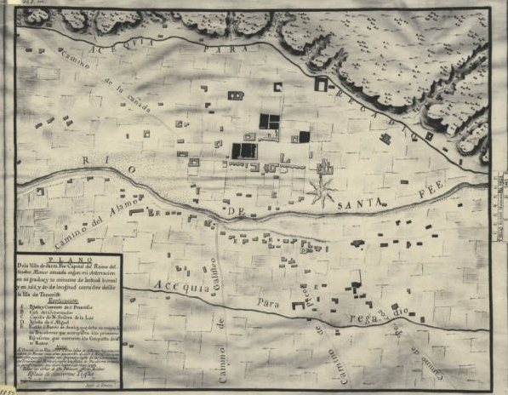
Project Objectives
Begin developing comprehensive information resource
Establish a viable technical infrastructure
Serve as a collaborative model

Slide 11
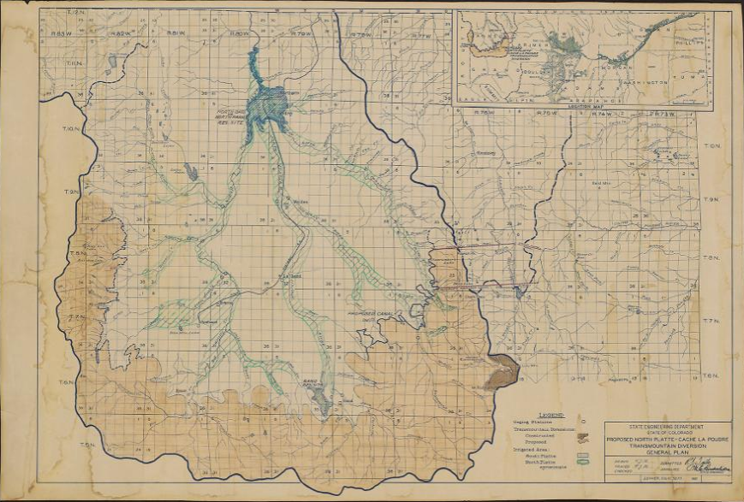
Initial river basins focus:
Platte, Colorado, Rio Grande, Columbia

Slide 12
Access to Content
Harvesting metadata to central server at Utah
Creating aggregated index for virtual, seamless searching of all collections from single website
PKP harvester
Sites mostly CONTENTdm users initially
Balancing local control and central usability

Slide 13
Project Outcomes
Expanded collaborative relationships established in 2003-2005
Exceeded objective to digitize 20,000 pages related to water policy and environmental history by digitizing or making accessible some 47,739 manuscript pages, legal documents, and photographic images
Redesigned and enhanced the WWDL web site

Slide 14
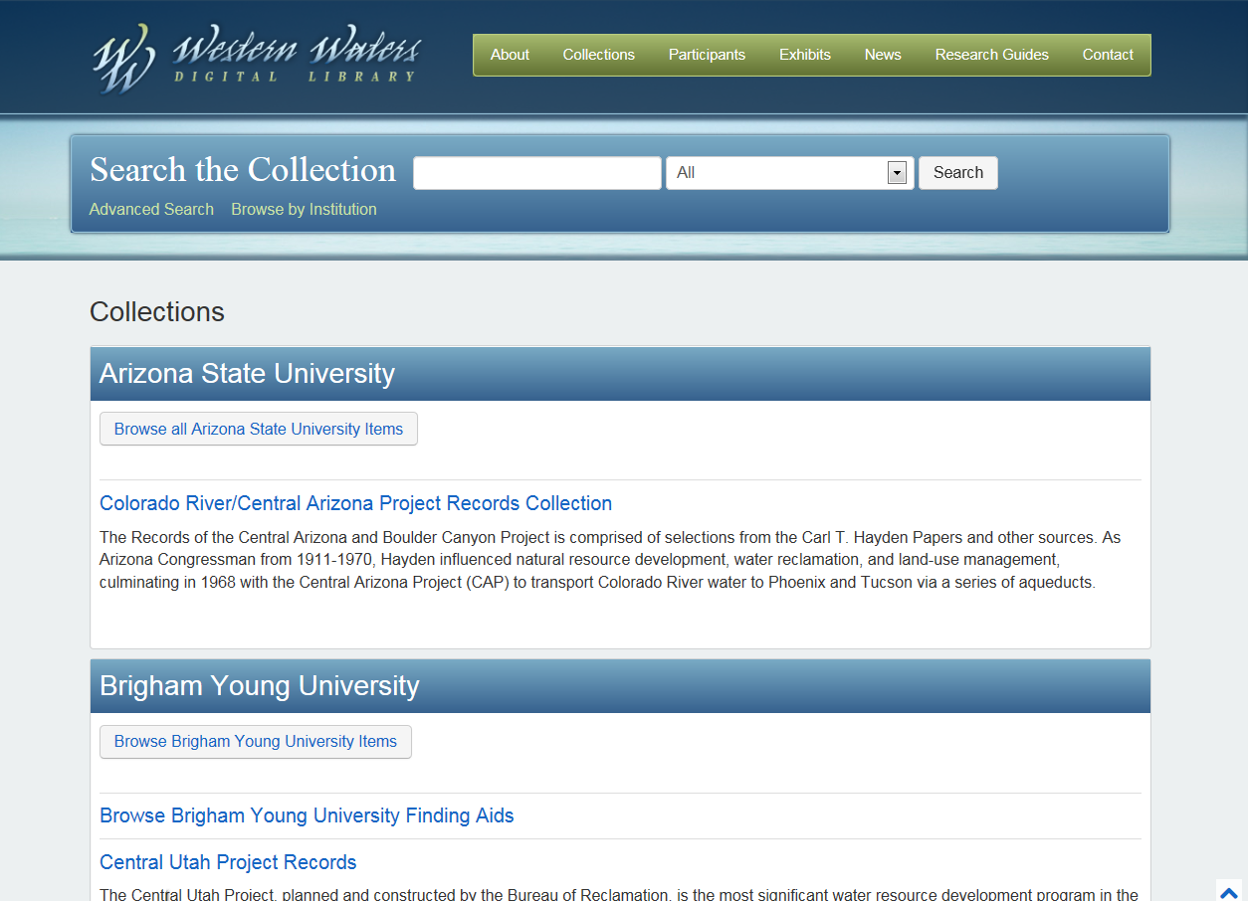
Also--
Added initial repository of 30 Encoded Archival Description (EAD) finding aids, with multiple ways to retrieve them

Slide 15
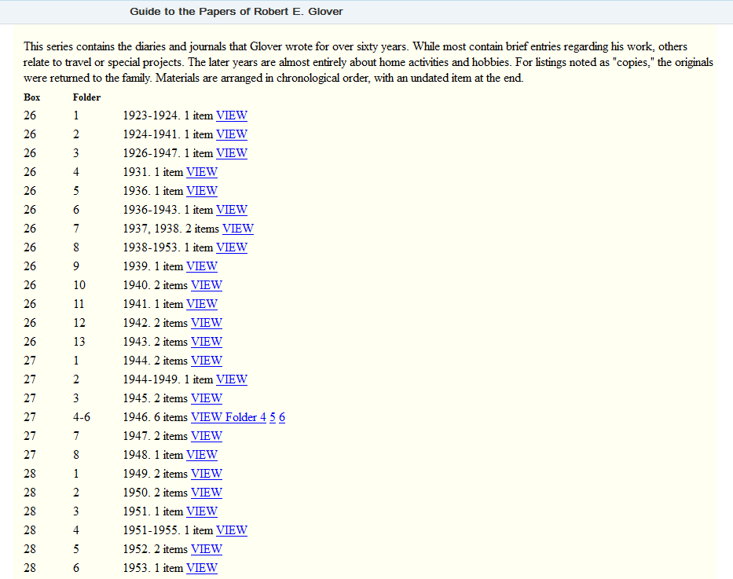
Linked finding aid entries to corresponding digital objects for easy access by users

Slide 16
Contributors
Additional institutions (some outside GWLA) are contributing content to the WWDL via harvesting of metadata:

Slide 17
Partnerships and Benefits
United around common goals & objectives
Developed collections, solved technological issues collaboratively
Digitized greater variety of material
Widened use of metadata standards
Testing, refining

Slide 18
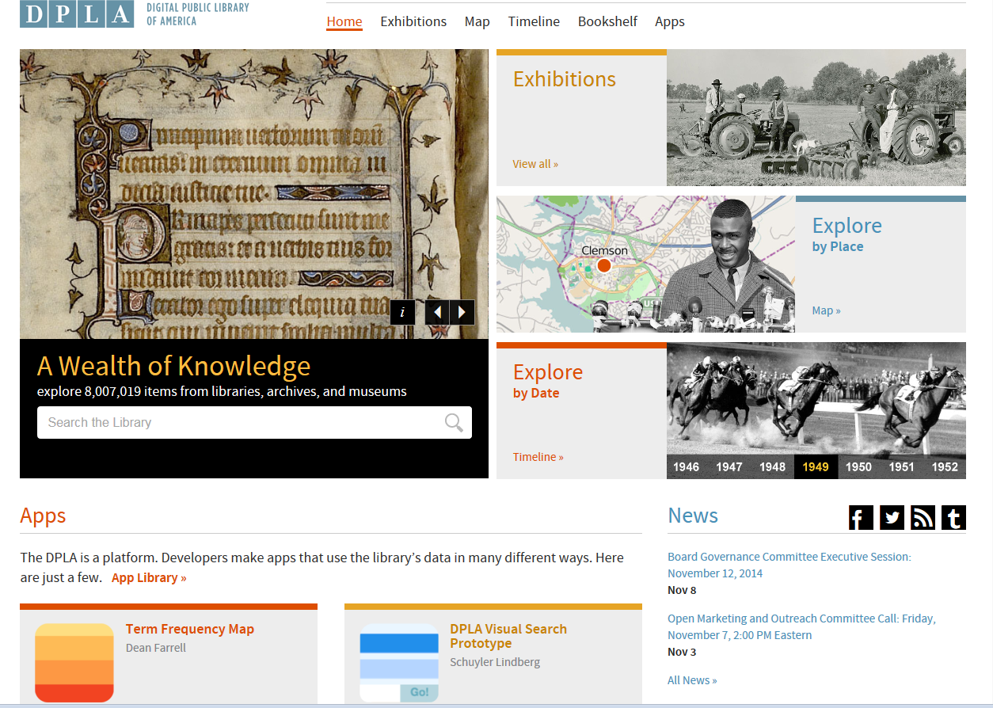
Are we interested?
Yes!

Slide 19
Website – http://westernwaters.org
Contact Information
Dawn Paschal, Assistant Dean, Digital Library & ePublishing Services
Morgan Library, Colorado State University
dawn.paschal@colostate.edu
(970)-491-1849

