Slide 1
Library Content Comparison System
Shared Print Workshop
September 12, 2016
DU Anderson Commons
Rose Nelson, Assistant Direct CO Alliance of Research Libraries

Slide 2
Why We Developed a Collection Analysis Tool
To support work of the Shared Print project
An analysis tool was needed that was affordable and flexible
Commercial tools (Intota Assessment, OCLC Collection Evaluation, SCS Greenglass for Groups) are excellent services but were too expensive for member libraries

Slide 3
Comparison Tool Selected Characteristics
Must be scalable to work from the smallest to largest libraries
Must work in real-time
Must support comparing (1-1 and 1-many)
Must support export of MARC, XML and delimited (Excel)
Must show what’s unique and overlapping, including visualizations
Must be able to have searches or facets to work with any fields in a MARC record
Matching algorithm must be made from elements in a MARC record but NOT depend on OCLC #, ISBN, ISSN
Must be easy-to-use!

Slide 4
Elements in Match Key
Title
245 $a $b
General Media Description
245 $h
Type of
'_' Leader
Title Part
245 $p
Title Number
245 $n
Publication Year
260 or 264 $c
Pagination
300 $a
Edition Statement
250 $a
Publisher Name
260 or 264 $b
Additional programming for cartographic and sudocs

Slide 5
Technology
Linux (CentOS)
“Play” web application framework
SOLR indexing
Open source charting software-High Charts
All virtualized on multiple VMs
Same MARC ingester as the one used in the Google Books Project

Slide 6
Loading & Updating
System is ILS agnostic
Records can be done as often as you want but no more than once per day
Suggested that full database updates be done monthly or quarterly (unless a big change occurs and then it can be done on-demand)
No deletes, at the present, so full updates are needed when many records are removed from your local catalog
SFTP (secure FTP) is used to deposit records in either a “full” or “updates” directory

Slide 7
Source of MARC Records
Prefer a direct export from your ILS rather than a union catalog export
Challenges with union catalog (INN-Reach) metadata
Nobody contributes all MARC records
The master record may not always be yours
Libraries prefer getting their own records back rather than a generic MARC record from the union catalog
A local export will eventually be need for item and/or circ data

Slide 8
Sample Use Cases
Shared Print
New Program
Weeding pool
Commercial dataset
Branch comparison

Slide 9
Demo

Slide 10
Tips for using the tool
Implied “OR” so use quotations if searching an exact keyword phrase
Click on region label to select all sites in the group
Click search button without entering anything to see all sites in system and number of records held
Works best in FireFox
When building complicated queries, use the save search option
Sometimes it’s easier to start over rather than remove criteria from a search

Slide 11
Questions & Discussion
Contact Information: rose@coalliance.org

Slide 12
Gold Rush Decision Support

Slide 13
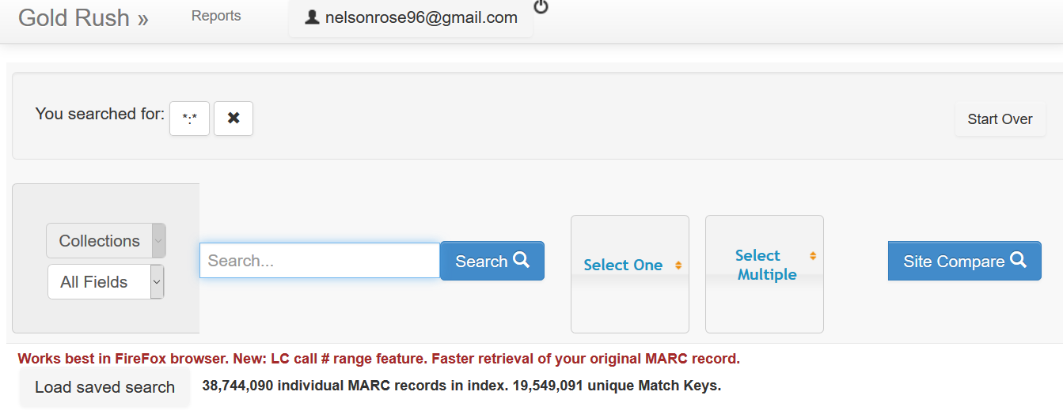

Slide 14
Variety of search options

Slide 15
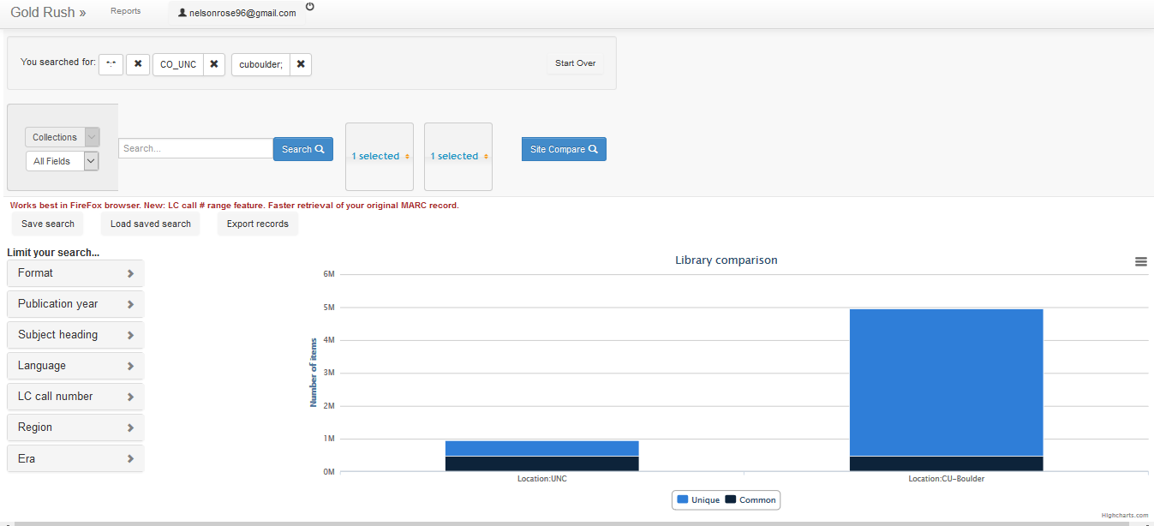
UNC vs. CU Boulder

Slide 16
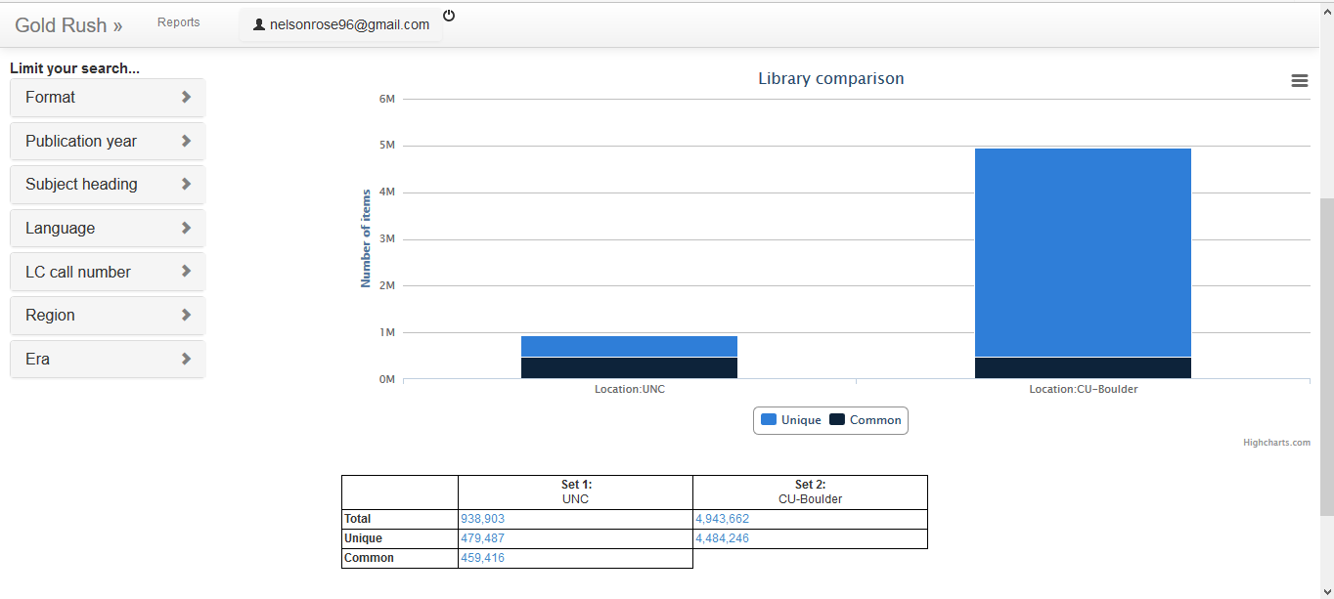
UNC vs. CU-Boulder

Slide 17
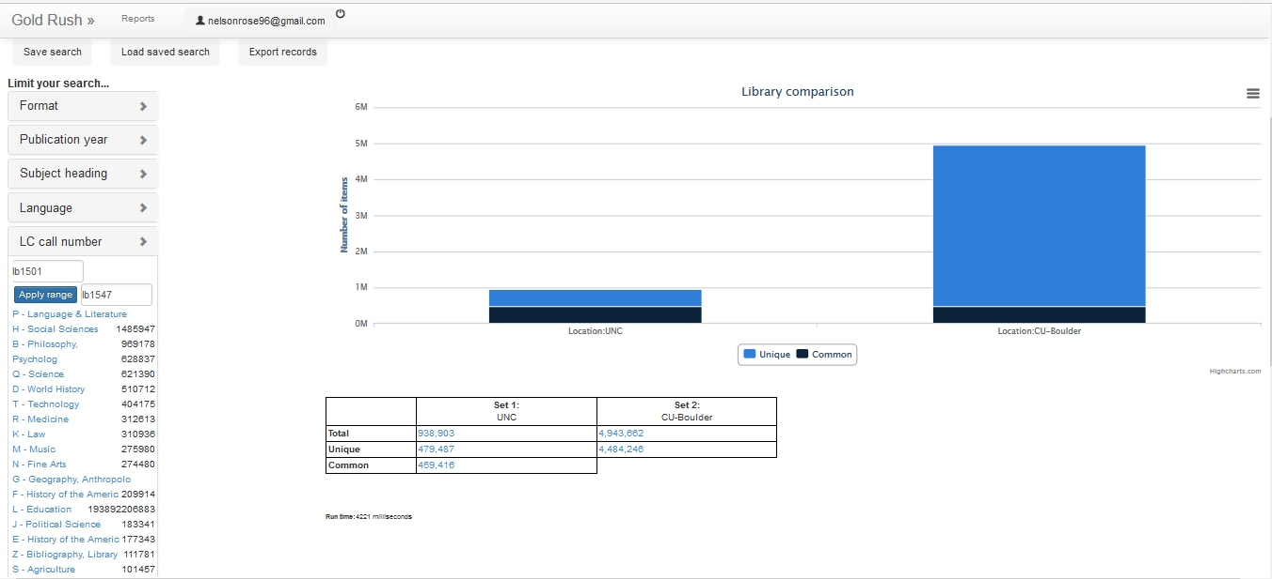
Limit by Call # Range: Primary Education

Slide 18
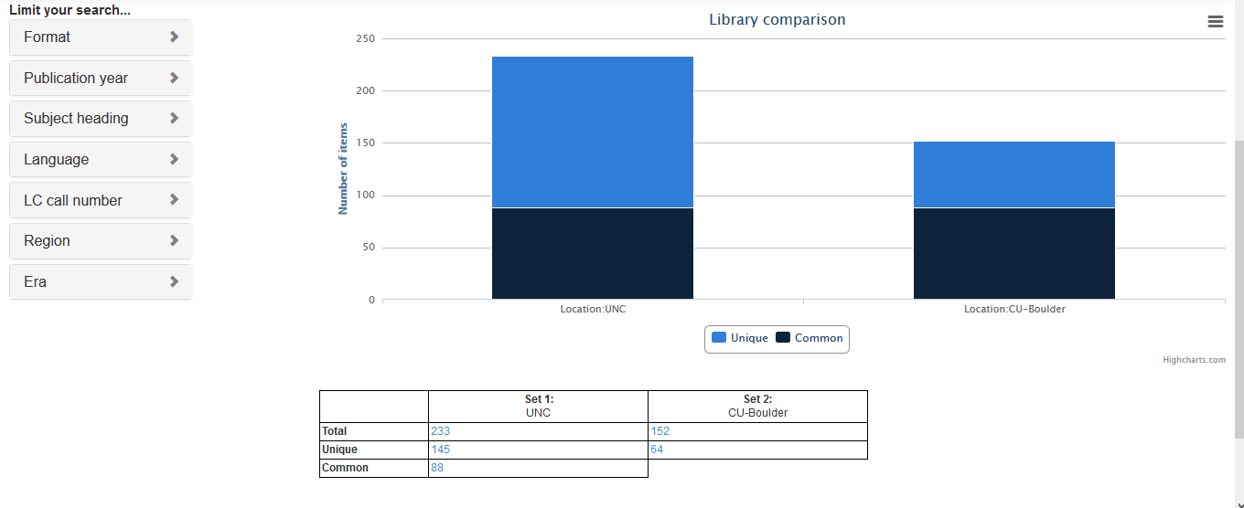
Results by Call # Range

Slide 19
UNC-more items in Primary Education: What are the 64 unique items held by CU?

Slide 20
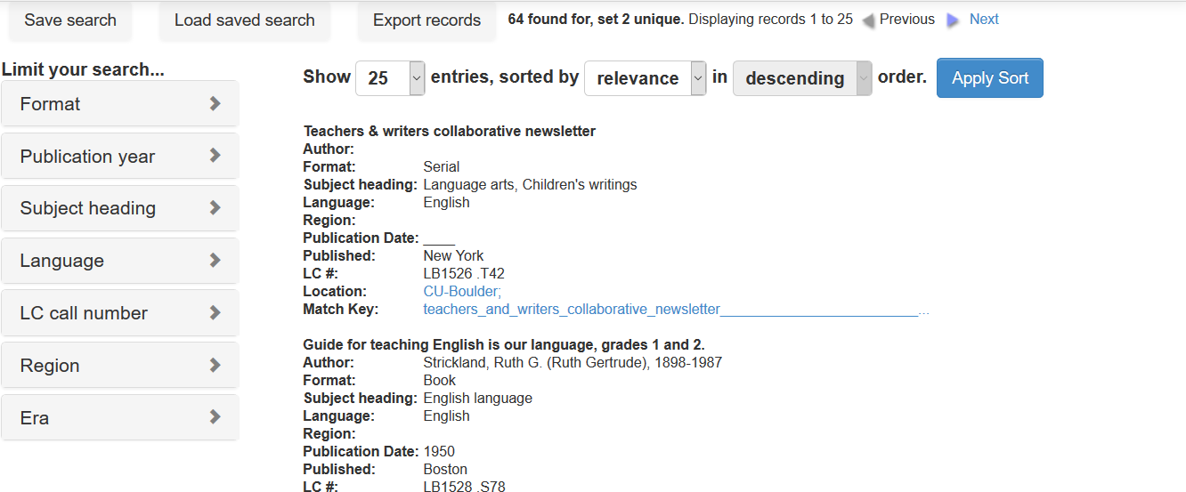
64 Unique items from CU-Boulder
Click to view MARC record from CU

Slide 21
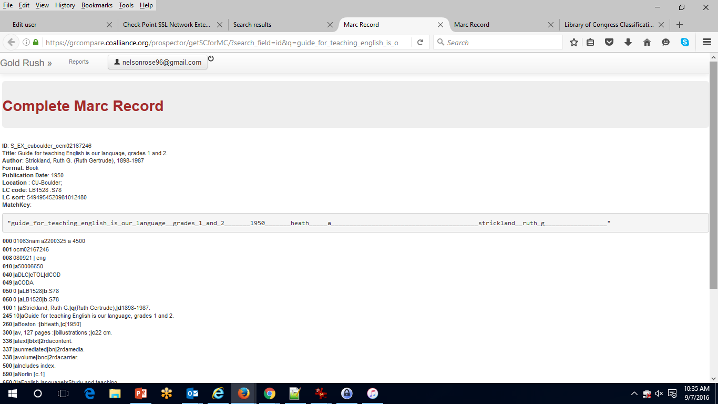
MARC Record View
Match Key
100
245
260

Slide 22
Weed dated Astronomy titles

Slide 23
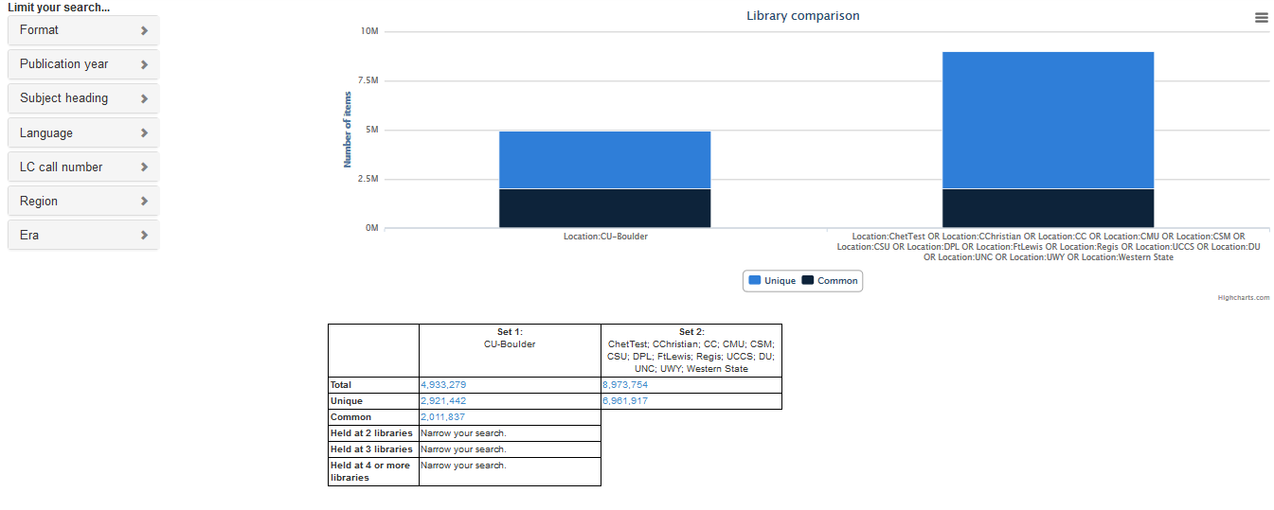
CU Boulder vs. Alliance Libraries

Slide 24
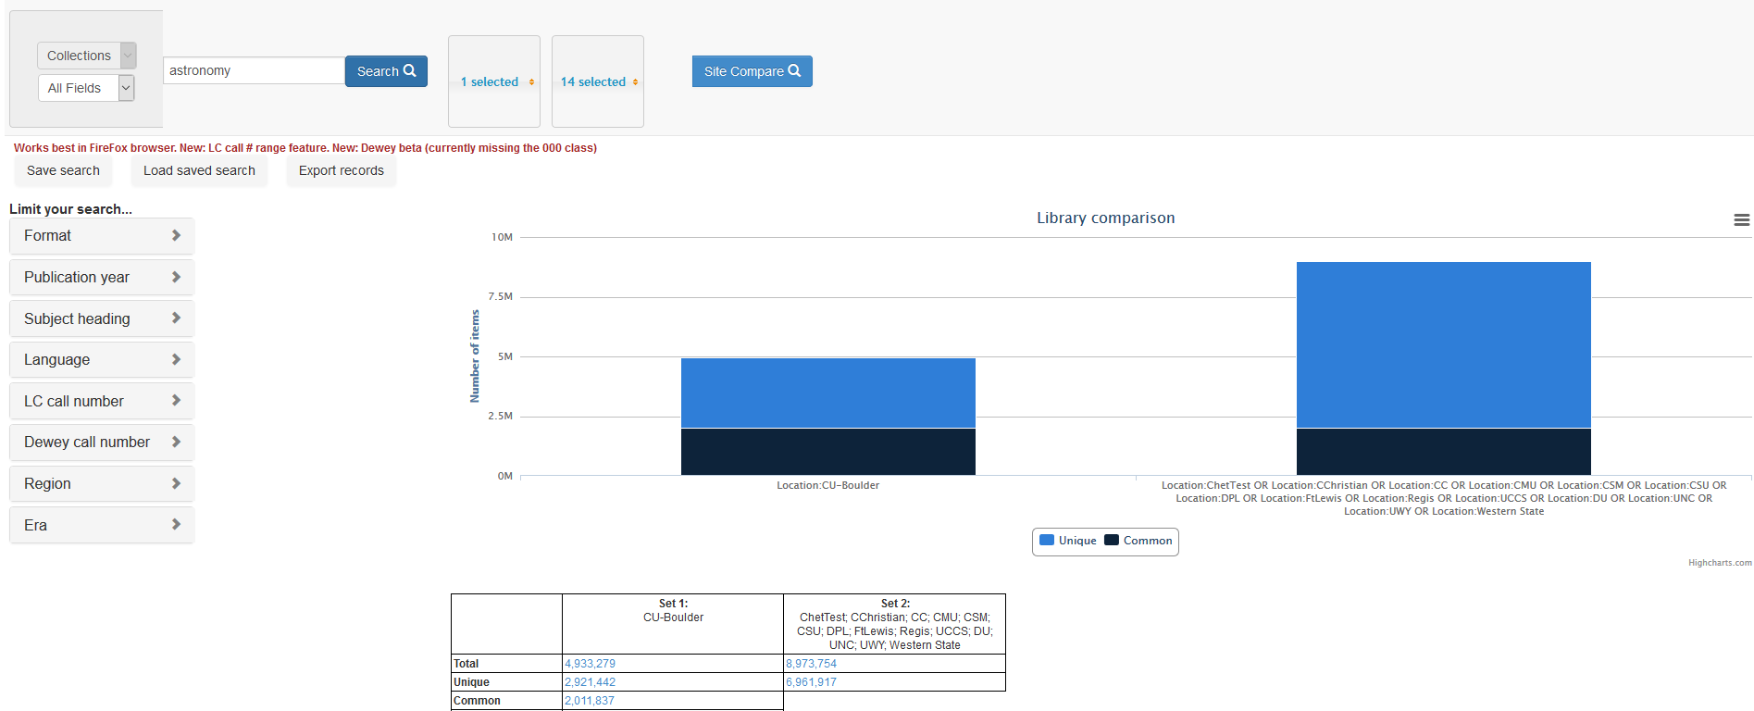
Narrow by keyword: “Astronomy”

Slide 25
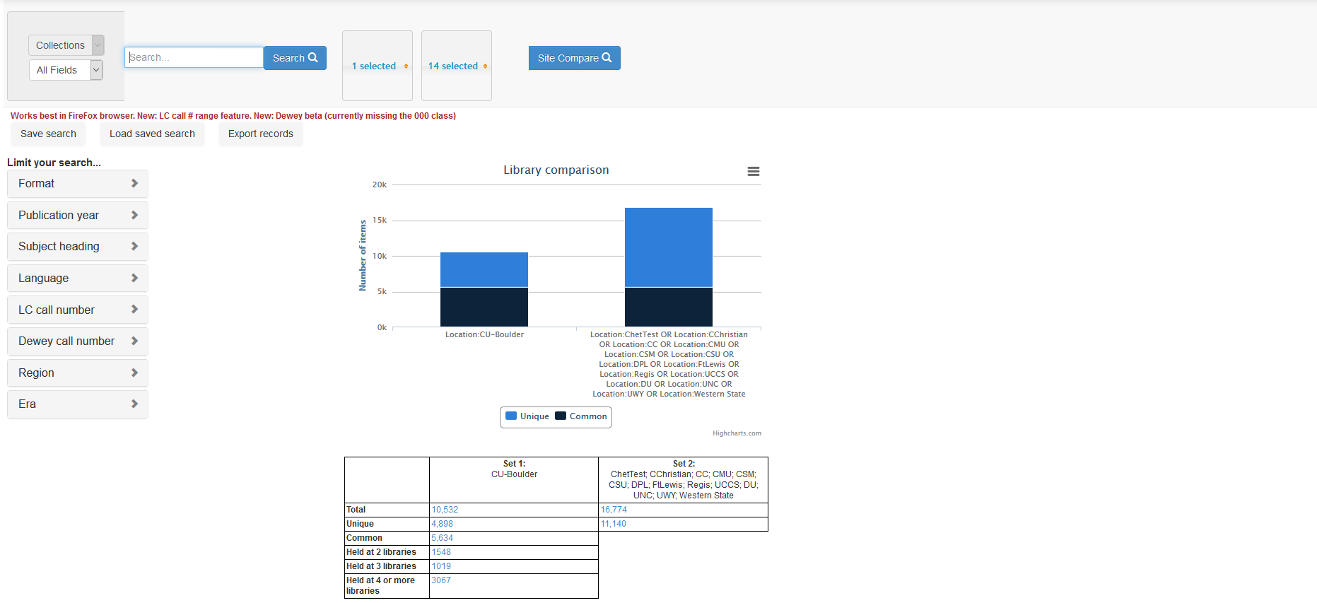
Smaller results set

Slide 26
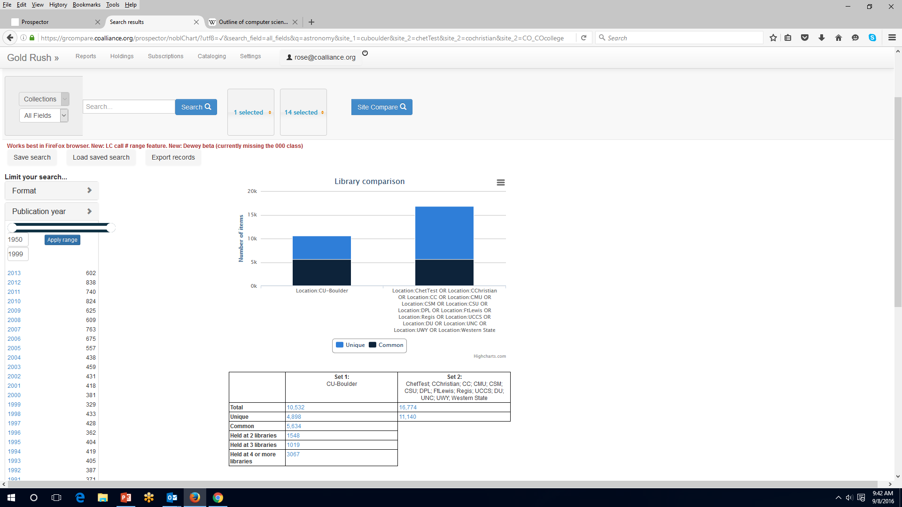
Refine search more by publication date facet: “1950-1999”

Slide 27
Look at records held at 3 or more libraries as potential candidates for weeding

Slide 29
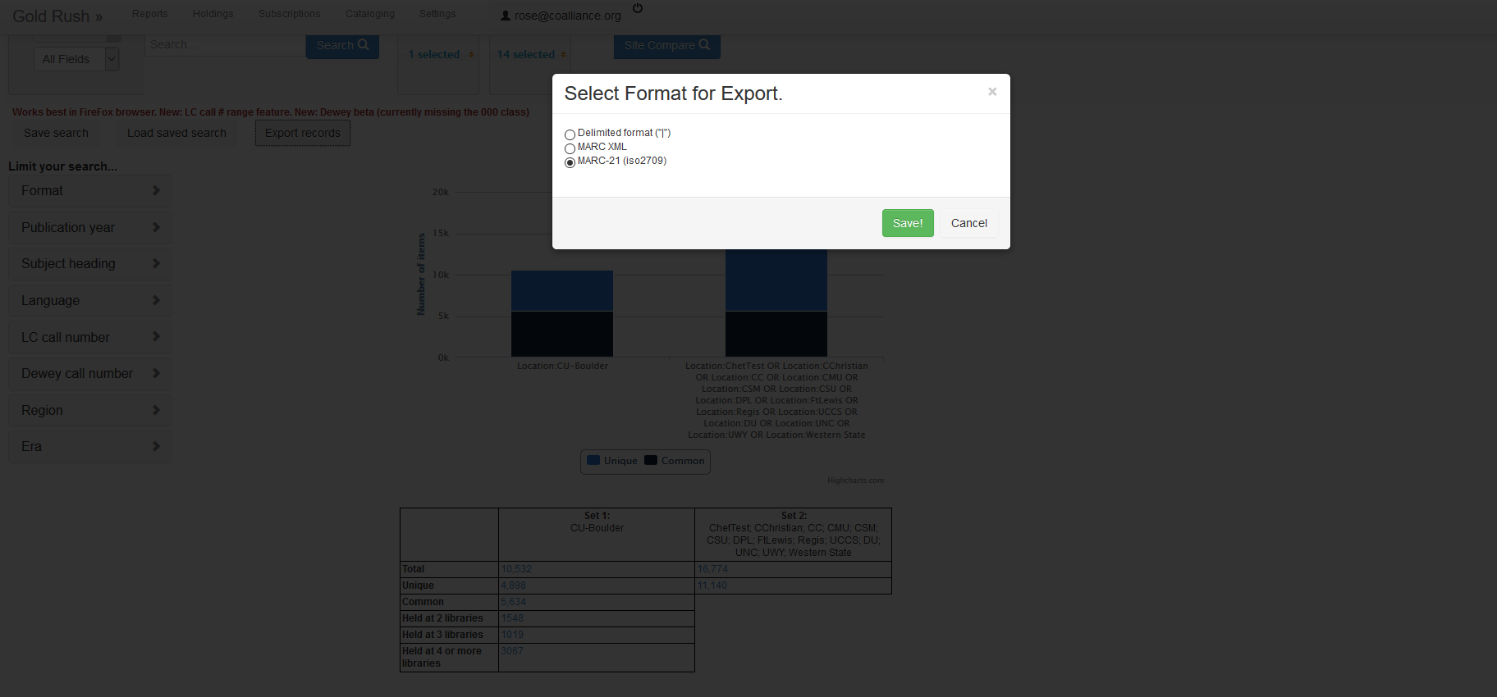
Export records in a variety of formats

Slide 30
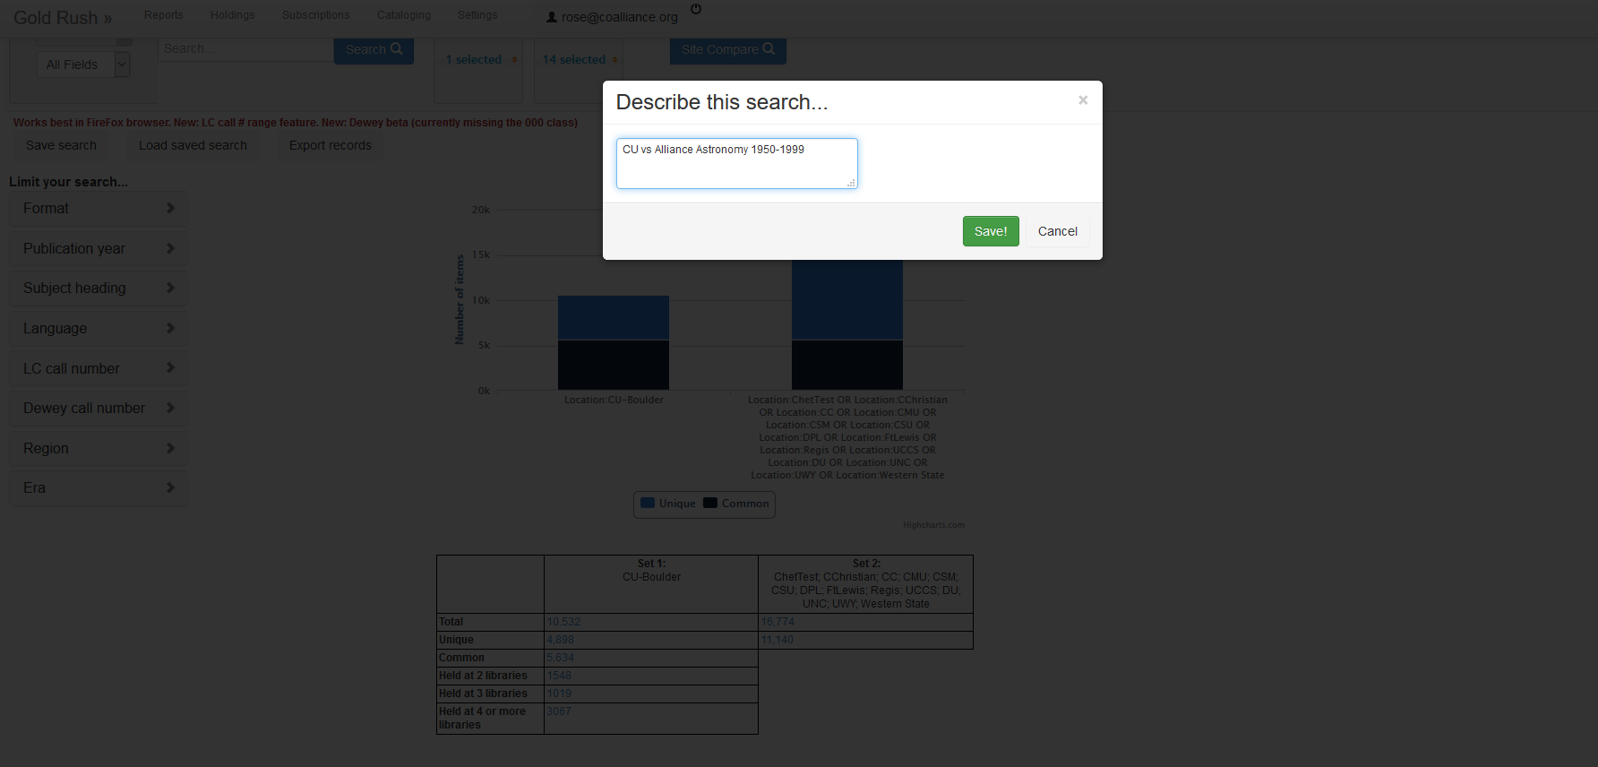
Save a search

Slide 31
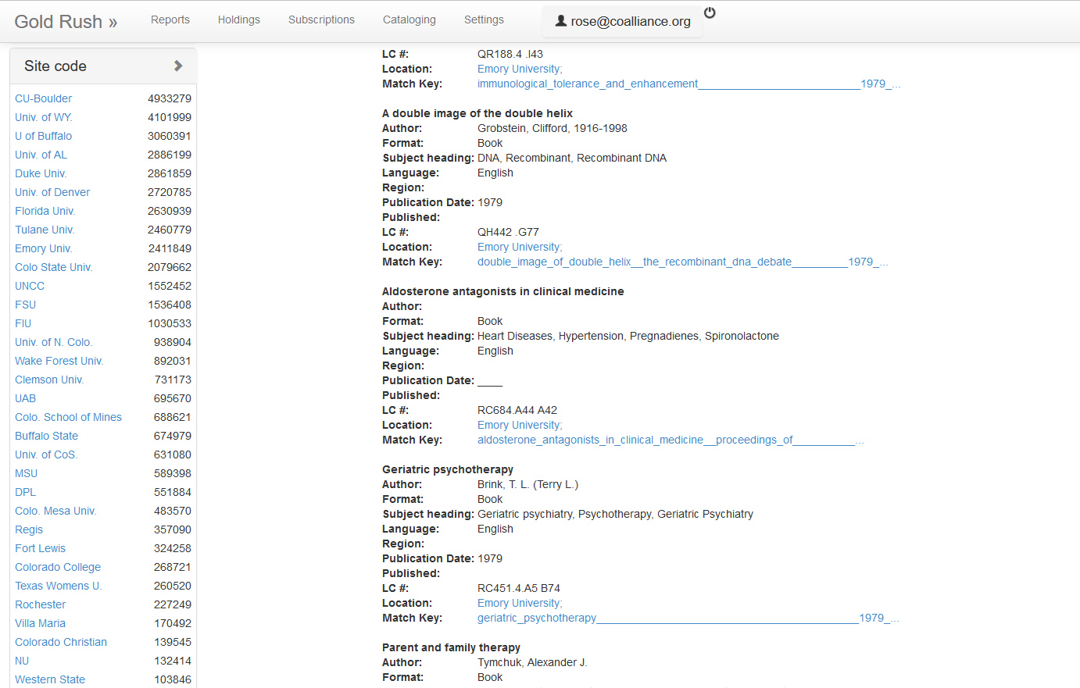
Blank search: number of records held by each site

Slide 32
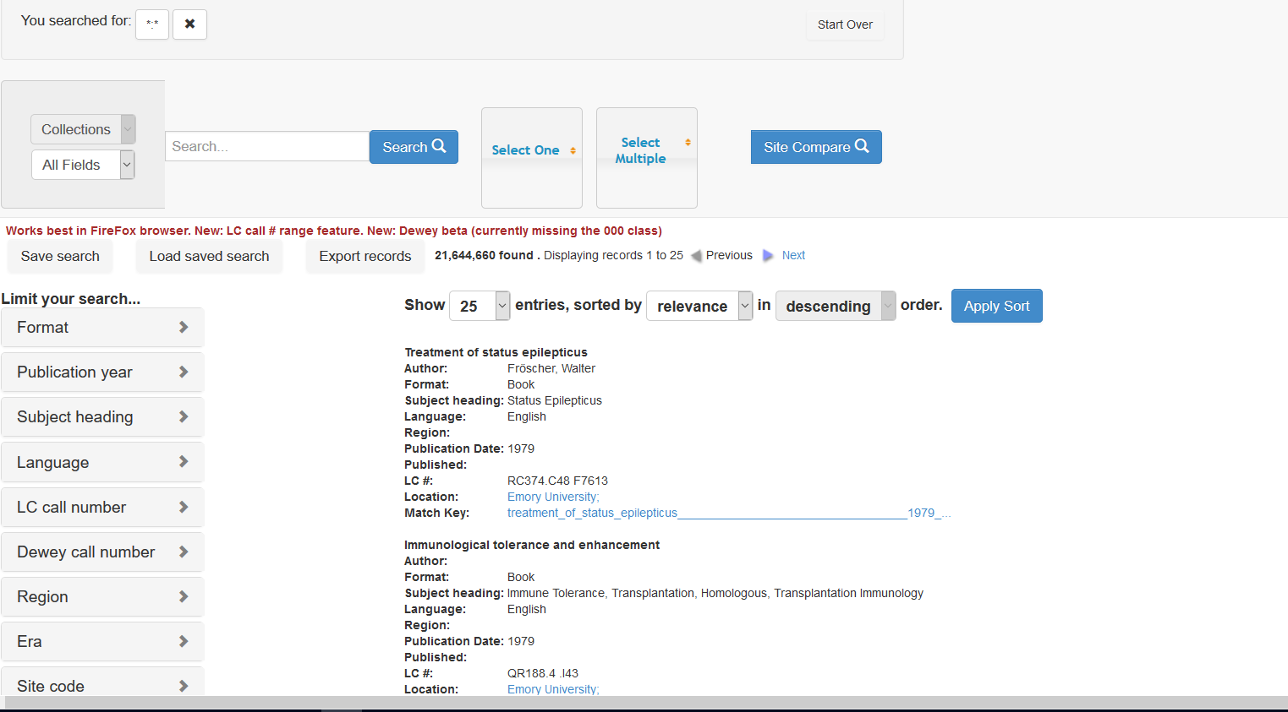
From there, you can limit by facet to refine search

Slide 33
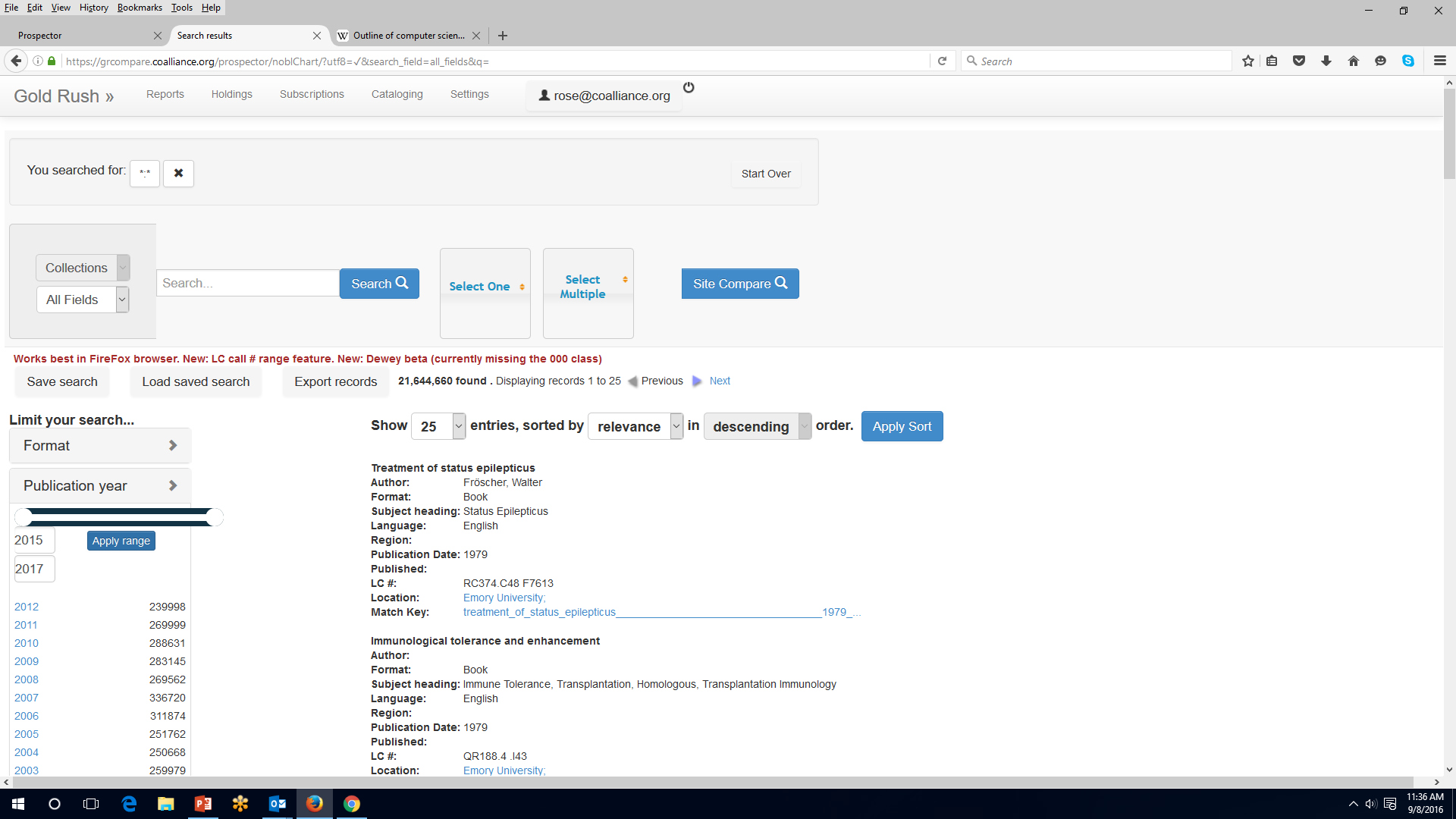
Limit by publication year

Slide 34
Limited Set: publication range 2015-2017

Slide 35
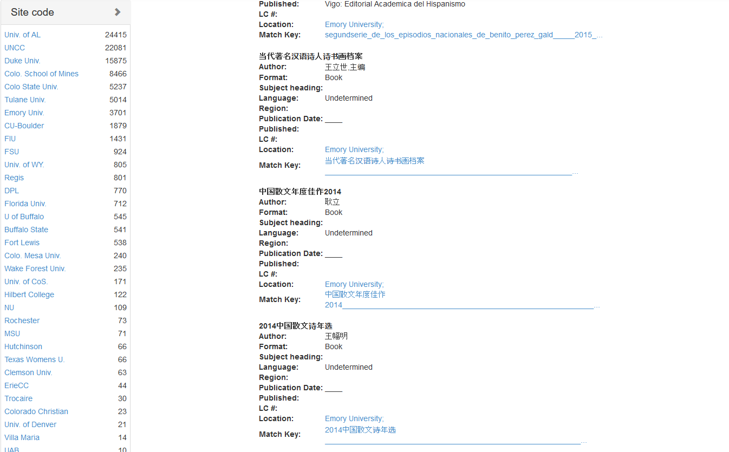
Smaller set of results

Slide 36
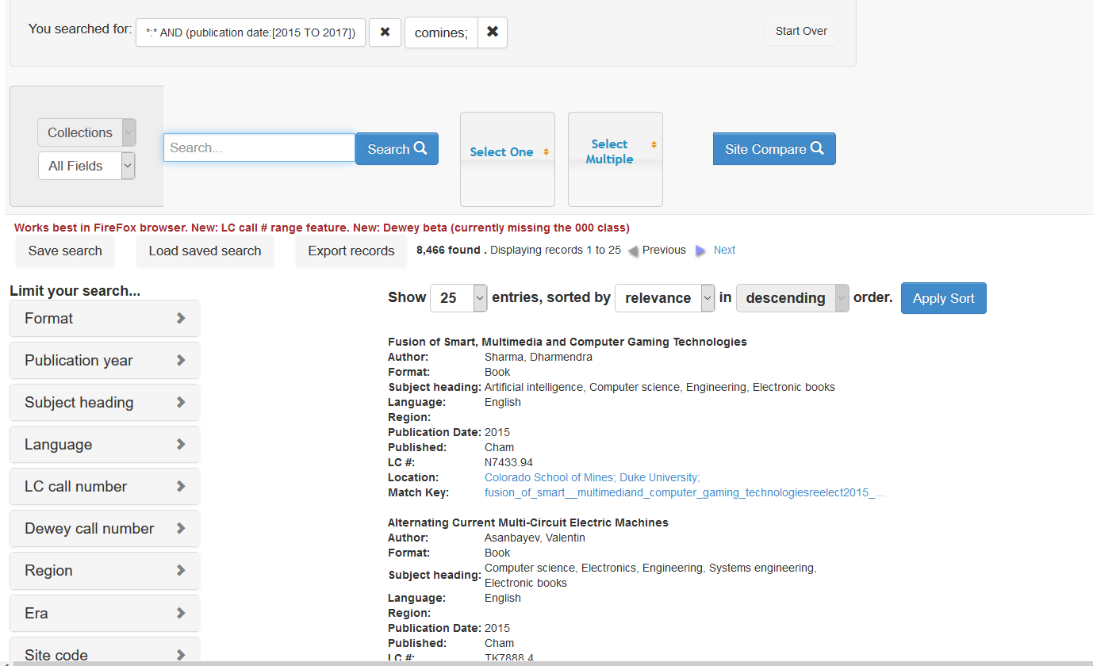
Randomly chose Colorado School of Mines

Slide 37
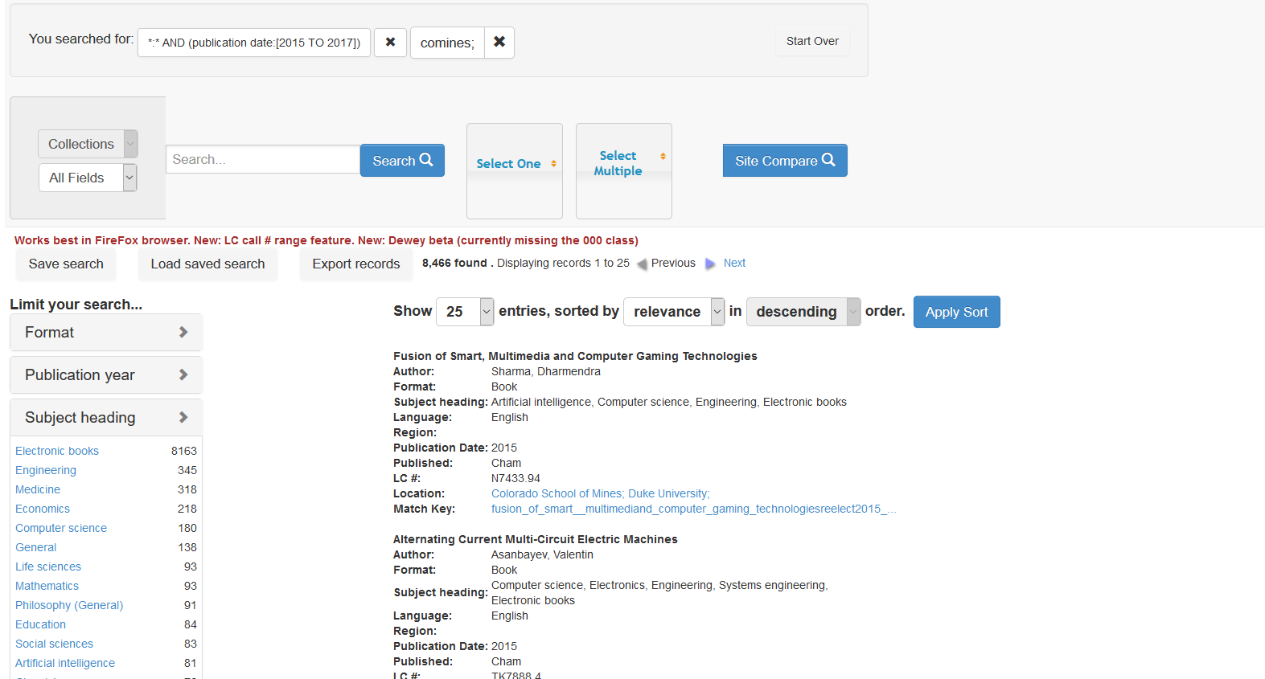
Refine by subject heading facet-ebooks

Slide 38
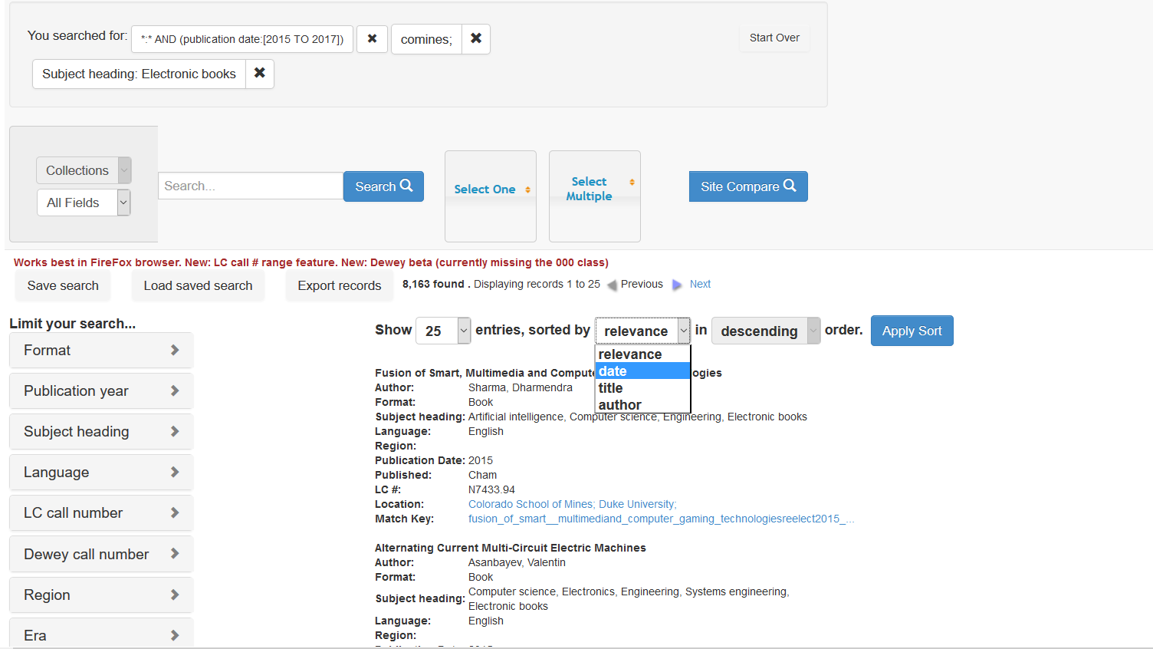
Sort refined list of ebooks by “date”

Slide 39
Future Enhancements
583 Facet and Search Box
Load item level data which includes branch information and circ data
Develop module to export tailored record set for Bibframe publishing to the web
What else would you like to see added?

