Slide 1
Scoring Student Research Projects
Kate Conerton, University of Wyoming Libraries

Slide 2
Developing the Question
Started with learning outcome from new general education program:
Find, analyze, evaluate, and document information appropriately as applicable to the discipline, interdisciplinary field, or professional setting as demonstrated by completing a substantial communication project that requires appropriate research skills.

Slide 3
Developing the Question
find, analyze, evaluate, and document
How does library instruction affect students’ demonstrated ability to evaluate, synthesize, and attribute information?
Notes:
Partly a feature of the assignments we were using - from a final assignment, can’t really figure out how students FIND their resources

Slide 4
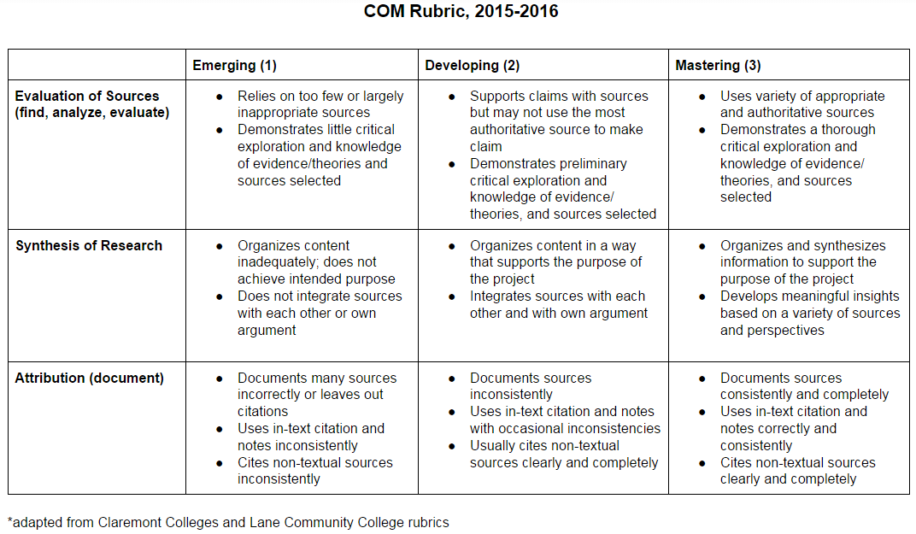

Slide 5
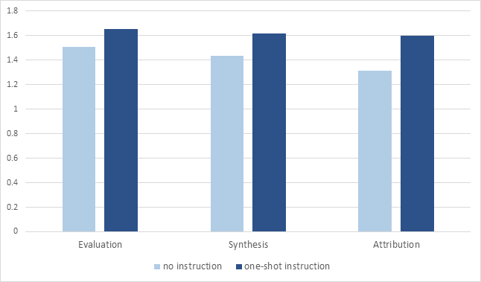
Communication 2 Findings
Notes:
2020

Slide 6
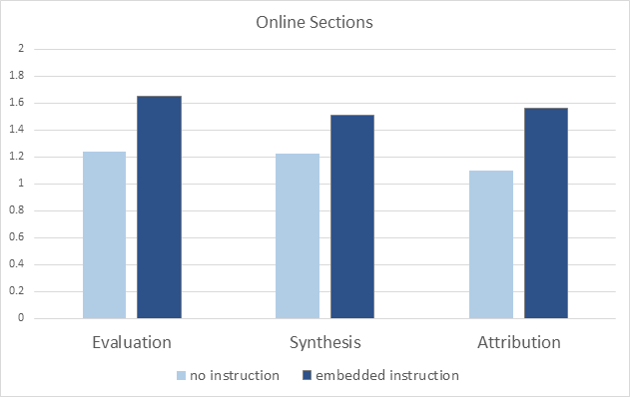
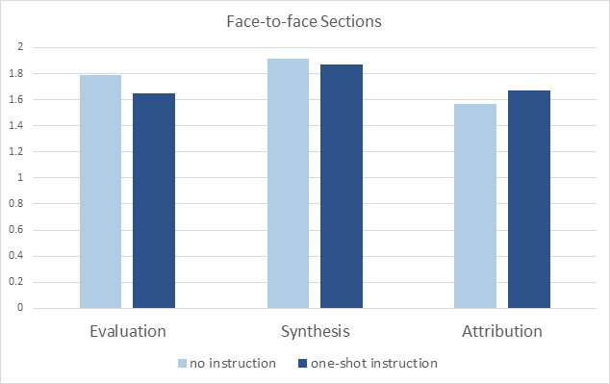
Communication 3 Findings
Notes:
So assignment design really drives student performance on these outcomes - students may or may not be able to pull off what they are asked to do but they absolutely won’t pull off what you don’t even ask them to do
ALSO, students in online classes may need additional support.

Slide 7
Unexpected Finding
In research proposals, students used resources in their background but not their proposed methods.
Notes:
Transfer problem?

Slide 8
What’s Next
Partnering with center for teaching & learning on research assignment development workshops
Rethinking instruction: what do students in these classes really need to know?
Notes:
Transfer problem?

