Slide 1
Use It or Lose It? The Power of Usage Data with Print Periodical Subscriptions
Alliance Library Assessments Workshop
November 18, 2016
Katy DiVittorio, Acquisitions Librarian
Katy.DiVittorio@ucdenver.edu
Kimberly DeRosa, Serials Specialist
Kimberly.DeRosa@ucdenver.edu
Melissa Higgins, Collections Analyst
Melissa.Higgins@ucdenver.edu
Serving the University of Colorado Denver, Metropolitan State University of Denver, and Community College of Denver.

Slide 2
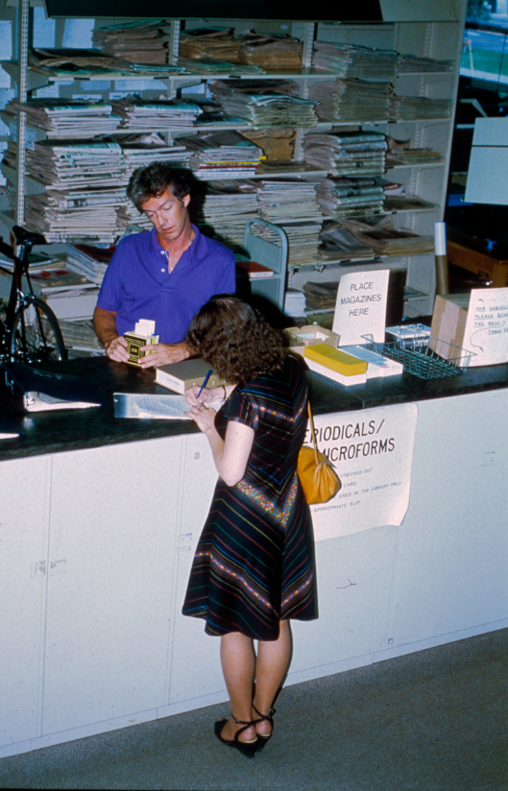
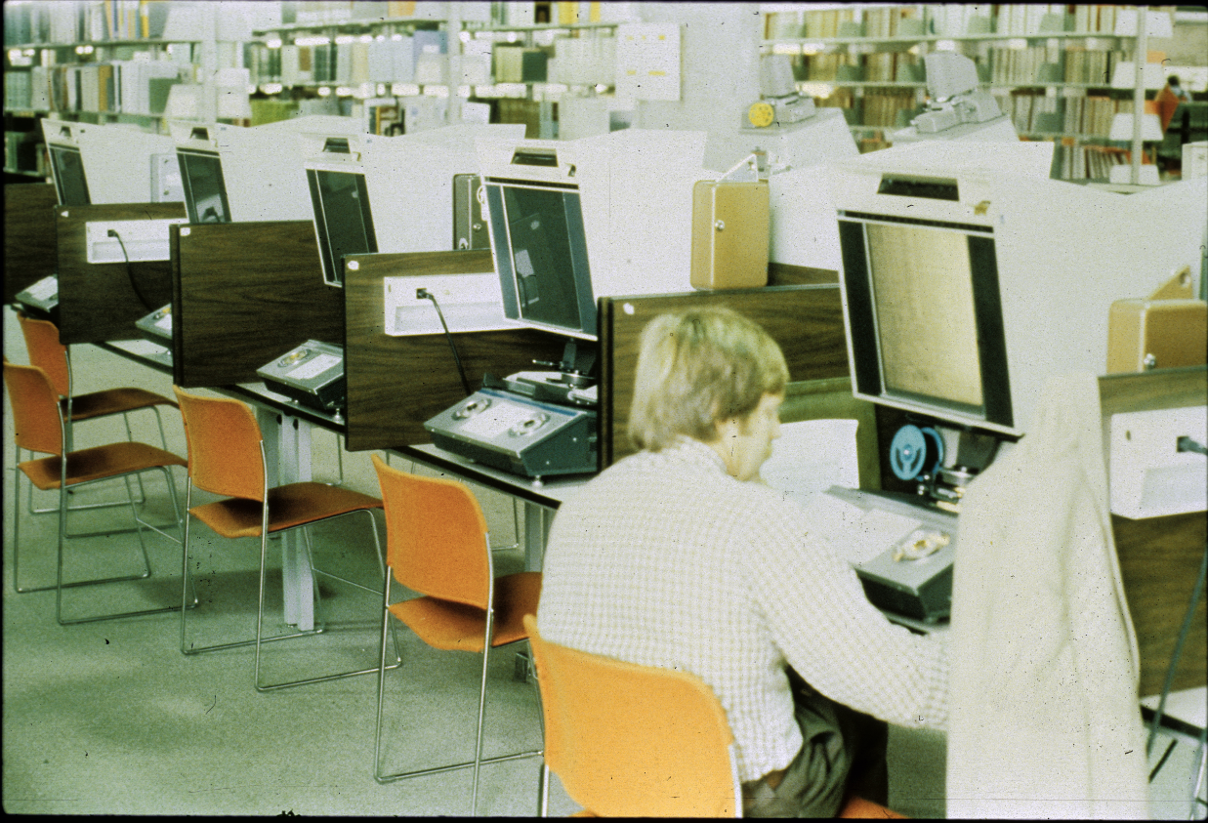
Auraria Library was built in 1976 to serve 15,000 students
180,000 square feet

Slide 3
Today serves 51,000 students with same amount of space. Renovations created need to decrease shelf space in favor of new collaborative spaces.

Slide 4
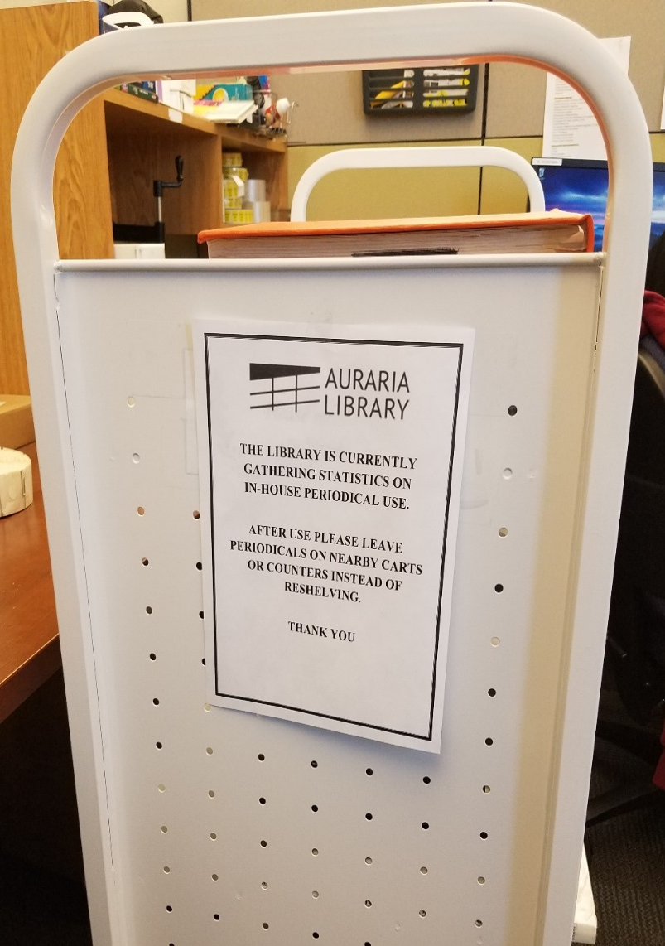
Actual Study
Goal: Identify print periodical titles that could be deselected, retained, or switched to online
Method: "Sweep Method"
Results of study were sent to Collection Development Librarians for evaluation

Slide 5
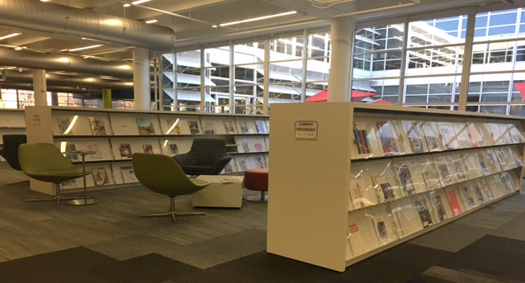
Because of the first print periodical study...
180 titles were cancelled
$13,000 dollars were saved from cancellations
Most popular title based on usage: Rolling Stone
11 switched format to online

Slide 6
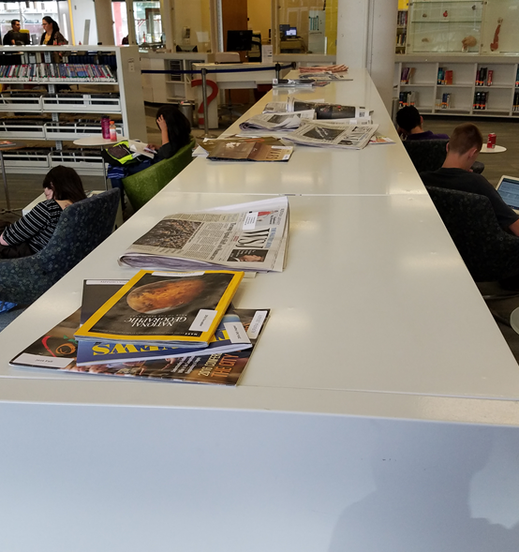
Limitations/Challenges
Patron re-shelving
Misplaced items do not equate to usage
Multiple uses
Amount of time taken to re-shelve
More visible periodicals may get more usage
Uncertainty of reasons for usage

Slide 7
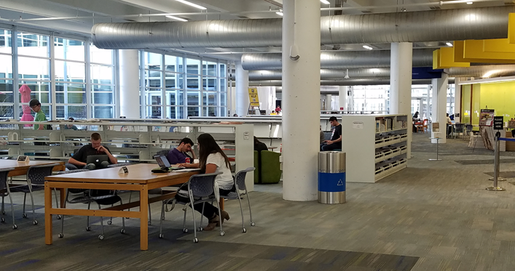
Next Steps
More focus to bound periodicals and adding online usage to the study
More in-depth analysis possible
Effect of new shelving on periodicals
Space vs. budget constraints

Slide 8
Thank You!

